Slide 1

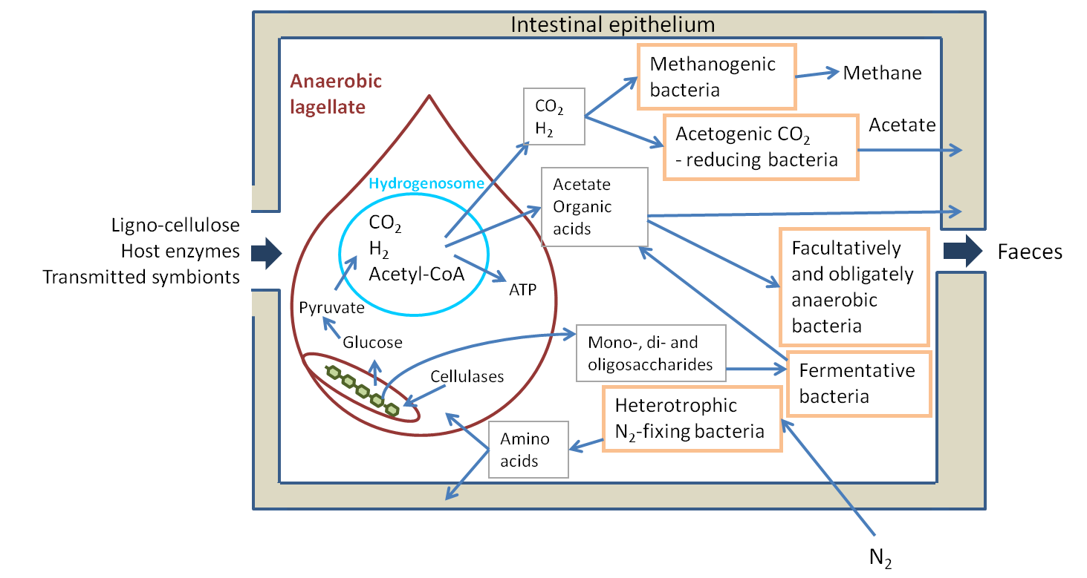
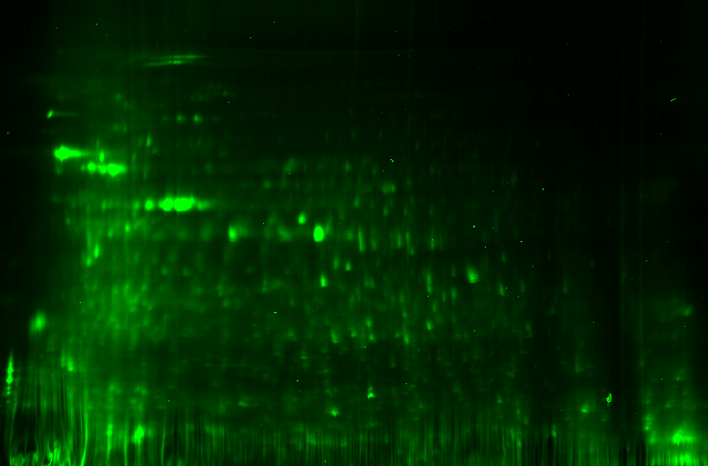
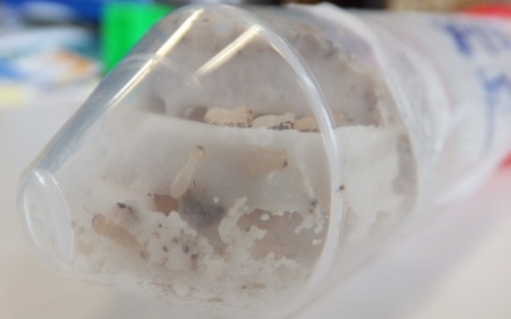
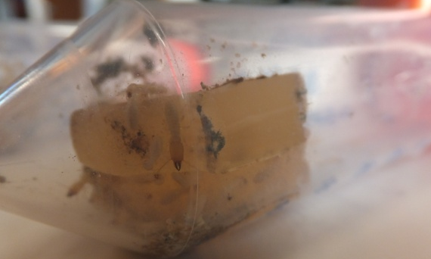
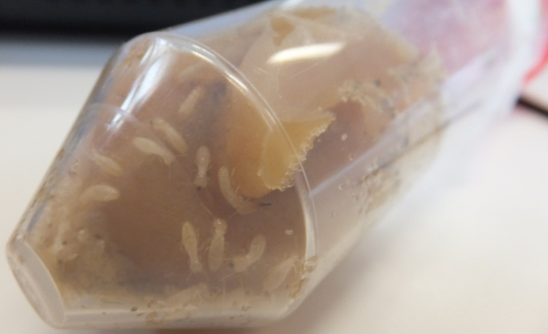
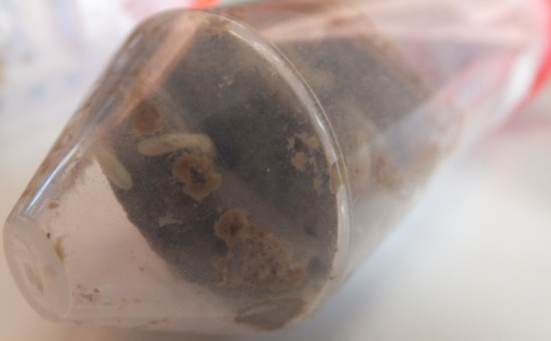
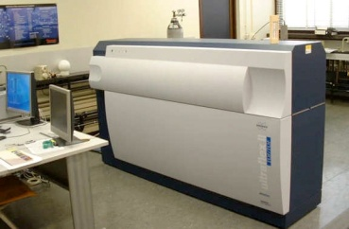

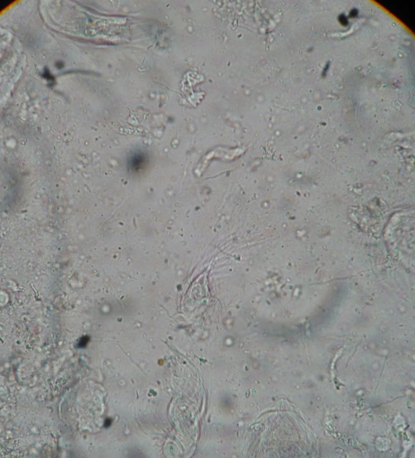
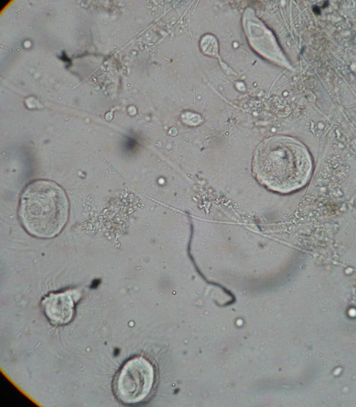
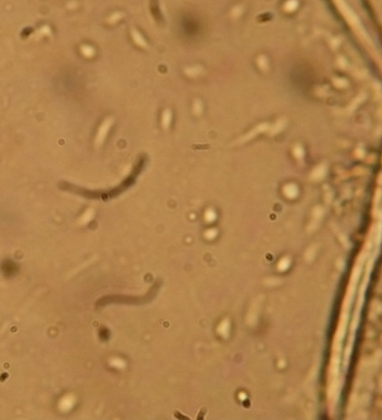
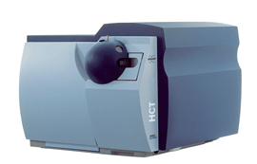
Changes in termites feeding diets for gut micro-organisms selection and further cultivation
Bauwens Julien¹, Tarayre Cédric², Mattéotti Christel³, Brasseur Catherine⁴, Destain Jacqueline², Vandenbol Micheline³, Portetelle Daniel³, Thonart Philippe², De Pauw Edwin⁴, Haubruge Eric¹ and Francis Frédéric¹.
1 : Functional and evolutionary entomology unit – University of Liege Gembloux Agro-Bio Tech
2: Bio-Industries unit – University of Liege Gembloux Agro-Bio Tech
3: Animal and microbial biology unit – University of Liege Gembloux Agro-Bio Tech
4: Mass spectrometry laboratory – University of Liege
julien.bauwens@ulg.ac.be
Introduction
Symbiotic interactions in termites are a possible source of efficient key enzymes for bioethanol production. Bacterial, fungal and protist species are involved in lower termites. From this highly diversified system, only few symbiotic species have been cultivated yet from termites gut. The aim of this work was to establish relatively progressive changes using termites as first bioreactor for further proteomic analyses and microbial cultivation.
Basic model of symbiotic interactions in lower termites
Enzymatic assays
Proteomic analysis
Termite gut proteome was investigated following two different approaches:
Artificial diets
Lower termites (Reticulitermes santonensis (Feytaud)) were reared on several agar-based diets including various carbon sources, such as carboxymethyl-cellulose, microcrystalline cellulose, xylan, cellobiose or glucose.
2D SDS-PAGE coupled with MALDI-TOF/MS: mostly prokaryotic identifications.
Cellulose
Glucose
Xylan
Cellulose + Lignin
Digestive tracts were dissected in order to extract proteins and to cultivate microorganisms.
Results
Microscopic observations
ESI-LC/MS-MS: mostly eukaryotic identifications in NCBI “all entries” database.
Wood
Cellulose
Glucose
Major changes:
Strong diminution or total loss of most large flagellates, especially Dinenympha sp., Trichonymphea sp. and Spirotrichonymphea sp..
Some flagellates seemed to be favored by specific diets.
Proteins assigned to protists from “control termites” mostly consisted in tubulins, but also included some glycosyl hydrolases family 7 sequences and actins. Proteins assigned to insects, other arthropods or other metazoans were almost exclusively actins.
Discussion
Termites gut may overcome important dietary perturbations, initial diversity acting as key point buffering effects on host, although termites possess their own enzymatic system. Some artificial diets permitted a simplification of the lower termites gut symbiotic system, which could be used as first step in symbionts isolation and cultivation. Preliminary assay of cultivation actually gave encouraging results. Proteomic proved to be suitable tool to investigate such a complex system. Nevertheless, for some symbionts very few genes are sequenced, which should lead to more targeted proteomic studies. Protein chromatography will allow to split up the proteome and more accurate analysis.

