Slide 1
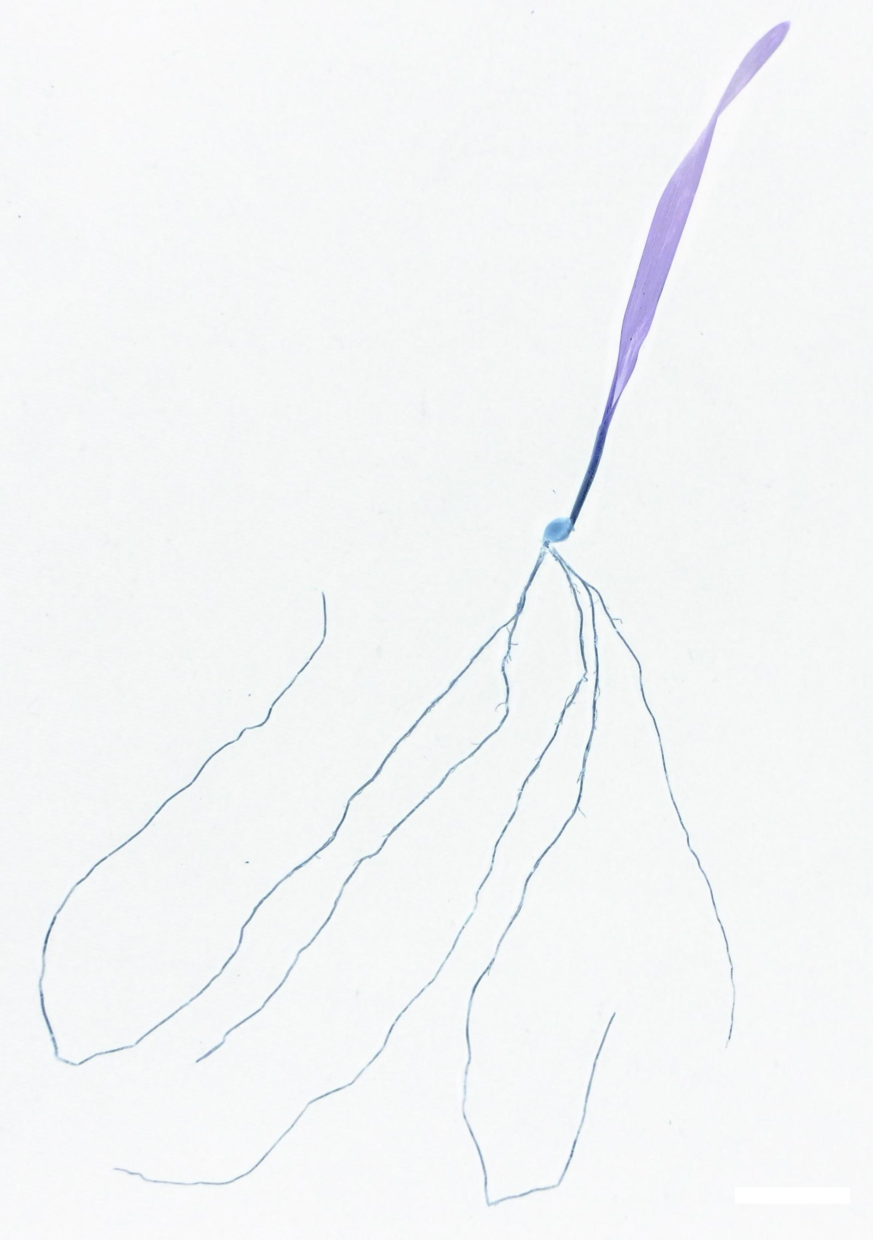



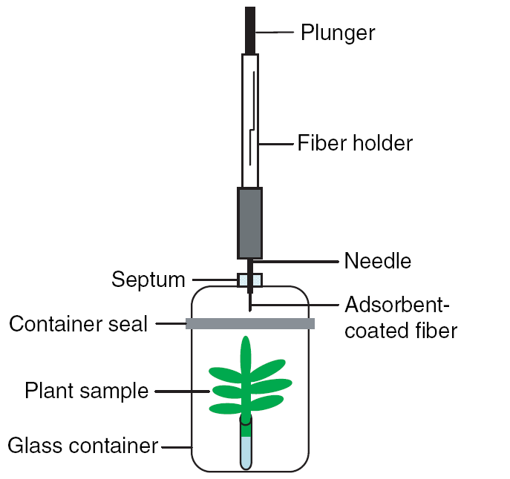
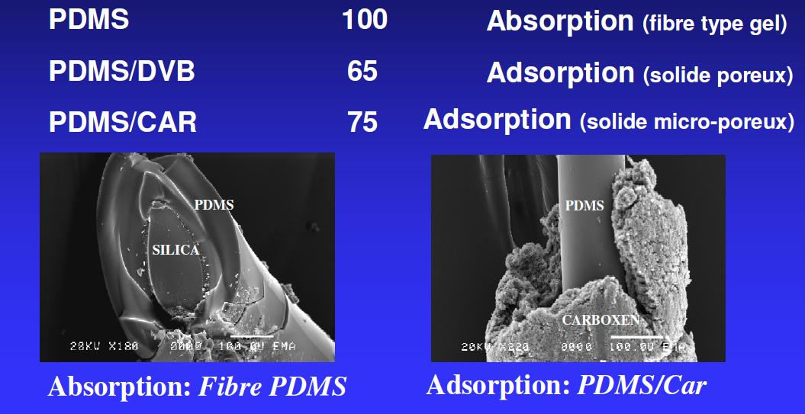
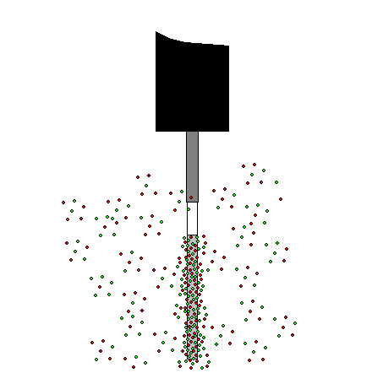
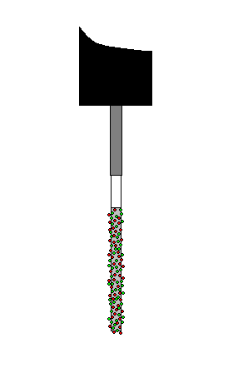
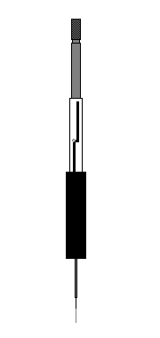
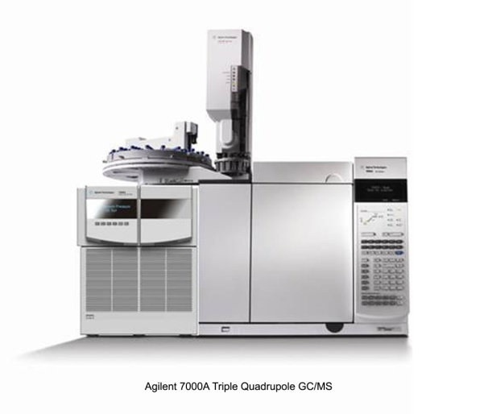
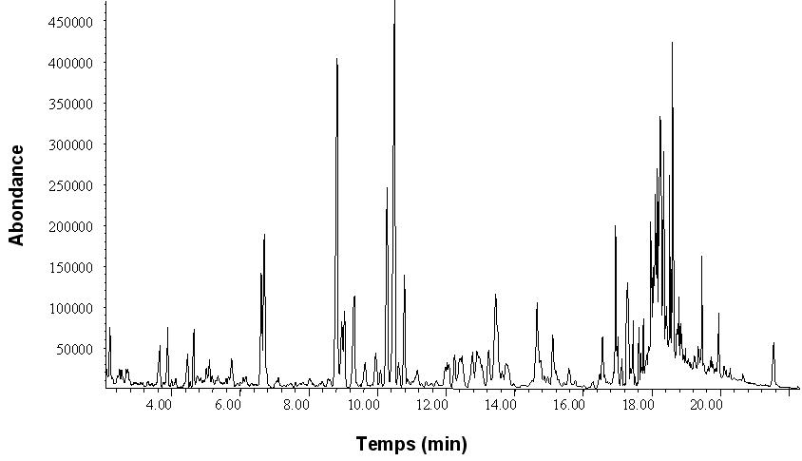
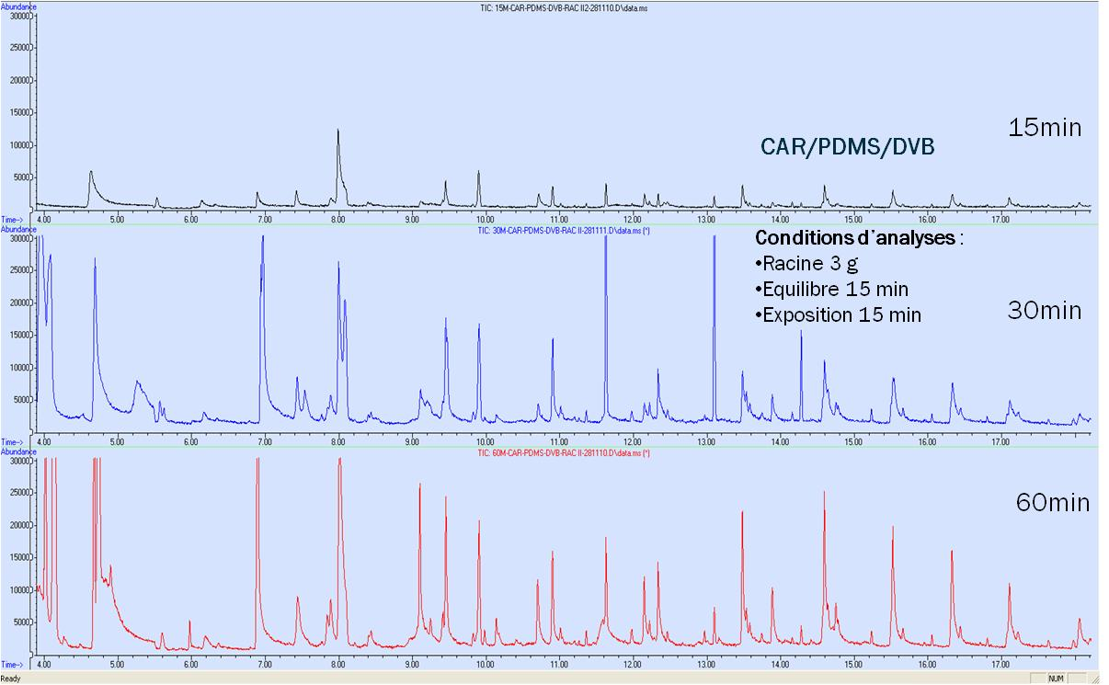
Development of a headspace solid-phase microextraction method coupled to gas chromatography (HS-SPME GC-MS) to capture and analyze the volatile organic compounds emitted by barley roots (Hordeum vulgare cv. Quench)
Morgan Laloux *^{(a)}, Djamel Edine Kati ^{(a)}, Marie-Laure Fauconnier^{(b)} , Georges Lognay ^{(c)}, Jean-Paul Wathelet ^{(a)}
^{((a)} General and Organic Chemistry Unit, ^{(b)}Plant Biology Unit, ^{(c)}Analytical Chemistry Unit, Gembloux Agro-Bio Tech, University of Liège, Passage des déportés, 2, B – 5030 Gembloux, Belgium.
* mlaloux@ulg.ac.be
Parts of plants above and below ground emit volatile organic compounds (VOCs) that have beneficial (growth promotion, attraction) or detrimental effects (toxicity, repellence) on other organisms. This multidisciplinary project studies the role of the VOCs emitted by the roots of barley (Hordeum vulgare cv. Quench) in multitrophic interactions with other organisms (plants, insects, fungi, bacteria, and virus) of the rhizosphere.
One of the first aims of this project was therefore to be able to capture and analyze the emitted VOCs. A headspace solid-phase microextraction method, coupled to gas chromatography-mass spectrometry (HS-SPME GC-MS) was developed. This analytical method allowed to identify and quantify about 30 compounds (2-pentylfuran, octan-1-ol, (E)-non-2-enal, for example).
Principle of HS-SPME
Materials and methods
Step 1: Equilibration and exposure of the fiber in the headspace
HS-SPME
Three grams of root were placed in a 20 ml vial which is sealed by a seal composed of silicone / PTFE.
1. Fiber choice: Polydimethylsiloxane (PDMS), polyacrylate (PA), Carboxen / polydimethylsiloxane (CAR / PDMS), Carboxen / polydimethylsiloxane / divinylbenzene (CAR / PDMS / DVB).
2. Equilibration and Exposure temperatures: 23 to 30 ° C.
3. Equilibration time: 5, 10, 15 and 20 min.
4. Exposure time: 15, 30 and 60 min.
Different affinities depending on the fiber coating
Step 2: retention of VOCs on the active sites of the fiber
GC-MS
Absorption and/or adsorption of the analytes on the polymer(s) constituent(s) of the fiber coating
Injections are performed manually, in splitless mode. The chromatograph is an Agilent Technologies 7890 A coupled to a mass spectrometer Agilent Technologies 5975C inert XL EI / CI MSD. The temperature program is as follows: initial temperature of 35 °C was maintained for 2 min, then increases at a rate of 5 °C / min. to 155 °C. It then reaches the final temperature of 250 °C at 20 °C / min., Which is kept constant for 10 min.
5. Selection of column: polar (VF-WAXms (CP9205) 30 m x 0,25 mm, 0,25 µm) or apolar (HP5ms (19091-433) 30 m x 0,25 mm, 0,25 mm).
6. Injector temperature: 230, 250 and 270 ° C.
Step 3: thermal desorption of VOCs and GC-MS analysis
Identification:
MS
Kovats
Standards
Thermal desorption
(+/- 250 °C)
Separation
by GC
Results
1. Fiber choice
Fibers with mixed coating improve significantly in both qualitative and quantitative way the capture of COVs.
3. Equilibration time
Relative stabilization after 15 minutes equilibration.
Different behavior depending on the nature of the analyte.
4. Exposure time
Intensity of peaks significantly increase after 30 min. of exposure.
No qualitative differences between 30 and 60 minutes.
5. Selection of column
Improved resolution and separation on polar column.
6. Injector temperature
Injection temperature does not induce significant differences in the desorption of VOCs.
Abundance
Effects of injector temperature on the desorption of the SPME fiber after exposure to root samples, for three target molecules
Time (min)
Comparison of VOCs profiles obtained from four types of fibers. From top to bottom: PA; PDMS; CAR/PDMS; CAR/PDMS/DVB.
Abundance
Temps (min)
HS-SPME GC-MS method development
2. Equilibration and Exposure temperatures
Superposition of the chromatograms obtained using a nonpolar column HP5ms (above) and with a polar column of type VF-WAXms (below).
Increase in the signal of some VOCs and additional detection of VOCs at 30 ° C.
■ 2-pentylfuran
■ 6-methylhept-5-en-2-one
■ Hexan-1-ol
B
A
Effects of equilibration and exposure temperature on the capture of VOCs.
Effects of exposure time of the SPME fiber on the capture of VOCs.
A: comparison of chromatograms corresponding to three experimented extraction times.
B: Comparison of peak areas of targets VOCs.
Evolution of peak areas with equilibration times.
Finally, the following standardized parameters have been selected:
CAR/PDMS/DVB fiber; 15 min. of equilibration; 30 min. exposition; equilibration and exposition temperature at 30 °C; 3 g of roots; injector temperature at 250 °C; polar column Wax factor four (Agilent technologies USA; 30 m x 0.250 mm I.D, 0.25 µm film thickness). The total run time is about 92 min per sample.

