Slide 1
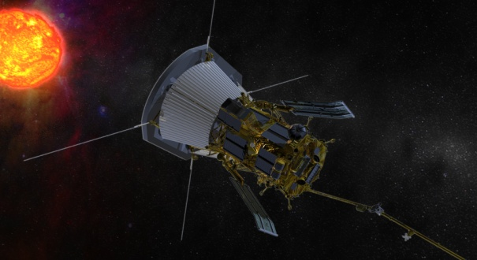
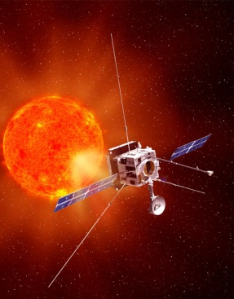
Observations of the White Light Corona from Solar Orbiter and Solar Probe Plus
RA Howard¹, AF Thernisien², A Vourlidas¹, SP Plunkett¹, CM Korendyke¹, NR Sheeley¹, JS Morrill¹, DG Socker¹, MG Linton¹, PC Liewer³, EM DeJong³, M Velli³, Z Mikic⁴, V Bothmer⁵, P Lamy⁶, P Rochus⁷
1. Naval Research Laboratory, Washington, DC, 2. George Mason University, Fairfax, VA, 3. Jet Propulsion Laboratory, Pasadena, CA, 4. Predictive Sciences Incorporated, San Diego, CA, 5. University of Gottingen, Gottingen, GERMANY, 6. Laboratoire d’Astrophysique Marseille, Marseille, France, 7. Centre Spatiale de Liege, Liege, BELGIUM

Slide 2
Outline
Solar Orbiter/SoloHI and Solar Probe Plus/WISPR
Mie Scattering Modeling of F-Corona
View from WISPR
View from Solar Orbiter
Summary

Slide 3
MOTIVATION
The Solar Orbiter and Solar Probe Plus Missions will sample regions of the inner heliosphere that have never been sampled before.
An auxiliary measurement that will be made is that of the near-Sun dust environment – i.e. the F-corona.
As dust particles get close to the Sun they will evaporate and then not contribute to the scattering. The radial distance of this evaporation depends on the chemical composition of the material.
A dust free zone at about 4-5 Rsun has been postulated (Russell, 1929), but has never been observed.
QUESTIONS:
What will the background F-Corona look like from these vantage points?
Can the dust-free zone be seen in the observations?
What inferences might we be able to make about the near-sun dust environment.

Slide 4
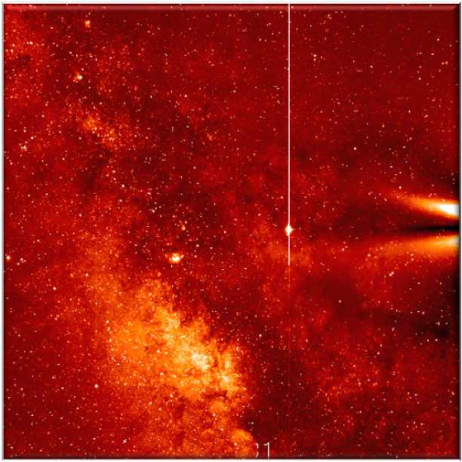
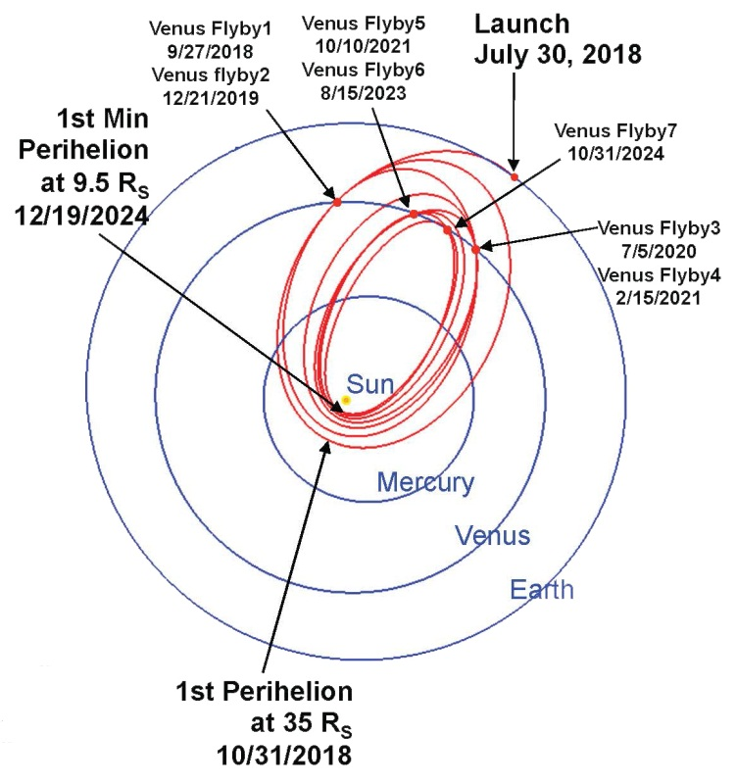
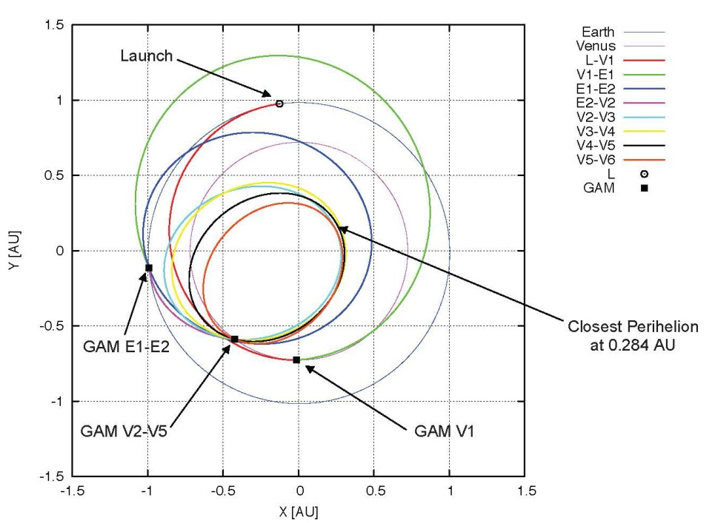
SoloHI and WISPR
Solar Orbiter/SoloHI and Solar Probe Plus/ WISPR are white light imagers evolved from the STEREO/SECCHI heliospheric imagers.
SoloHI – FOV: 40°, Inner limit: 5° from Sun Center
WISPR – 2 Tels, with radial coverage 13° to 108°
FOV: 40°, Inner limit: 13° from Sun Center
FOV: 58°, Inner limit: 50° from Sun Center
SOLAR PROBE PLUS
SOLAR ORBITER

Slide 5
Outline
Solar Orbiter/SoloHI and Solar Probe Plus/WISPR
Mie Scattering Modeling of F-Corona
View from WISPR
View from Solar Orbiter
Summary

Slide 6
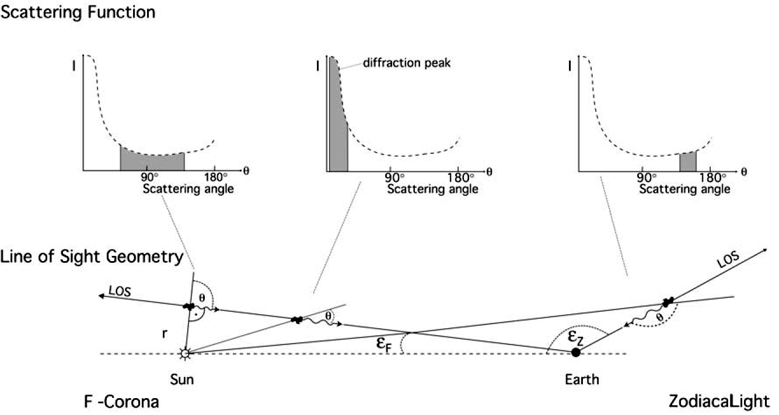
Dust Scattering Geometry
(Mann et al, 2004)

Slide 7
Dust Scattering Equations
Scattering Cross Section
Simplified Scattering Phase Function
Volume Scattering Function
F-corona/Zodiacal Light Intensity

Slide 8
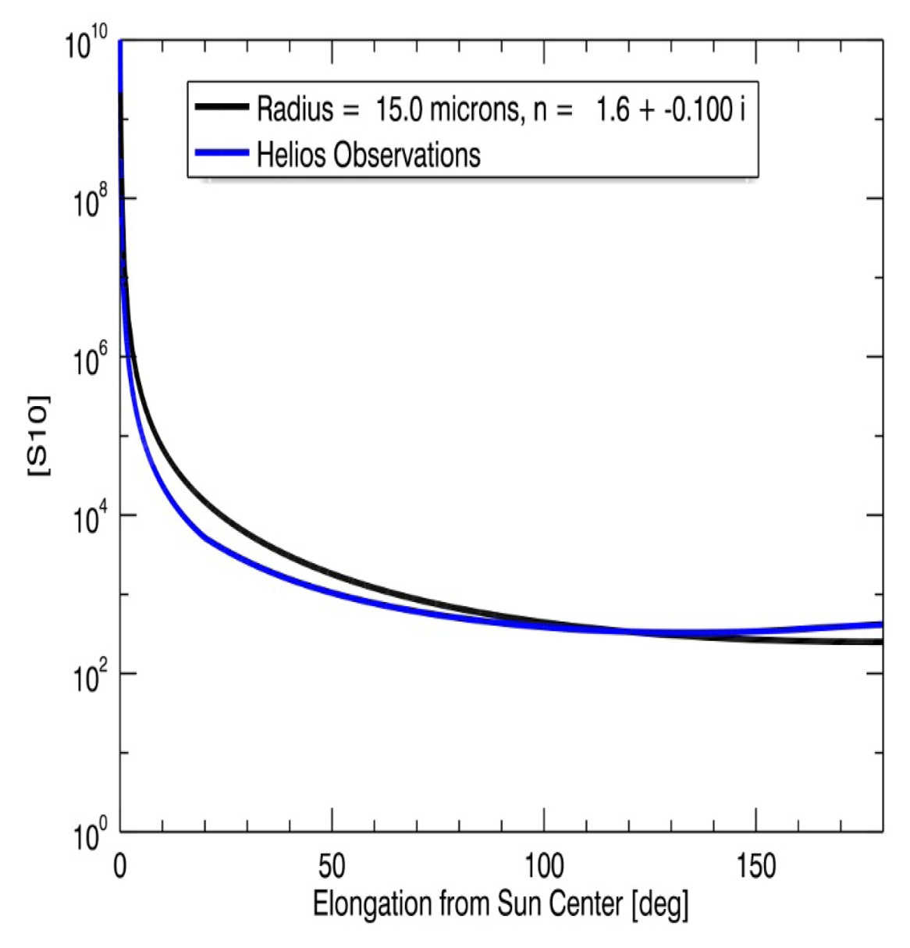
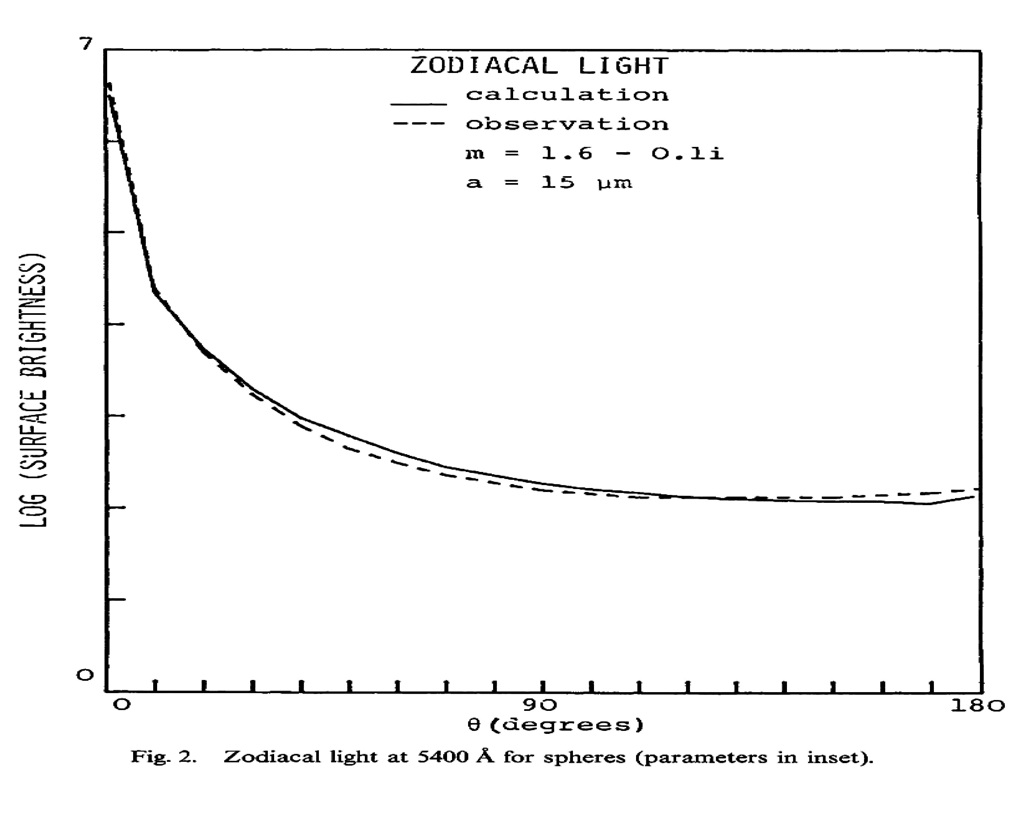
Comparison with Helios Observations
We have added a Mie scattering capability into our forward modeling program for Thomson scattering , and compared it to the Helios observations and the calculations of Hoyle & Wickramasinghe (1984)
Our Results
Hoyle and Wickramasinghe (1984)

Slide 9
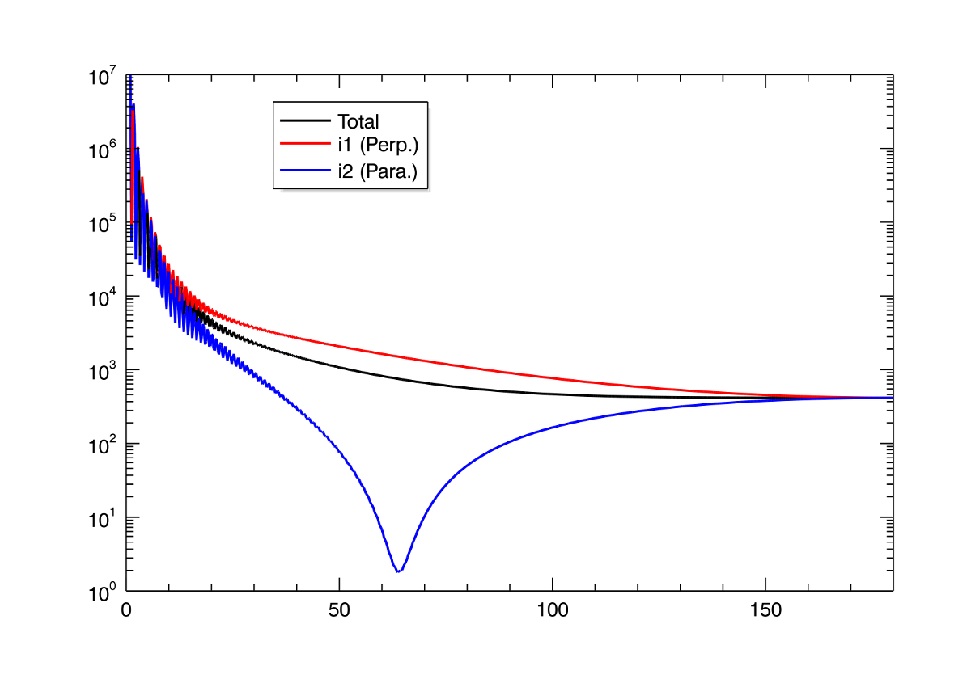
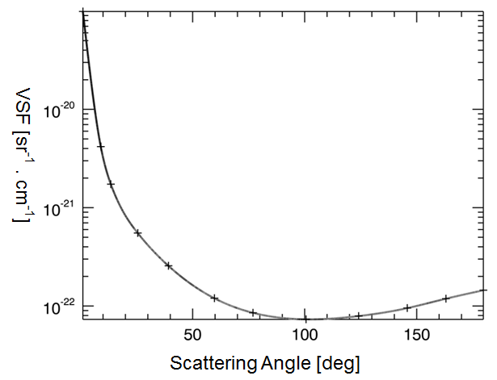
Mie Scattering Phase Function and Volume Scattering Function
Scattering Angle [deg]
Mie phase functions for a spherical particle of a = 15 μm radius, and index m = 1.6 – 0.1i, at 540 nm wavelength, (as used in Hoyle & Wickramasinghe.)
Volume Scattering Function (VSF) of Lamy & Perrin (1986). The VSF incorporates distributions of particle size and indices of refraction.
We use this VSF in the subsequent calculations.

Slide 10
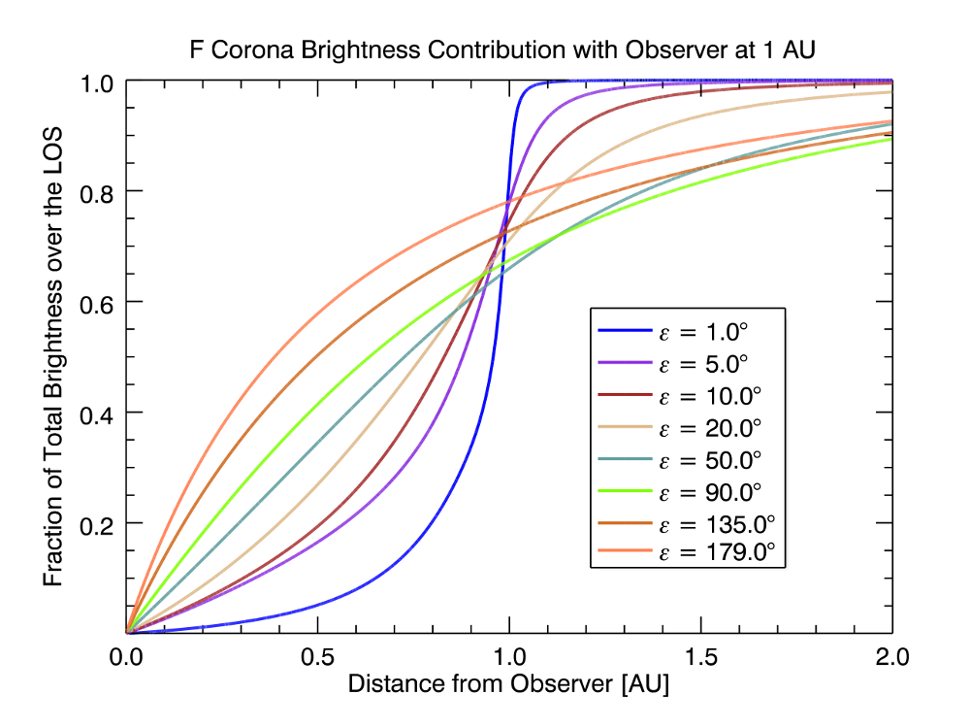
LOS Brightness Contribution with Observer at 1 AU
Note the large range of heliocentric distances contributing to the F-coronal signal. At least half is arising 0.1-0.2 AU from the Sun.

Slide 11
Outline
Solar Orbiter/SoloHI and Solar Probe Plus/WISPR
Mie Scattering Modeling of F-Corona
View from WISPR (Perihelion at 9.5 R_{sun})
View from Solar Orbiter (Perihelion at 0.28 AU)
Summary

Slide 12
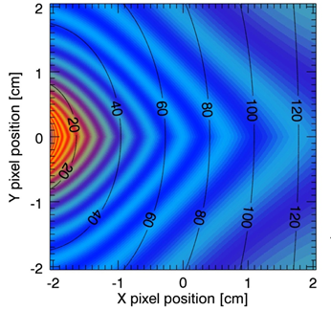
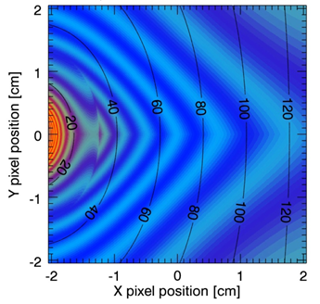
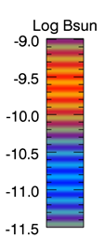
K+F Corona From WISPR at 9.5 R_{s}
No Dust Free Zone
Dust Free Zone Below 5R_{s}
The black sold lines show the elongation from 14°-104°
The F-corona is simulated using Mie scattering with a particle size of 15µm radius, and an index of refraction n=1.6-0.1i (Hoyle & Wickramasinghe, 1984)
The particle density varies as r⁻¹exp(-2.6|sinβ_{π}|^{1.3}) with β_{π} the angle between a point of the corona and the plane of symmetry taken to be the ecliptic plane (Leinert, 1976)

Slide 13
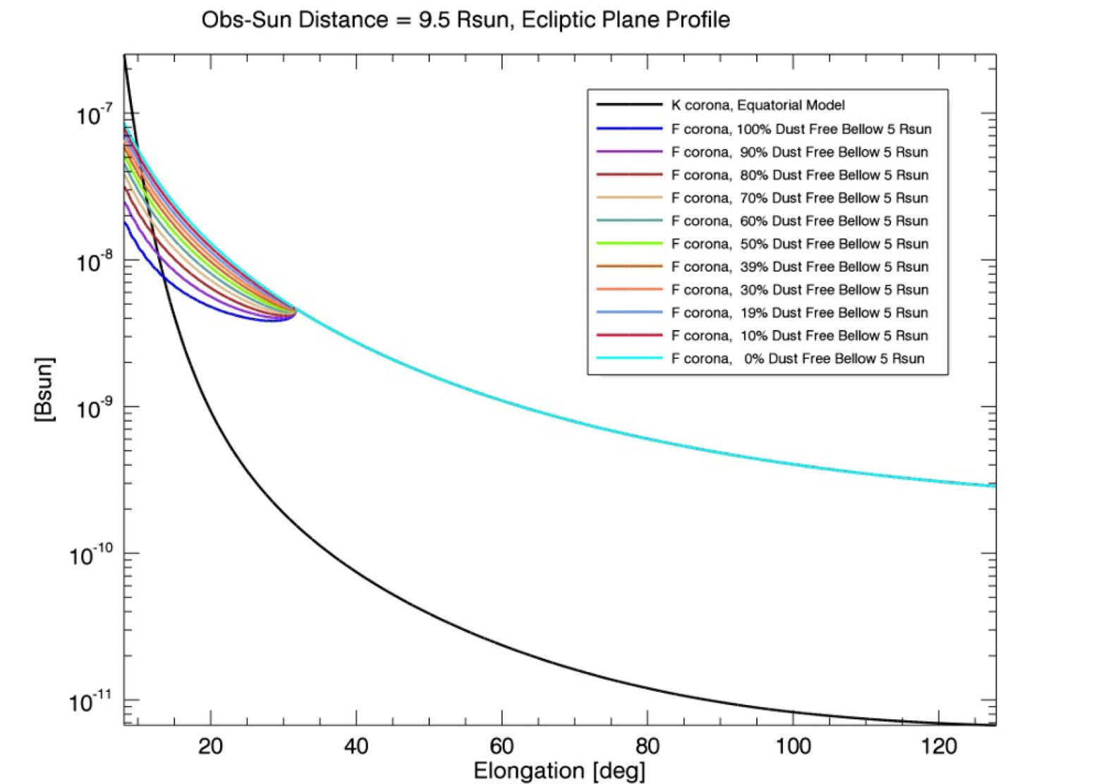
F-Coronal Profiles With Various Dust Density Decreases
“nominal” F-corona
K-corona
Dust density is decreased from the “nominal” 1/r density model, in increments of 10% to a full 100% decrease.
The profiles are taken in the ecliptic plane.
The elongation range corresponds to the WISPR field of view (14-104°).

Slide 14
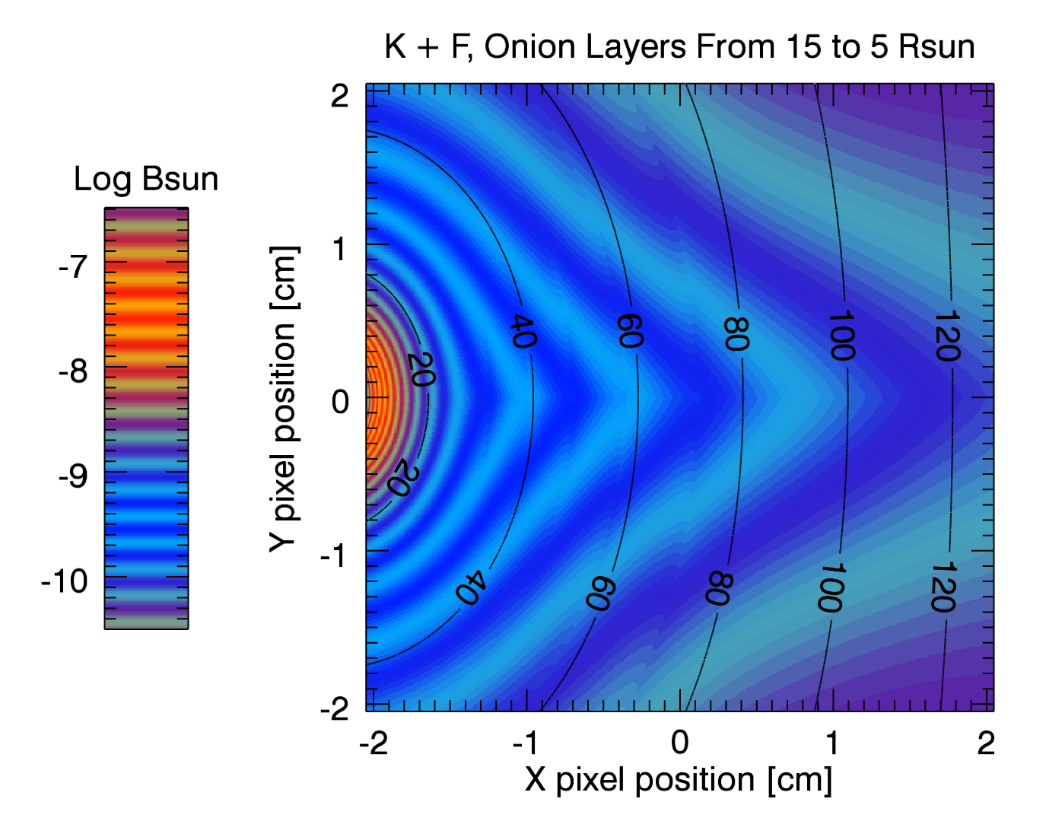
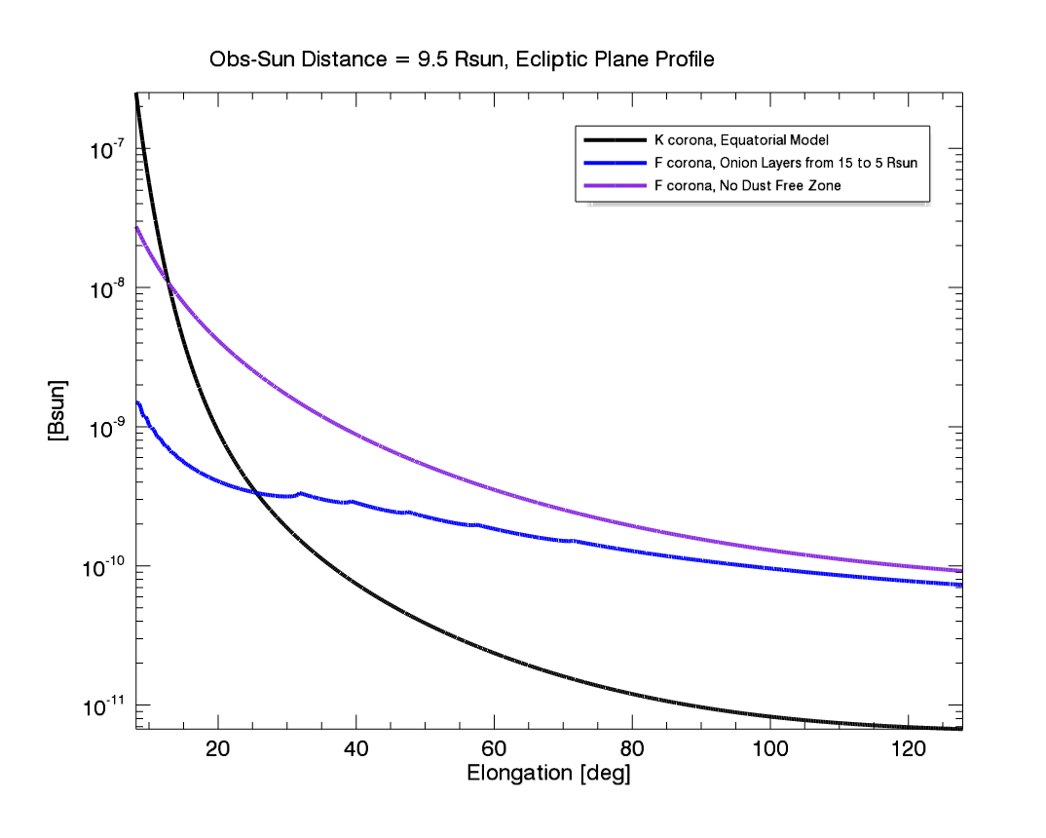
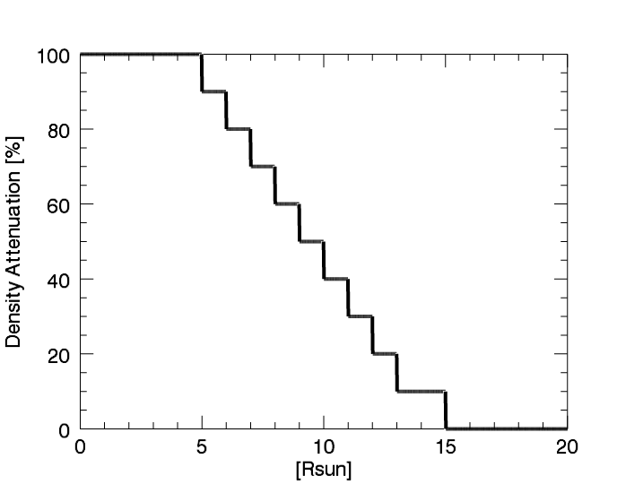
Onion Layers Dust Free Zone, WISPR FOV, from 9.5 R_{sun}
Top left: WISPR image of the K+F coronae, viewed from 9.5 R_{sun}
Bottom left: dust density attenuation function that simulates different dust species evaporating and not scattering.
Top right: K and F coronae profiles. Since the spacecraft is at a height of 9.5 R_{sun}, it is within the onion layers and we only see the steps below 9.5 R_{sun}. Moreover, since there is a lower density of particles near the spacecraft, the brightness is slightly below the no dust free zone F corona at elongations above 70°.

Slide 15
Outline
Solar Orbiter/SoloHI and Solar Probe Plus/WISPR
Mie Scattering Modeling of F-Corona
View from WISPR (Perihelion at 9.5 R_{sun})
View from Solar Orbiter (Perihelion at 0.28 AU)
Summary

Slide 16
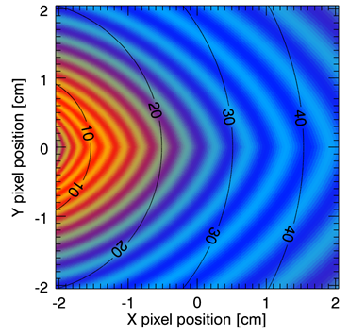
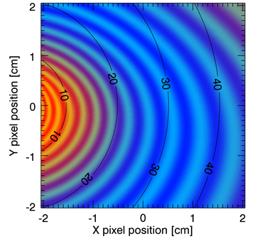
Onion Layers Dust Free Model, SoloHI FOV, from 0.28 AU
In the Ecliptic Plane
35⁰ Above the Ecliptic Plane
K+F Corona
The “onion layers dust free model”

Slide 17
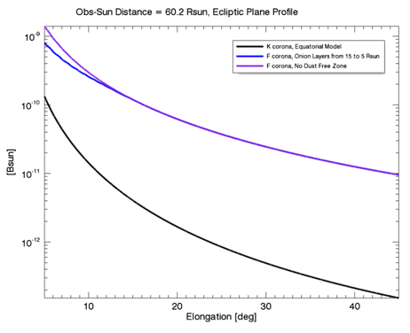
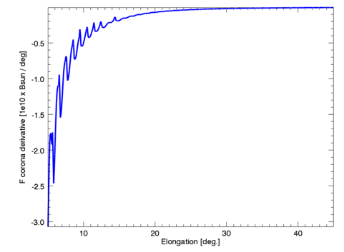
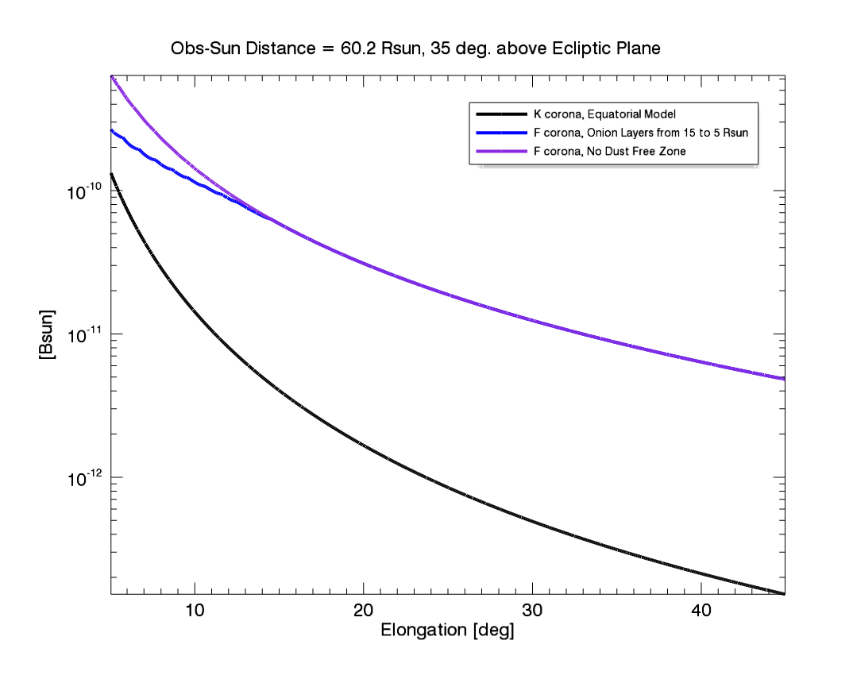
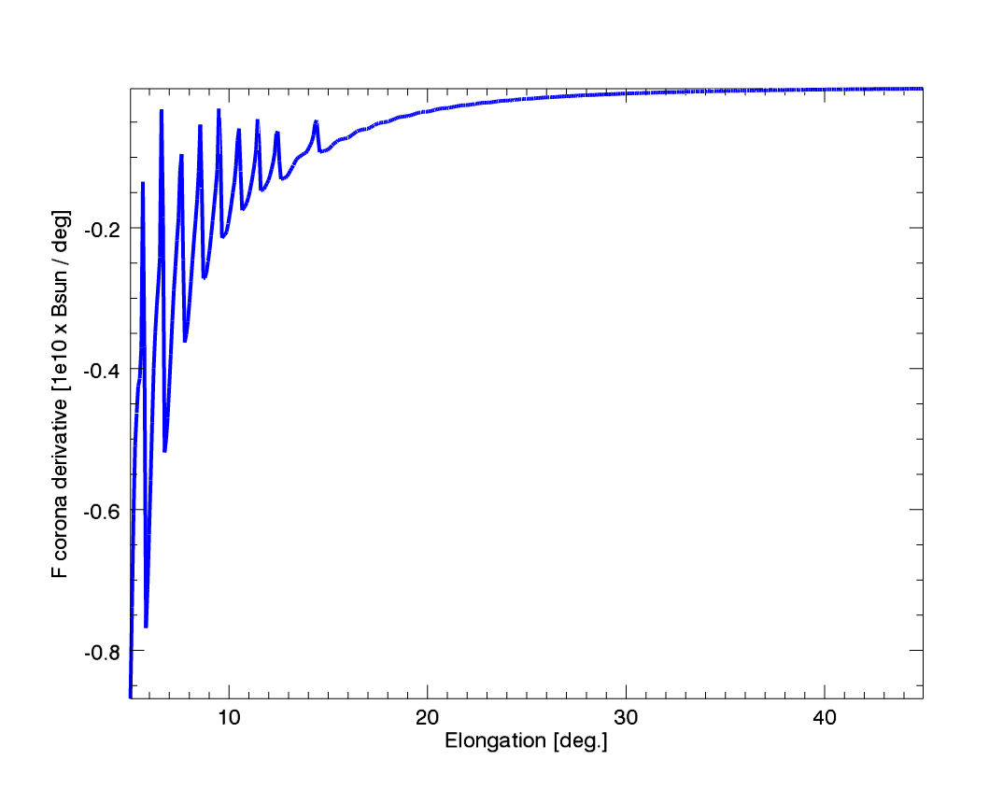
Onion Layers Dust Free Model, SoloHI FOV, from 0.28 AU
K and F coronal profiles
Spacecraft Location
Derivative of the Total Brightness Curve
In the Ecliptic Plane
35⁰ Above the
Ecliptic Plane

Slide 18
Summary
We have successfully added Mie scattering and the Volume Scattering Function to our forward modeling program to study the accumulation along the line of sight.
The region where the dust starts to vaporize will be observable from both Solar Orbiter and SPP, and the dust-free zone will be observable from SPP.
We expect to detect inflections/discontinuities in the slope of the F-Corona
as individual species of dust vaporize and no longer scatter or as reflections from dust grain facets overtake small angle scattering.
Modeling efforts will greatly enhance the interpretation of the types and sizes of dust grains in the near-sun environment.
Both SO & SP+ are very exciting missions for understanding the dust – electron corona interactions in the inner heliosphere.
This work was performed under the NASA Solar Orbiter and Solar Probe Plus Programs.

Slide 19
BACKUP

Slide 20
Abstract
The SoloHI instrument on Solar Orbiter and the WISPR instrument on Solar Probe+ will make white light coronagraphic images of the corona as the two spacecraft orbit the Sun. The minimum perihelia for Solar Orbiter is about 60 Rsun and for SP+ is 9.5 Rsun. The wide field of view of the WISPR instrument (about 105 degrees radially) corresponds to viewing the corona from 2.2 Rsun to 20 Rsun. Thus the entire Thomson hemisphere is contained within the telescope’s field and we need to think of the instrument as being a traditional remote sensing instrument and then transitioning to a local in-situ instrument. The local behavior derives from the fact that the maximum Thomson scattering will favor the electron plasma close to the spacecraft exactly what the in-situ instruments will be sampling. SoloHI and WISPR will also observe scattered light from dust in the inner heliosphere, which will be an entirely new spatial regime for dust observations from a coronagraph, which we assume to arise from dust in the general neighborhood of about half way between the observer and the Sun. As the dust grains approach the Sun, they evaporate and do not contribute to the scattering. A dust free zone has been postulated to exist somewhere inside of 5 Rsun where all dust is evaporated, but this has never been observed. The radial position where the evaporation occurs will depend on the precise molecular composition of the individual grains. The orbital plane of Solar Orbiter will gradually increase up to about 35 degrees, enabling a very different view through the zodiacal dust cloud to test the models generated from in-ecliptic observations. In this paper we will explore some of the issues associated with the observation of the dust and will present a simple model to explore the sensitivity of the instrument to observe such evaporations.

Slide 21
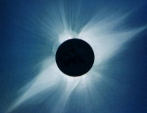
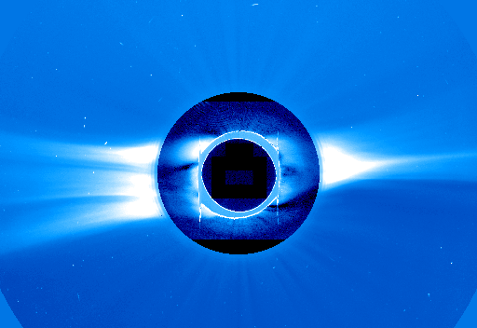
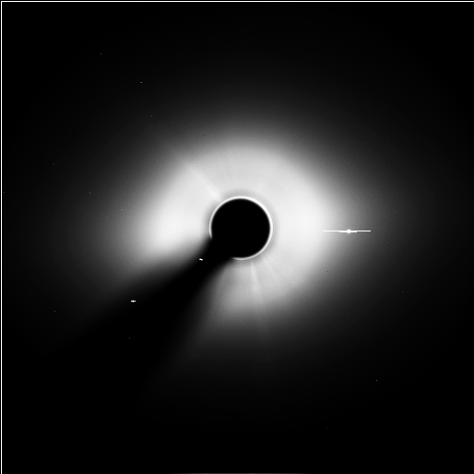
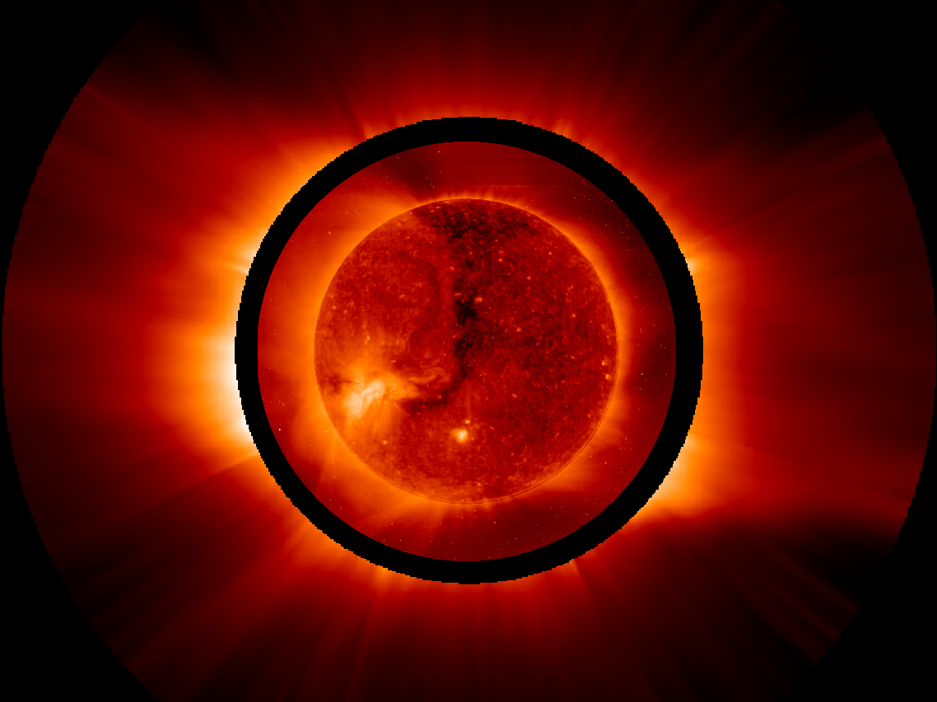
There are several “coronas” originating from different emission processes
K- corona: A reflection (Thomson scattering) of the photospheric light by coronal electrons
F-corona: A reflection of the photospheric light by dust particles.
E-corona: True coronal emission in spectral lines (EUV, UV, X-rays & Visible)
T- corona: Infrared emission from dust particles.

Slide 22
Current Understanding of F-Corona
Most of our knowledge about the F-corona comes from coronagraph and eclipse observations from Earth and from in-situ and photometric observations from the Helios mission (Leinert et al. 1998).
The F-coronal brightness results from the line-of-sight integral of the scattering from 1-100 μm dust particles.
These particles undergo efficient forward-scattering at small angles. The details of the scattering at all angles are still not well understood.
Hence dust located in the region about half-way between the Sun and the observer generates most of the F-coronal brightness at small elongations.
The F-corona observed by LASCO has been extremely stable throughout the year and from year to year.
Raw C3 Image
The F-corona brightness curves observed by LASCO at 1 AU agree with the curves established by Helios from 0.3 AU to 1 AU, implying that the radial distribution is quite stable from 0.3 to 1 AU

Slide 23
SoloHI and WISPR Opens Up New Observational Possibilities for Dust Studies
A dust-free zone near the Sun has been predicted (Russell, 1929), but no observations have confirmed or rejected its existence.
Small angle scattering (Mie) is the most common model for dust, but as the path length decreases, reflections from facets could become dominant.
As the distance to the Sun decreases, there may be more variation in the dust density as functions of radial distance and longitude as sun-grazing comets deposit their dust grains along their orbital plane.
SoloHI and WISPR observe the integral of the scattering along the line of sight, so that modeling must be invoked to deconvolve the contribution along the LOS.
We have added Mie Scattering to the Thomson Scattering program, Raytrace, that we have used to analyze CMEs and streamers (e.g. Thernisien et al, 2006, 2009)

Slide 24
Vulcanoids
A dynamically stable region interior to Mercury’s orbit is predicted to contain a population of small, asteroid like bodies called Vulcanoids from the early solar system and may be the source of impacts onto Mercury.
Searches for the existence of Vulcanoids have been unsuccessful. Durda et al. (2000), Stern et al. (2007), Merline et al. (2008) and Steffl et al. (2009) have used LASCO, Messenger and SECCHI observations to search for Vulcanoid objects and have put upper limits on the number of objects above certain sizes.
While asteroids have been detected within the Vulcanoid region (0.08-0.2 AU), none were Vulcanoids.
Using WISPR, SPP will extend these searches to fainter objects and place new constraints on the formation and evolution of objects in this region.

Slide 25
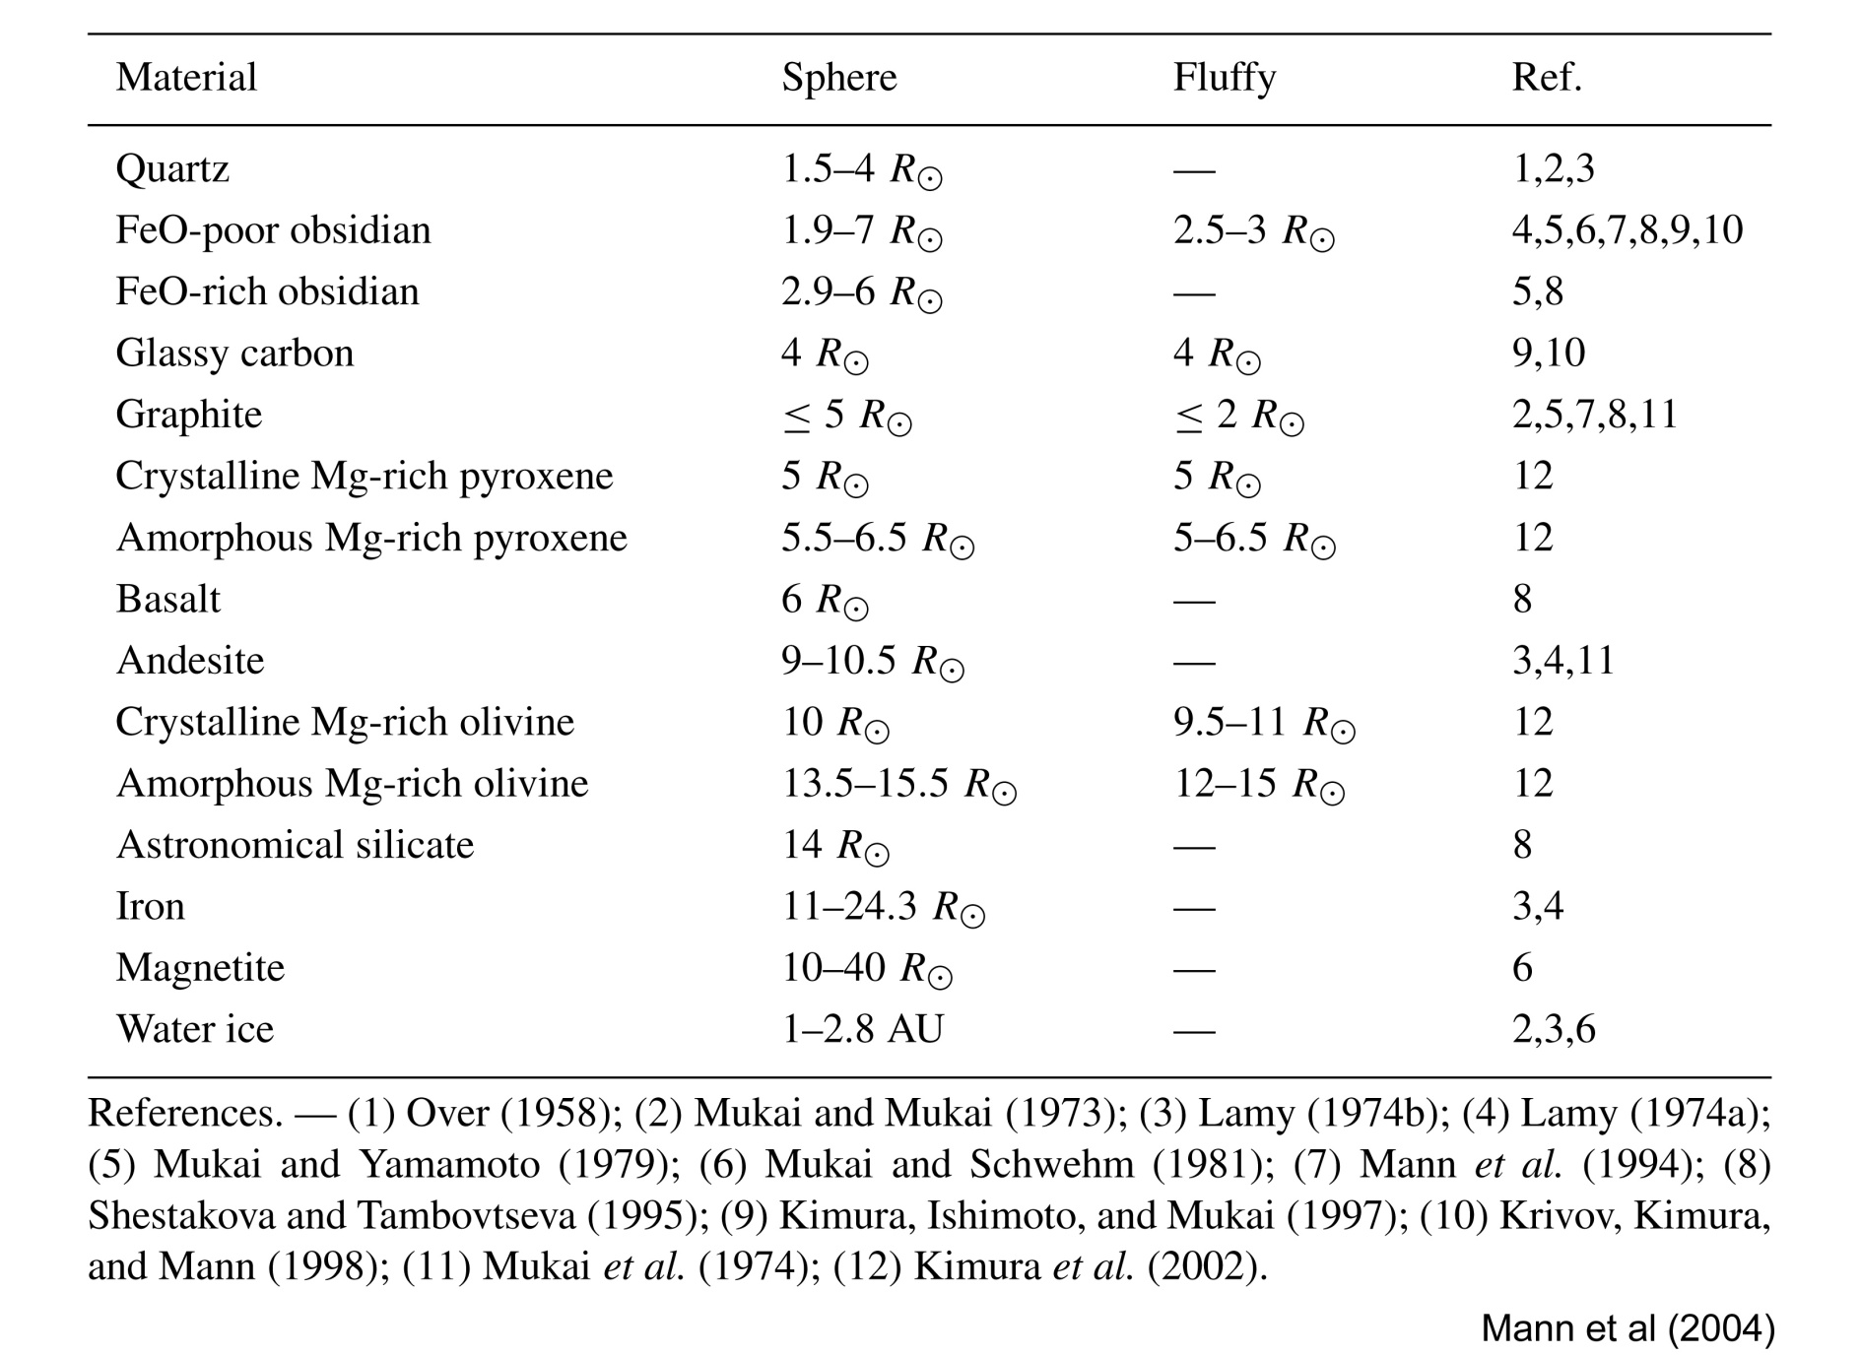
Sublimation Zones For Different Materials

Slide 26
Dusty Plasma
Ragot & Kahler (2003) speculated on the possibility of CMEs interacting with dust in the 3-5 Rsun regime and changing the structure of a CME.
A change in the F-corona as a result of CMEs has never been observed. In fact the F-corona is quite constant.
However the volume of space in which the CME is observed is different from the volume of space in which the dust is observed.
SPP will bring these two regimes closer
A CME (and/or shock) has been observed to modify the comet tail by LASCO, STEREO, and SMEI at distances from 15 Rsun to 1 AU.
SoloHI and WISPR will make the first reliable measurements of the dust environment close to the Sun and will be able to determine whether there is an interaction between the electron and dust coronae.

Slide 27
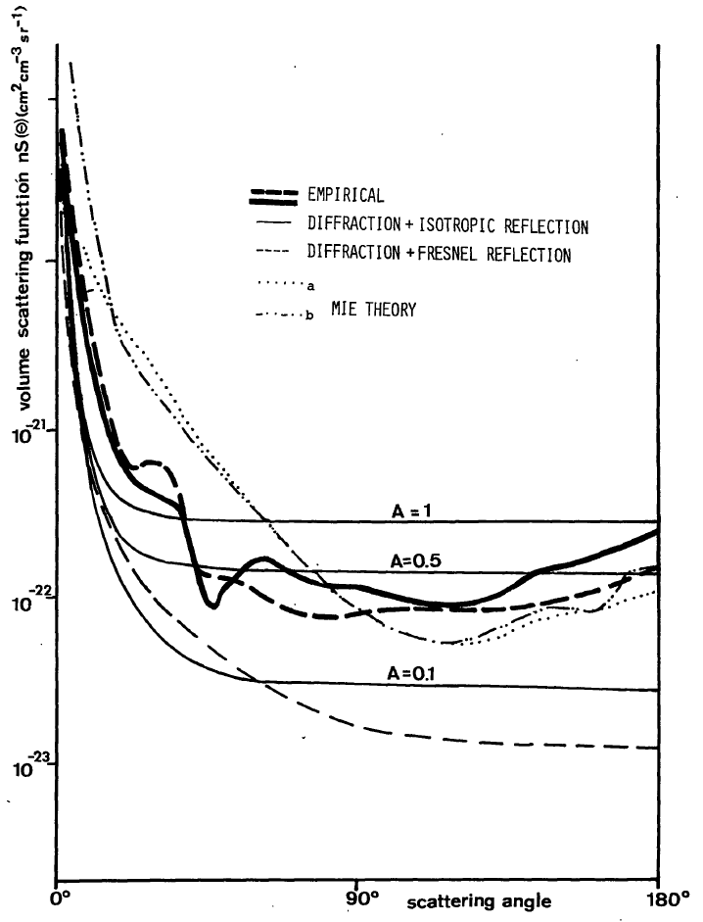
VSF Derived by Leinert et al. (1976)

Slide 28
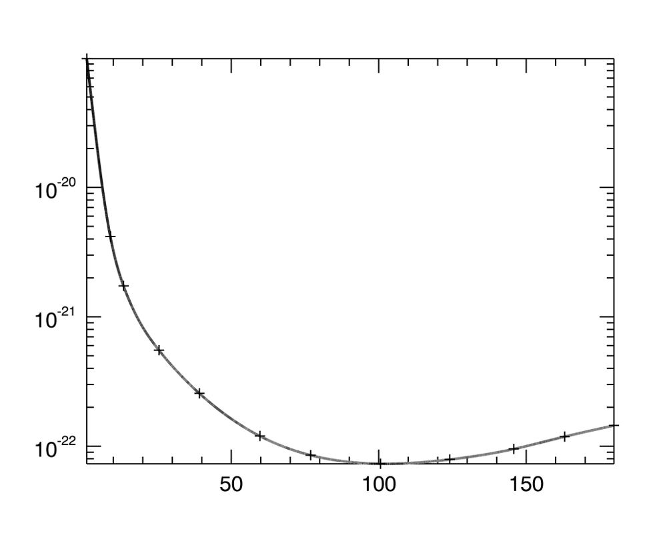
Comparison to Lamy-Perrin VSF
VSF [sr⁻¹ . cm⁻¹]
Scattering Angle [deg]
Forward Scattering
Backward Scattering

Slide 29
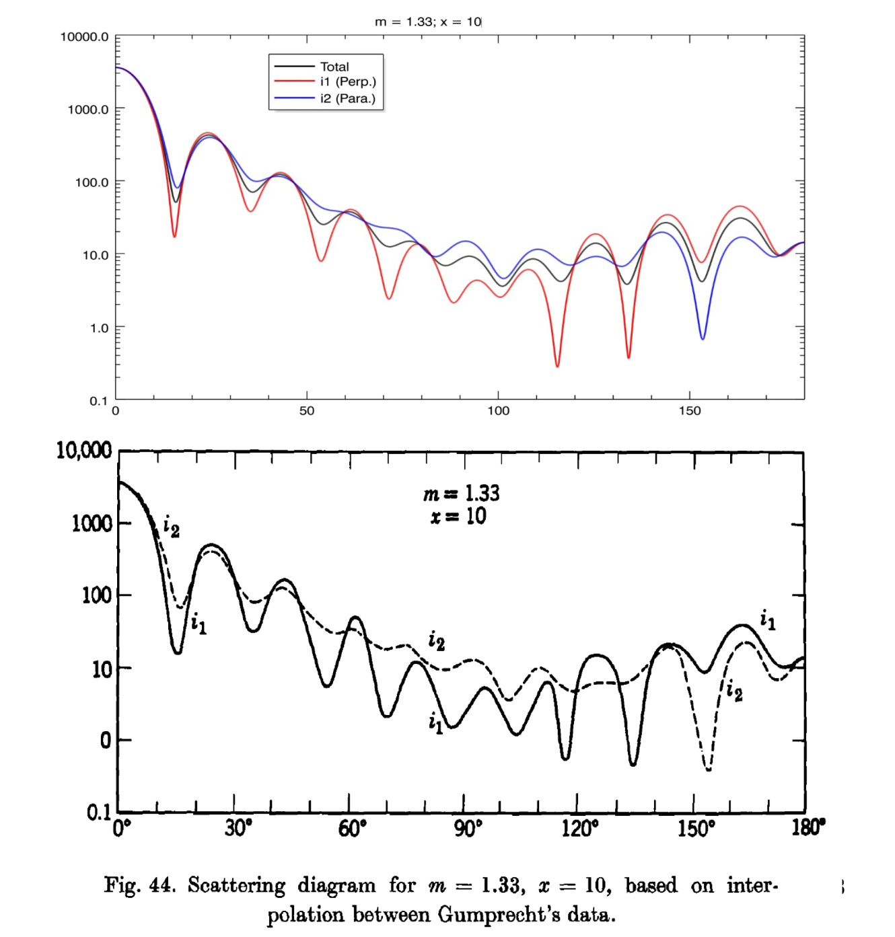
Sanity Check of the Mie Scattering Computation
Mie phase function i1 and i2 are computed with DU algorithm (2004), for a particle of index m=1.33, and size parameter x=10, where x=2π a/λ, with a the radius of the particle, assumed spherical, and λ the wavelength of light.
Same Mie phase functions i1 and i2 for the same particle index and size, as published by van de Hulst (1981).

Slide 30
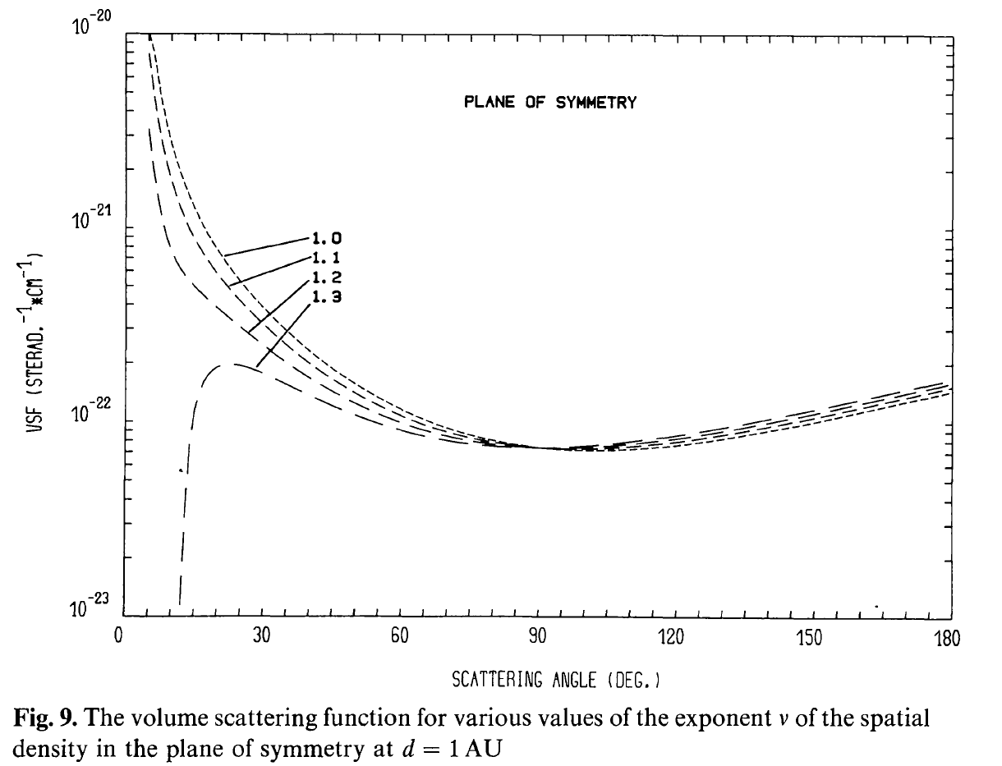
Extrapolation of the LP VSF below 10° Elongation using Leinert et al. VSF

Slide 31
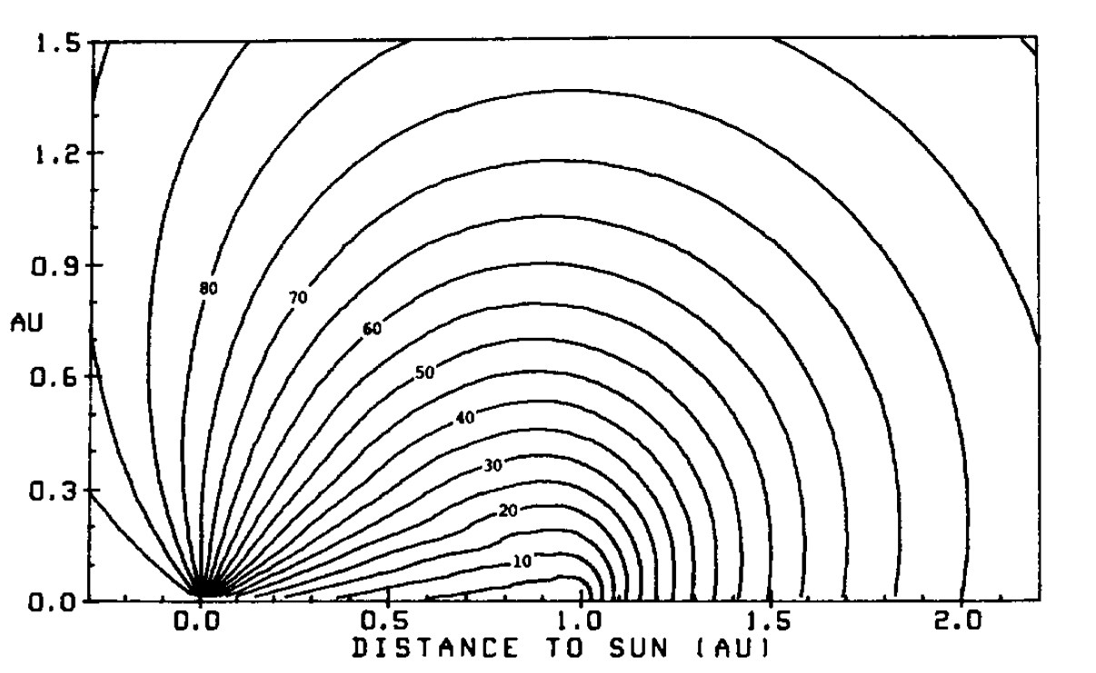
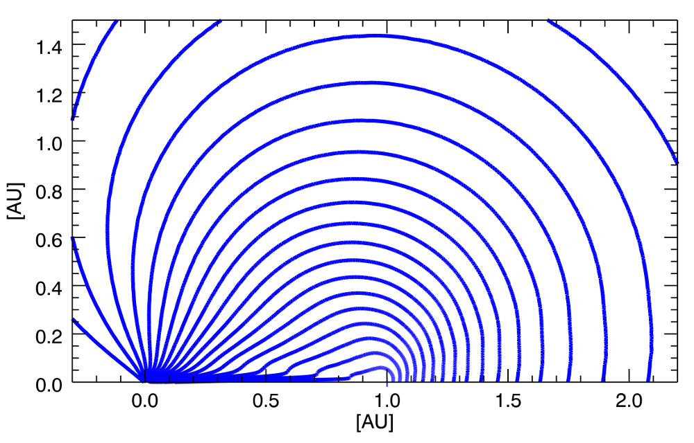
Brightness Contribution Calculated by Misconi and Rusk using Lamy-Perrin VSF
Left Panel: brightness contribution using Lamy-Perrin VSF and computed by Misconi and Rusk (1987)
Right Panel: same brightness contribution using Lamy-Perrin VSF but computed with our ray-tracing program.

Slide 32
Contributions along the Line of Sight

Slide 33
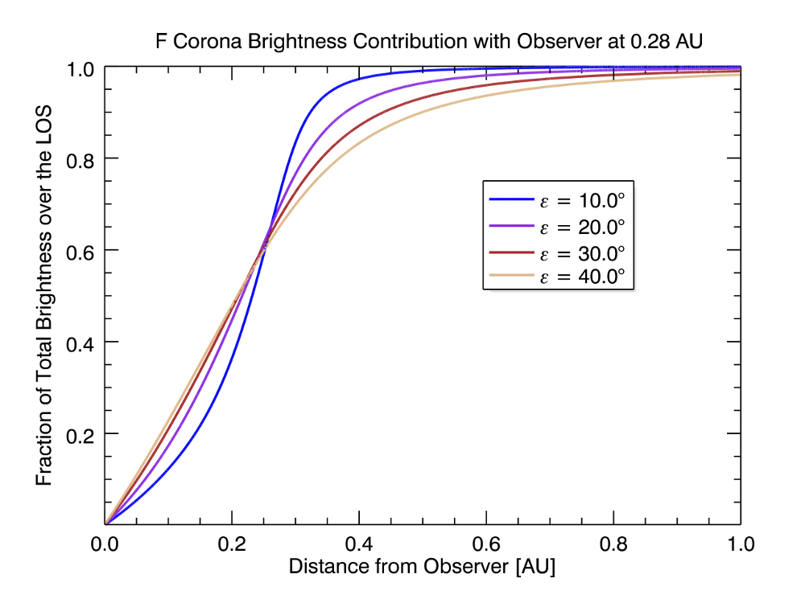
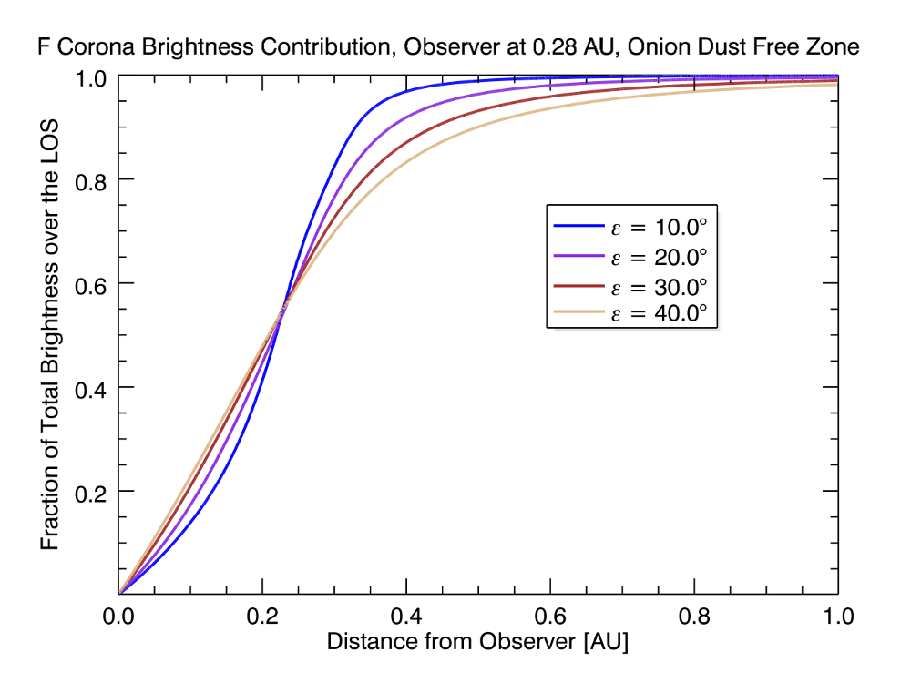
LOS Brightness Contribution with Observer at 0.28 AU

Slide 34
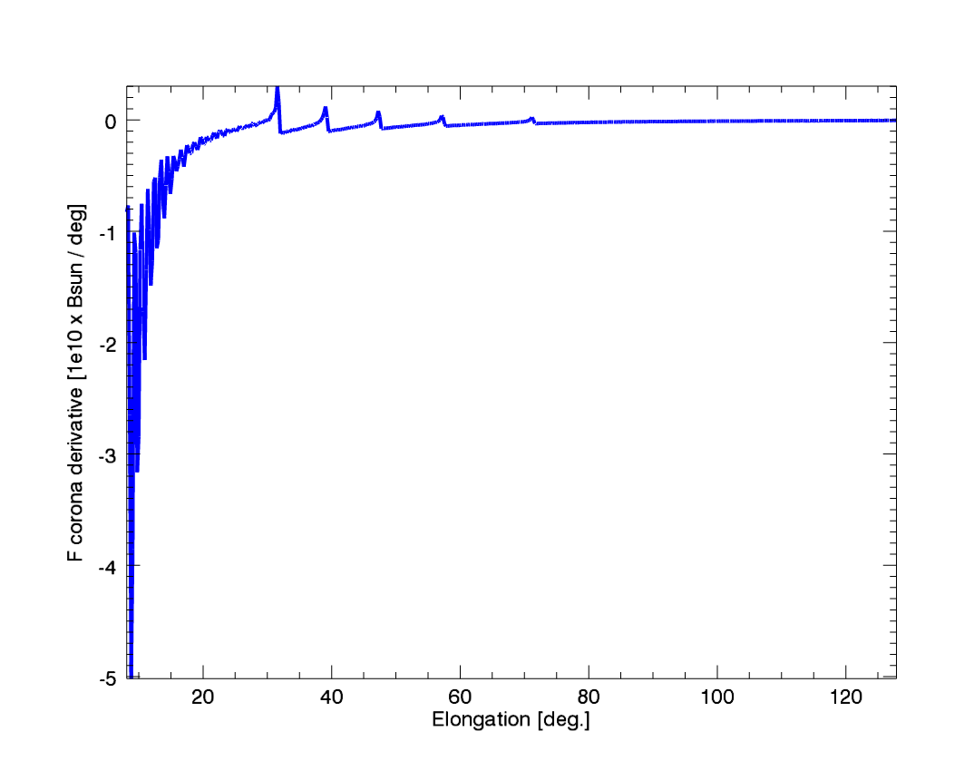
Onion Layers Dust Free Zone, WISPR FOV, from 9.5 R_{sun}
Left panel: K and F coronae profiles. Since the spacecraft is at a height of 9.5 R_{sun}, it is within the onion layers and we only see the steps below 9.5 R_{sun}. Moreover, since there is a lower density of particles near the spacecraft, the brightness is slightly below the no dust free zone F corona at elongations above 70°.
Right panel: derivative of the F corona with the onion dust free zone. The oscillations below 20° elongation are artifacts due to the LOS integration.

Slide 35
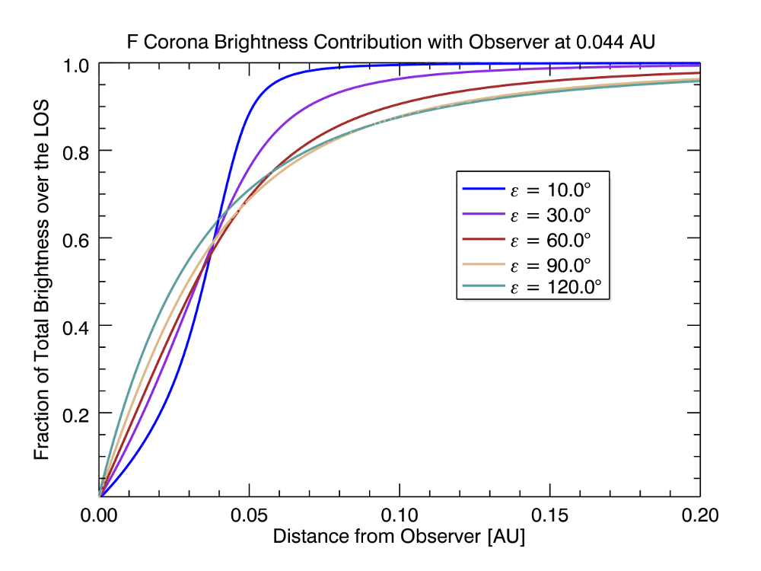
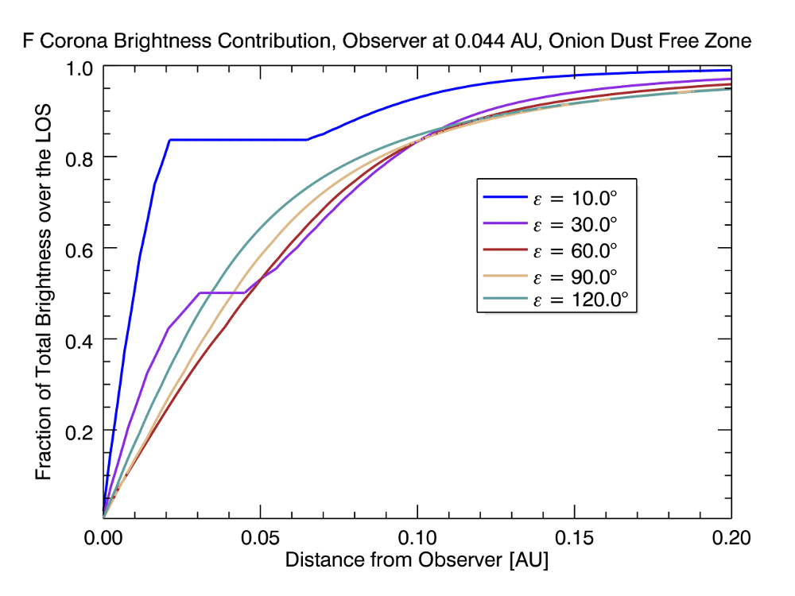
LOS Brightness Contribution with Observer at 0.044 AU

Slide 36
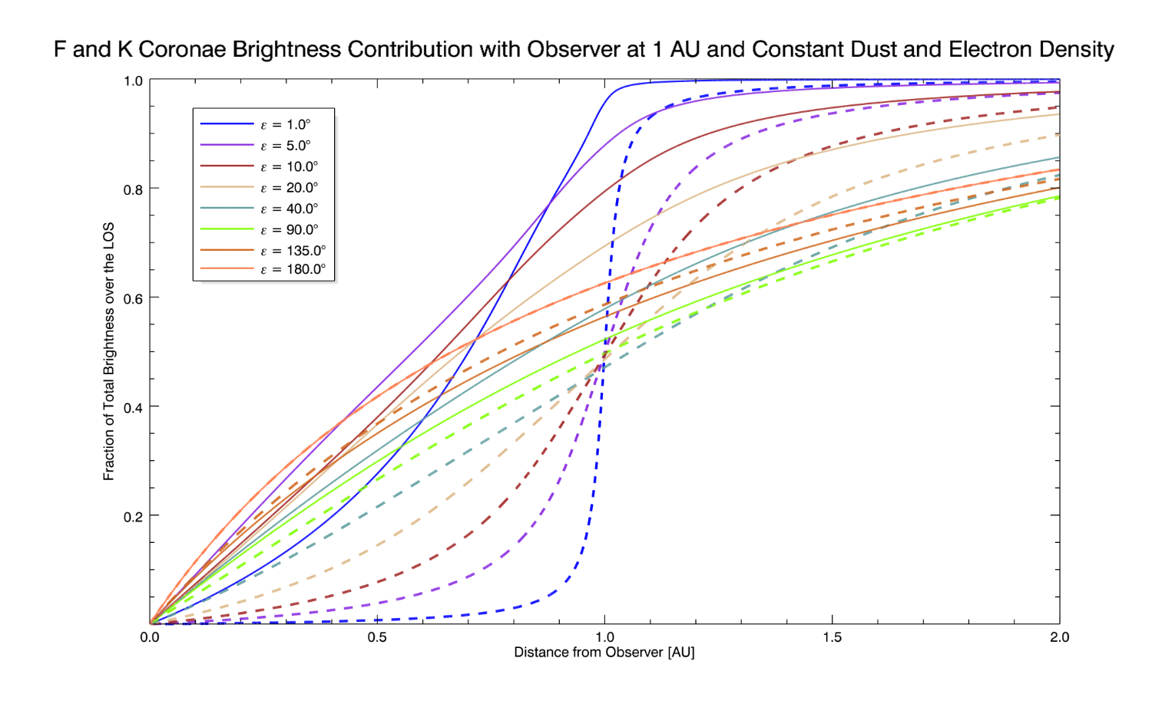
LOS Brightness Contribution with Observer at 1 AU

Slide 37
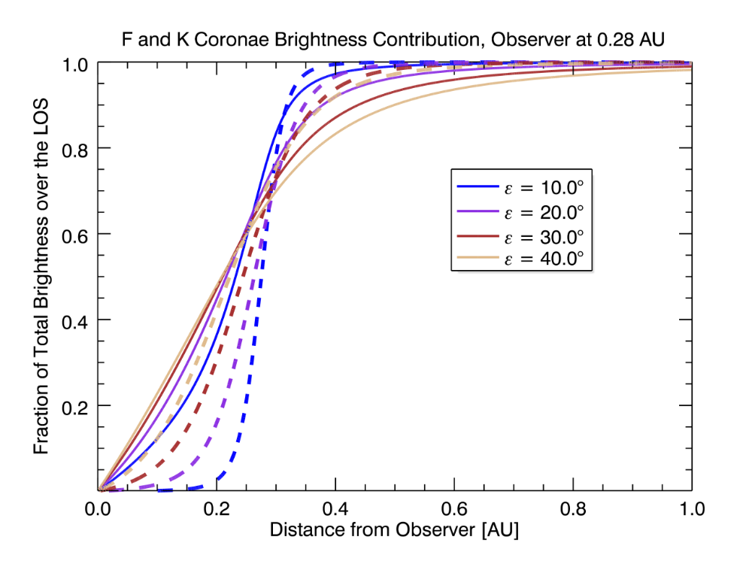
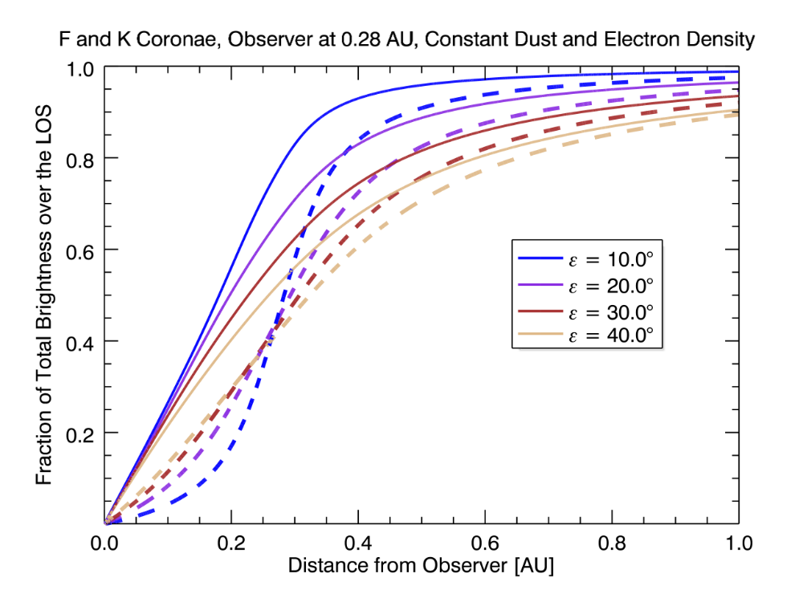
LOS Brightness Contribution with Observer at 0.28 AU

Slide 38
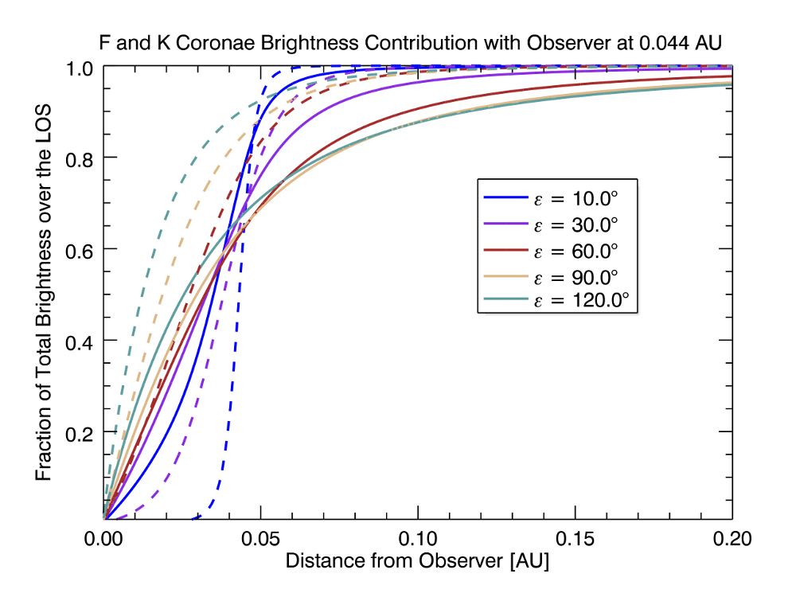
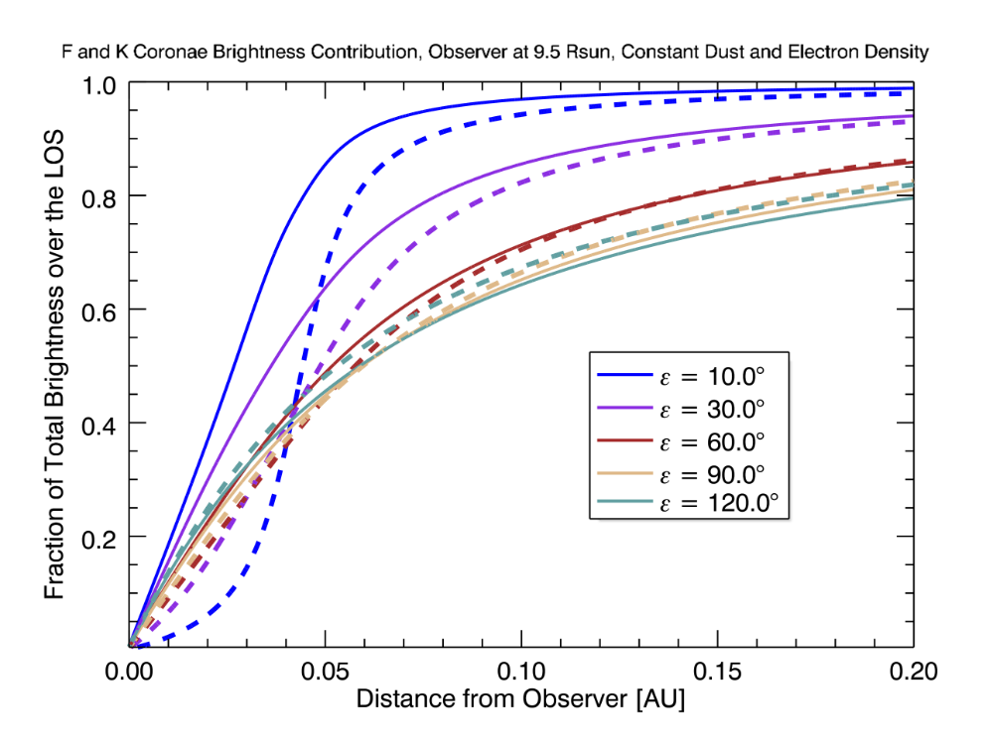
LOS Brightness Contribution with Observer at 0.044 AU

Slide 39
Onion Layers Dust Free Zone, SoloHI FOV, from 0.28 AU Spacecraft 35° above the Ecliptic Plane
Left panel: K and F coronae profiles. 15 R_{sun}, the beginning of the dust free zone, corresponds to an elongation of 14.3° from 0.28 AU.
Right panel: derivative of the F corona with the onion dust free zone.

Slide 40
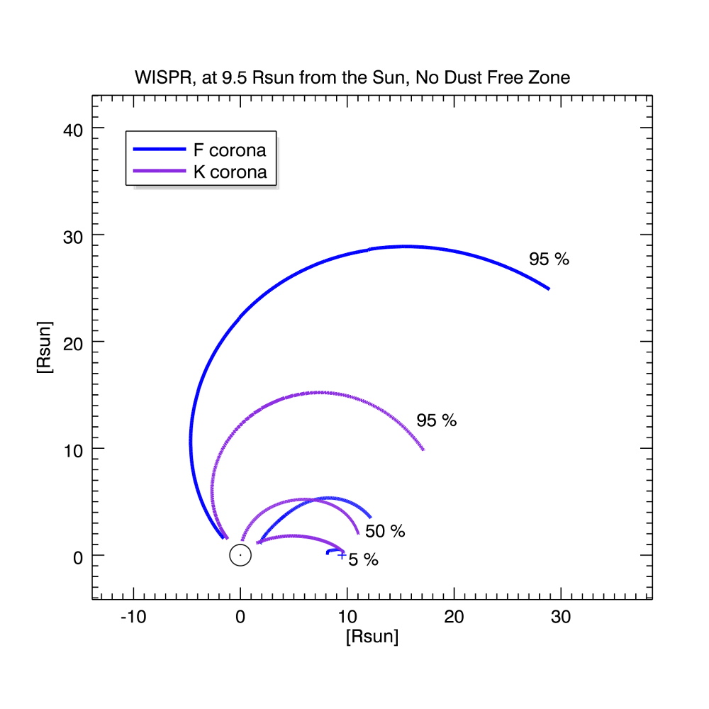
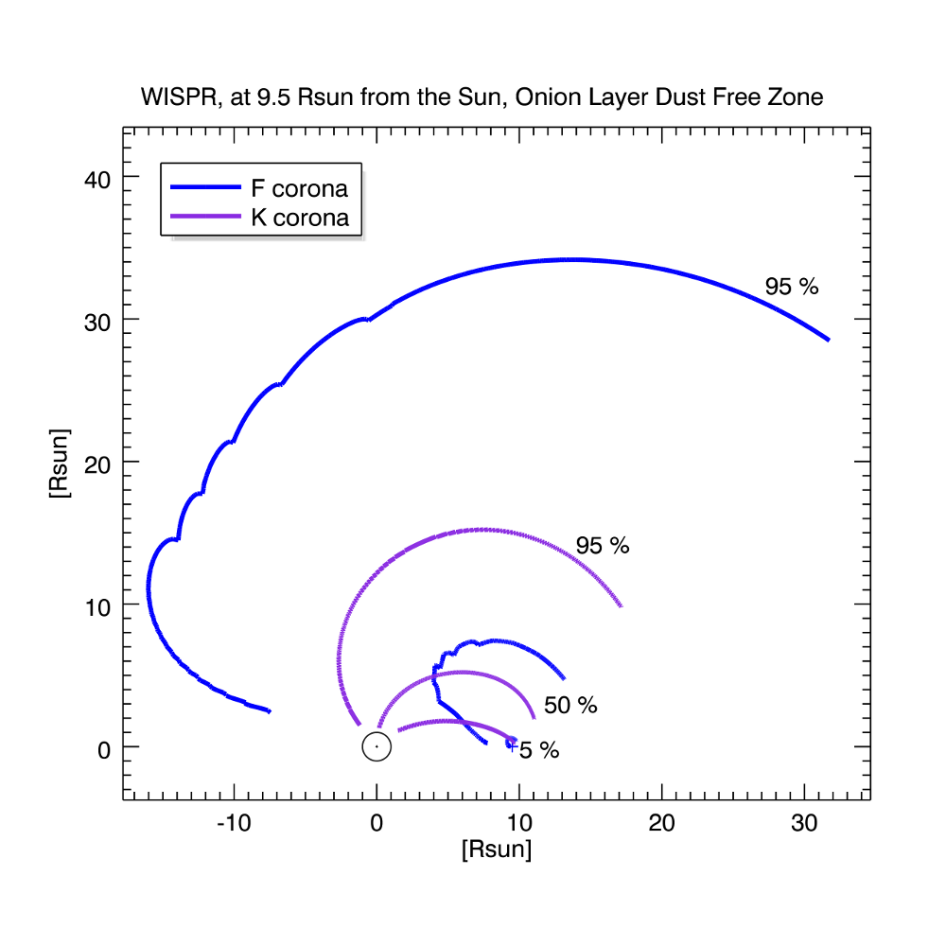
Depth Contribution for WISPR at Perihelion
K and F corona depth contribution.
Left panel: no dust free zone.
Right panel: onion layer dust free zone starting at 15 R_{sun}.

Slide 41
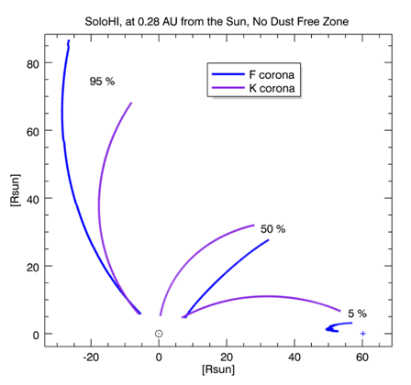
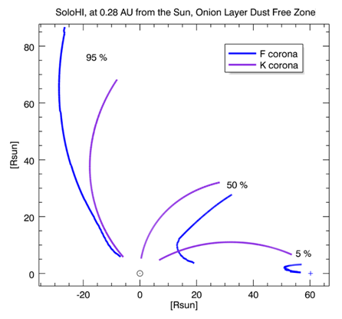
Depth Contribution for SoloHI at Perihelion
K and F corona depth contribution.
Left panel: no dust free zone.
Right panel: onion layer dust free zone starting at 15 R_{sun}.

Slide 42
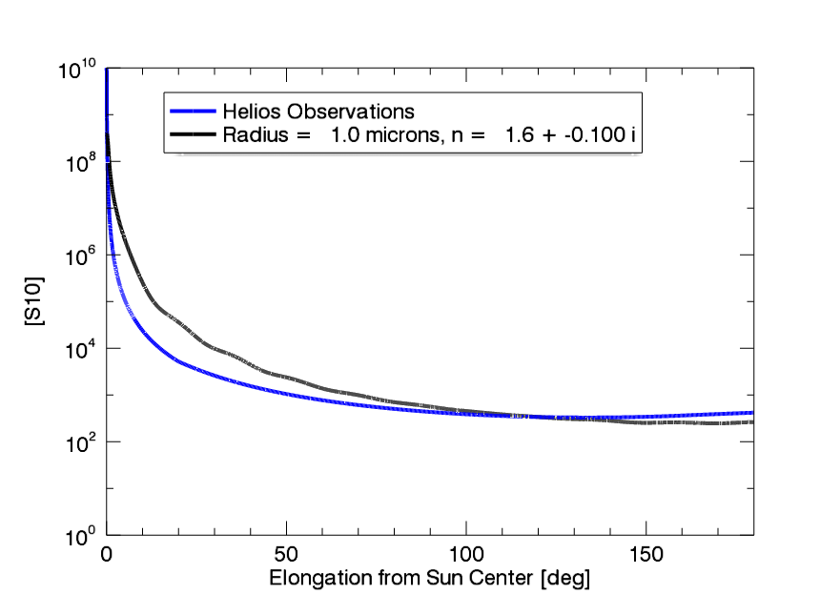
Variational Studies
Index of Refraction
Real part Imaginary Part
Particle Radius
1 micron
1.0
-0.1
Fit of Hoyle et al (1984)
15 micron
1.6
-0.01
-0.001
100 micron
2.0
Blue lines are the Helios observations

Slide 43
F-Corona From WISPR at 9.5 R_{s}
The black sold lines show the elongation from 14°-104°
The F-corona is simulated using Mie scattering with a particle size of 15µm radius, and an index of refraction n=1.6-0.1i (Hoyle &Wickramasinghe, 1984)
The particle density varies as r⁻¹exp(-2.6|sinβ_{π}|^{1.3}) with β_{π} the angle between a point of the corona and the plane of symmetry taken to be the ecliptic plane (Leinert, 1976)

Slide 44
K+F Corona From WISPR at 9.5R_{s}
Same simulation as on the previous slide, but with the addition of a K-corona model (Saito et al, 1977).
Note that the dust-free zone is still quite visible.

Slide 45
F-Coronal Profiles With Various Dust Density Decreases
Same calculation as previous slide, but now zoomed in to show the profiles.

Slide 46
Onion Layers Dust Free Zone, SoloHI FOV, from 0.28 AU Spacecraft in the Ecliptic Plane
Top left: SoloHI image of the K+F coronae, viewed from 60.2 R_{sun} (0.28 AU) .
Bottom left: dust density attenuation function that simulates the different dust type free zones.
Top right: K and F coronae profiles. The dust-free zone begins at 15 R_{sun}, which corresponds to an elongation of 14.3° from 0.28 AU.

Slide 47
Onion Layers Dust Free Zone, SoloHI FOV, from 0.28 AU Spacecraft 35° Above the Ecliptic Plane
Top left: SoloHI image of the K+F coronae, viewed from 60.2 R_{sun} (0.28 AU) .
Bottom left: dust density attenuation function that simulates the dust density decreases due to evaporation.
Top right: K and F coronae profiles. 15 R_{sun} is the beginning of the dust free zone and corresponds to an elongation of 14.3° from 0.28 AU.

