Slide 1
Impact of Teacher’s Dysphonia on Children’s Language Processing Skills.
Morsomme D ¹ - Minel L¹ - Verduyckt I ²
Ulg – Dpt Sciences Psychologiques: Cognition & Comportement,
Finalité Logopédie de la Voix
UCL – Faculté de Psychologie et des Sciences de l’Éducation

Slide 2
Our Aim
Investigate the impact of dysphonic teacher’s voice on the speech processing of 68 children
2 studies
  Morton & Watson, 2001¹
  Rogerson & Dodd, 2005²
With dysphonic voice, performance is impaired in comprehension of spoken words.
Morton, V. & Watson, D. R. (2001). The impact of impaired vocal quality on children's ability to process spoken language.
Logopedics Phoniatrics Vocology, 26(1), 17 – 25.
2. Rogerson J, & Dodd B. (2005). Is there an effect of dysphonic teachers' voices on children's processing of spoken language Journal of voice, 19(1), 47-60.

Slide 3
Method
SUBJECTS:
  68 students (34 - 34 )
  2 classes (A/B)
  Mean Age : 8Y;5M (SD: 8M)
TASKS:
  Individual subtests:
    Auditory Selective Attention Skills (NEPSY)
    Receptive Lexical Skills (ELO)
    Comprehensive Skills (ELO)
  Task 1: MCQ on a short story
  Task 2: Minimal Pair Discrimination (same/different)

Slide 4

Voice non dysphonic
Voice dysphonic

Slide 5
Voice non dysphonic
Voice dysphonic

Slide 6
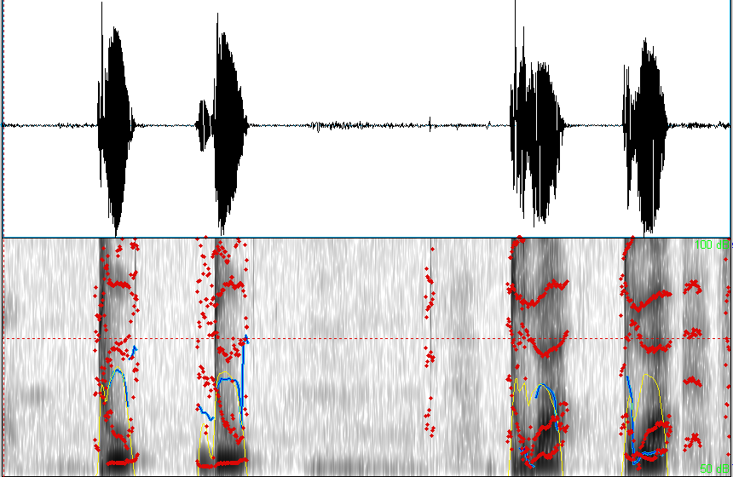
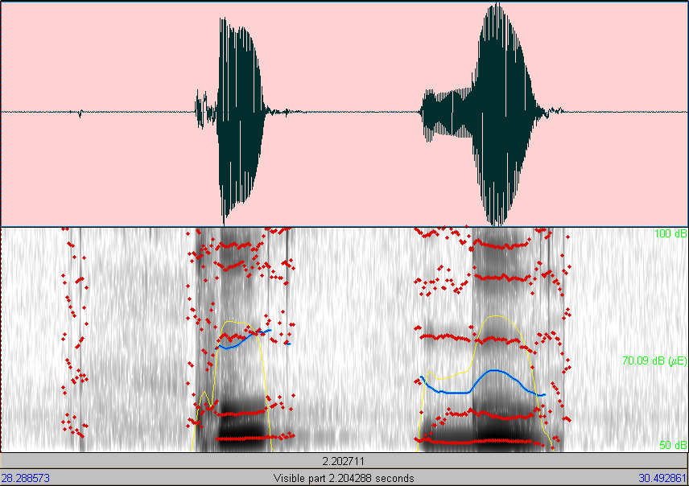
Tout – Doux / Trois - Droit
Coup – Goût

Slide 7





Procedure
Dysphonic Voice – Normal Voice
Normal Voice – Dysphonic Voice
A
B
Comprehension Task
Discrimination Task
Question about voice quality.

Slide 8
Results
Means Comparisons (Wilcoxon)
Dysphonic Voice < Control Voice (p<0.05)
Comprehension Scores
Discrimination Scores
Normal Voice Dysphonic Voice
Normal Voice Dysphonic Voice

Slide 9
Results [ANOVA repeated mesures]
Comparison of voice effect on the 2 tasks
  Interaction (p<0,05)
  Voice Effect: discrimination > Comprehension

Slide 10
Results
Other effect (U-Mann-Withney)
 | Comprehension |  | Discrimination
 | Normal | Dysphonic | Normal | Dysphonic
Gender | P=0.52 | P=0.64 | P=0.95 | P=0.32
School | P<0.05 | P=0.51 | P=0.28 | P=0.97
Order | P<0.05 | P<0.05 | P<0.05 | P=0.20

Slide 11
Judgment about the dysphonic voice
Children judgments (88,23%): 98.3% negative reactions classified in five ways, for example:
  Production: « she does not speak well».
  Acoustic: « the voice is too deep ».
  Pathologic: « she is sick ».
  Emotional: « she is dying ».
  Appearance: « she is a witch ».

Slide 12
Discussion
Disordered voice additional cognitive resources in the listener to process speech.
(Rogerson & Dodd, 2005).
Effect increased in a task of isolated words
  6 to 12 Y: less flexibility in perceptual task than adults.
  (Hazan & Barrett, 2000)
No gender effect
No school effect in the dysphonic mode
Effect of the voices presentation order.
Discrimination task + Dysphonic Voice  increasing difficulties

Slide 13
Discussion
About subjective judgment
  Negative reactions internal referent (Fex, 1992)
  Majority of words in connection with pathology
Dysphonic Voice = diseased state

Slide 14

Conclusion
→ Performances for recognition of spoken words in dysphonic voice.
Negative impact of dysphonic voice on children’s skills to treat spoken language.
Necessity to prevent voice disorders among teachers.
Create specific voice care programs.

