Slide 1


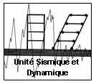
SEISMICALLY RETROFITTING AND UPGRADING RC-MRFs BY USING EXPANDED METAL PANELS
Presented by
PHUNG NGOC DUNG
PhD Student – SE Sector – ArGenCo – University of LIEGE
Notes:
Thank you Mr Chairman for the introduction. Dear the Jury, dear colleagues and friends. Today I would like to present my PhD thesis entitled ‘SEISMICALLY RETROFITTING AND UPGRADING RC-MRFs BY USING EXPANDED METAL PANELS’.

Slide 2
Outline
Introduction on seismic retrofit of RC-MRFs
Expanded Metal Materials and Panels (EMP)
Experimental studies on EMP
Numerical studies on EMP
Design of reference RC-MRFs
Seismic Evaluation of RC-MRFs
Design of EMP for seismic retrofitting
Conclusions and future development
Notes:
First, I will introduce general procedure of how to retrofit the frames under seismic actions. Next, I will explain what is the EMP and experimental and numerical studies on EMP. In the following, I will introduce the reference RC frames and their seismic evaluation. Then, I will present a method to design EMP for seismic retrofitting. Finally, some conclusions and future development will be introduced.

Slide 3
1. Introduction on seismic retrofit of RC-MRFs
Failure of a RC building due to an earthquake (Bendimerad, 2003)
Notes:
Let me start with a typical failure of a RC building which is not designed to seismic action. This type of building has been building in many parts of the world. The failure may be caused by soft-story mechanism or by brittle failure due to shear at beams and column or due to crushing of concrete at beam-column nodes. The necessity of retrofitting this type of building is more and more important.

Slide 4
1. Introduction on seismic retrofit of RC-MRFs
How to seismically retrofit RC-MRFs (ATC 40)
Seismic evaluation
Main retrofit systems
Retrofit strategies: increase stiffness, strength, ductility
Steel bracing or shear walls
Base isolation
Concrete shear walls
This study: EMP – New retrofit system
Notes:
Many studies have been performing to develop procedures to retrofit the RC frames. One of rather complete procedure to date is presented in ATC40. According to this document, to retrofit the frames we have to do three works; the first one is to do seismic evaluation of the existing frames; the second one is to decide retrofit strategies and the last one is to choose the retrofit systems related to the strategies that have been decided. Currently, there are some existing retrofit systems which can be used to retrofit RC frames such as steel bracing, steel or aluminium shear walls, base isolation and concrete shear walls. This study focuses on a new retrofit system with EMP.

Slide 5
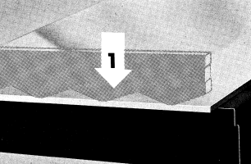
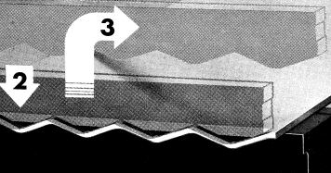
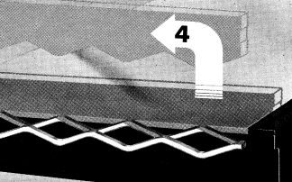
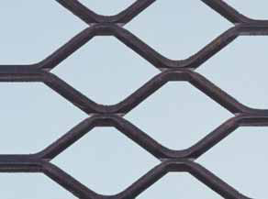
2. Expanded Metal Materials and Panels
Expanded Metal Materials: steel or different alloys
3D sheets: ±1.25 m x ± 2.50 m or ±3.00 m
Two types EMP: Normal and Flattened
Rhomb shaped stitches many possible dimensions
Normal Type: overlaps between stitches
Flattened Type: without overlap
A rhomb shape stitch
51-23-32-30: Normal EMP
LD = 51mm; CD = 23mm;
A = 3.2mm; B = 3.0mm
A51-27-35-30: Flattened EMP
LD = 51mm; CD = 27mm;
A = 3.5mm; B = 3.0mm
No structural application
Notes:
So, what is the EMP? It can be said that EM is a second product made from steel, aluminum or different alloys. To produce EMP, a expanded metal plate will be expansively pressed and simultaneously slit to obtain 3D rhomb-shape stitch sheets as shown in step 1 to 4. Then, these 3D stitch sheets will be cut by rectangular panels with the dimensions of about 1.25m in width and about 2.5m to 3m in length to obtain normal type EMP. Besides, the 3D sheets can also be flattened by passing it through a cold-roll reducing mill and then cutting with the fixed dimensions of ±1.25 m x ±2.5m - 3m to get flattened type EMP. The results from all processes mentioned above are the EM panels having many constant rhomb-shaped stitches with a lot of possible dimensions. A rhomb-shaped stitch is constituted by four bars having nearly the same geometrical configurations. A stitch is geometrically characterized by four dimensions, namely LD, CD, A and B. LD is the length, CD is the width of the stitch. A is the width of the bar and B is the thickness of the bar or the sheet.
As mentioned, there are two types of EMP including normal and flatten types. They are distinguished by geometrical configuration. In flatten EMP, there is no overlap between stitches, in contrast, there are many overlaps between stitches in normal type, as seen in this figure. The normal type EMP is labeled by the dimensions of its rhomb-shaped stitch. For example: 51-23-32-30 is the normal type EMP with LD, CD, A, B = . Flattened type EMP is labeled similarly, however a letter A is put at the beginning. For example A51-27-35-30 is the flattened type EMP with
It is very important to note that at the present the fabricator has not guaranteed the consistency of the mechanical properties of the EMP. Due to that EMP is seldom used in structural applications. It is usually used in non-structural applications such as storefront protectors, fences…

Slide 6
EXPERIMENTAL AND NUMERICAL STUDIES ON EMP

Slide 7
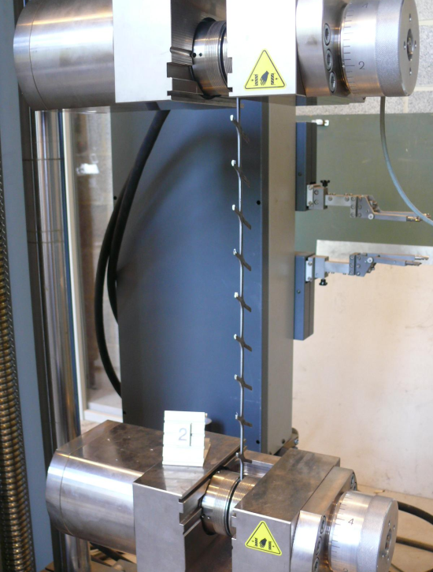
3. Experiments on EMP – Tensile tests
Variability of material properties => problems for seismic application
Yield strength (MPa) | Maximum strength (MPa) | Yield strain (%) | Maximum strain (%) | Elastic stiffness (MPa) | Strain-hardening stiffness (MPa)
350 | 410 | 0.25 | 1.50 | 140000 | 4800
270 | 370 | 0.25 | 3.50 | 134800 | 3077
Notes:
In order to study the shear behaviour of EMP, tensile tests of EMP bars were first performed to characterize their mechanical properties. The figure and table show the results of six tensile tests of the flattened EMP bars with the length equal to 500mm. These bars were randomly removed from the original EMP by oxygen cuttings. We can observe the variability of mechanical properties of the EMP bars as warned by the fabricator. This is not good for seismic application.

Slide 8
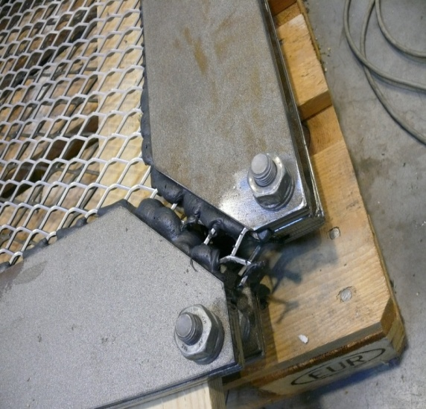
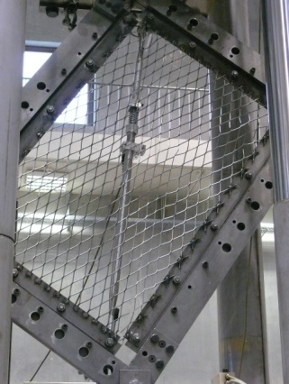
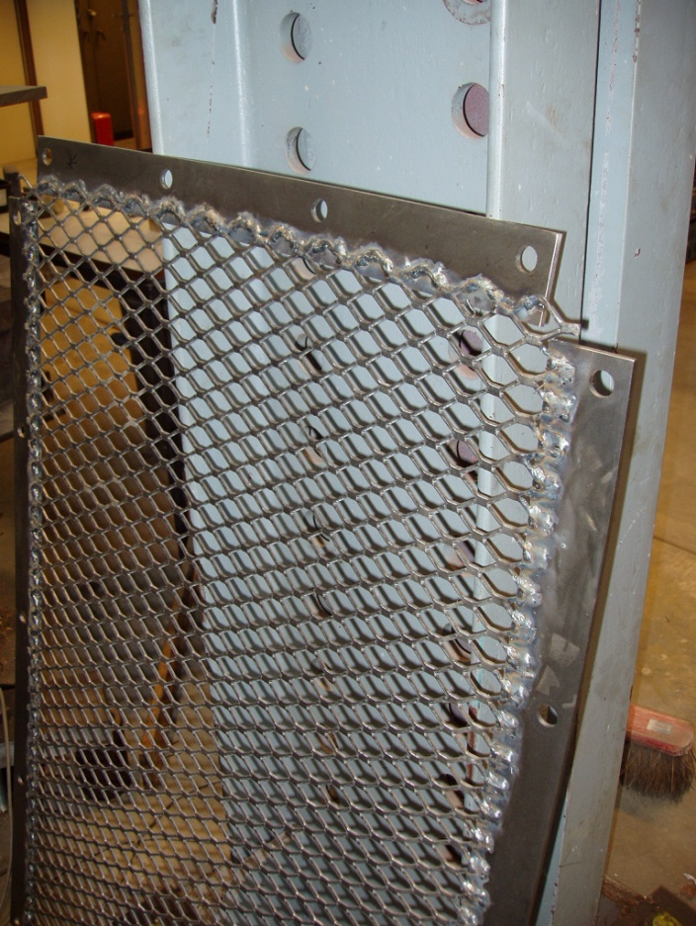
3. Experiments on EMP – Shear tests – small scale
1 m x 1.4 m EMP
8 different EMP
For each EMP:
1 monotonic test – welded connection
1 cyclic test – welded connection
1 cyclic test – glued connection
Glued connections
Applied Force
Welded connections
Notes:
Aiming at using EMP to retrofit RC frames under the earthquake, EMP will be tested under shear which can be simply regarded as the seismic action. The EMP were tested in two stages: small and large scale. In small scale tests, 8 specimens have been selected in two types of EMP. One in normal type is nearly similar to one in flattened one in geometry. This enables to compare the differences between two type EMP. Two types of connection have been used to form the panels, as we can see in this figure: glued and welded connections. The panels are then connected to the test frame by means of bolts. To examine the pure shear behaviour of specimens, four corners of test frame are hinged. The test frame has rectangular shape with 1m in width and 1.4 m in length. To facilitate the tests, force is applied to the diagonal of the test frame. This is equivalent to the shear forces, as explained in this figure. Concerning the procedure of tests, there are 1 monotonic tests with welded connection and two cyclic tests with glued and welded connections for each EMP.

Slide 9
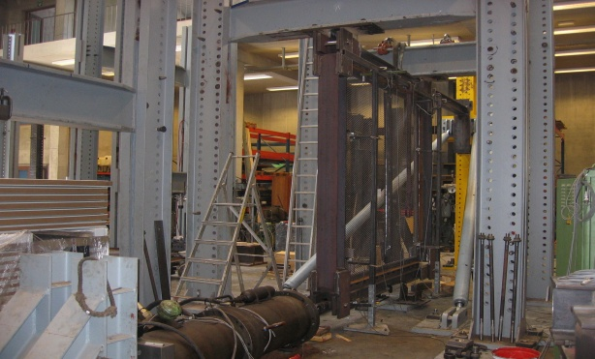
3. Experiments on EMP – Shear tests - large scale
Flattened type:
2.9 m x 3.2 m
Welded connections
2 EMP:
A51-27-35-30
A86-46-43-30
2 monotonic tests
2 quasi-static cyclic
ECCS procedure
Notes:
Based on the observation of the tests in small scale, the large scale tests have been designed. Only flattened type was chosen because this type of EMP was more efficient than normal one, mainly in the connection between EMP and the testing frame. This figure shows a picture of the specimen in large scale tests. Differently from tests in small scale, the specimen in large scale is a combination of two original fabricated EMP, forming a combined EMP having the dimensions about 2.9 x 3.2 m. Two flattened EMP were tested in monotonic and cyclic loading. All the tests were according to ECCS procedure.

Slide 10
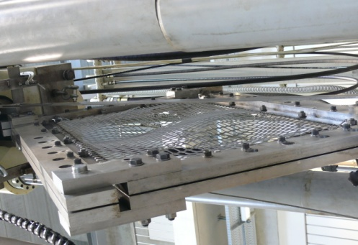
3. Experiments on EMP – Results of tests – Monotonic loading
Global buckling at low shear.
Post-buckling resistance: depend on type, size of panel and dimensions of stitches.
Yield drift: 0.12% - 0.4% (estimated by ECCS procedure)
Ductility: 4-13 for flattened type, 10-20 for normal type.
No failure at connections
Yield drift
Buckling in tests
Monotonic behaviour of A51-27-35-30 – welded connections
Notes:
Some common features of monotonic tests have been observed. First, all specimens have buckled at very low shear loads, and some have even buckled before applying shear loads. So, the buckling resistance of EMP is very small. Second, post-buckling resistance of EMP depends on the type, size of panel and on dimensions of stitches. Third, yield drifts of all specimens, estimated by ECCS procedure, range from 0.12% to 0.4%. Fourth, ductility ranges from 4 to 13 for flattened type and from 10 to 20 for normal type. Finally, there is no failure at the connection in all tests.

Slide 11
3. Experiments on EMP – Results of tests – Cyclic loading
S-shaped behaviour with pinching effects
Yield drift and ductility: same as for monotonic
No failure at connections
Notes:
There are several common features clearly observed in cyclic tests. First, behaviour of all specimens is S-shaped and pinched. Second, yield drift and ductility are nearly the same as those in monotonic tests. Finally, from the beginning to the end of the tests, there has been no failure either at the welded connections or epoxy-glued connections between the expanded metal panels and the test frame.

Slide 12
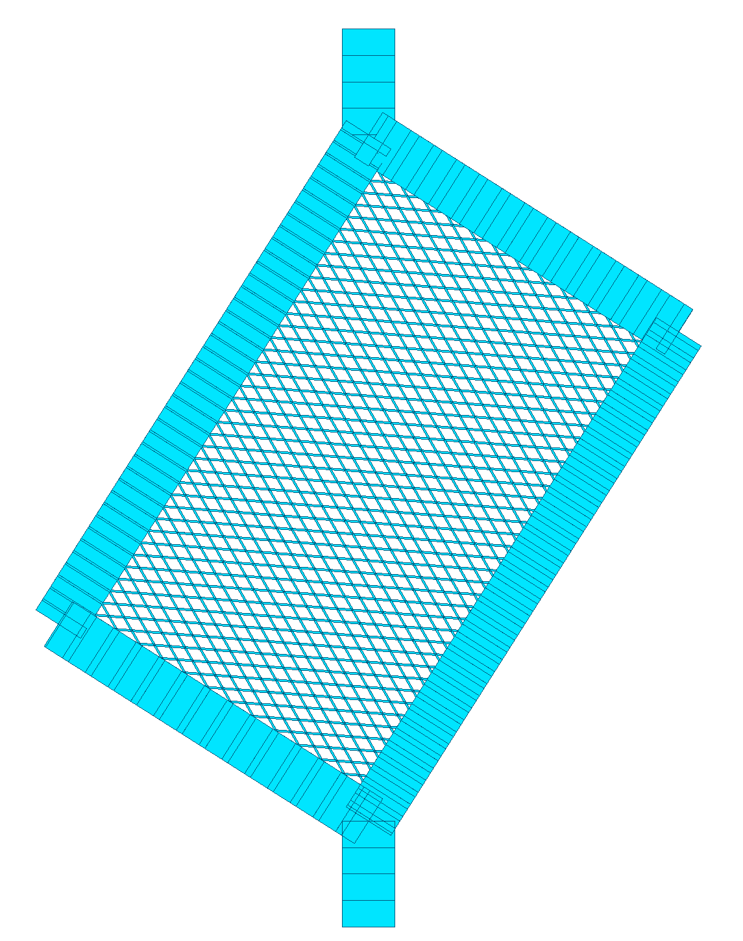
4. Parametric study on EMP – Simulation of the tests
FINELG
EMP bar as a 3D inelastic beam, bar buckling neglected.
Material properties from tensile tests.
Multi-linear relationship with softening and hardening
Initial deformations: first buckling mode shape with amplitude equal to long side length/200
Size dimensions from 100mm to 2000mm
Different width and height panel ratio
Critical analysis
Nonlinear analysis
Outcome of the analysis: shear resistance and ductility
3D inelastic beam
Modeling
Notes:
The tests provided many useful information, but they are not enough to represent the shear behavior of all EMP. Therefore, parallel to conducting experiments, it is necessary to use a nonlinear code to simulate the test to design the test components. In addition, based on the results of numerical simulation, the model for parametric study can be refined. Then parametric study can be performed to define a simplified model for the EMP loaded in shear. FINELG, a fully nonlinear code, is used to calibrate the analytical model of the tests. Each bar of a rhomb shape stitch is modeled as a 3D inelastic beam. Buckling of an individual bar is neglected. Material properties of EMP are exploited from tensile tests of bars: steel multi-linear relationship with softening and hardening taken into account. Initial deformations are taken as first buckling mode shape with amplitude equal to long side length/200.
Concerning parametric study, the panels have been examined with different size dimensions from 100 to 2000mm with different width and height panel ratio. Critical analysis is first performed to determine the different buckling modes of the EMP. Then, fully nonlinear analysis is carried out to define the shear behaviour of EMP. From the analysis we can define shear resistance and ductility of the EMP.

Slide 13
4. Parametric study on EMP – Comparison of Tests ⬄ Models
Monotonic loading
Notes:
Here are the results between test and numerical simulation in monotonic loading. We can see numerical analysis can predict rather well the initial stiffness, maximum strength and ultimate displacement of the specimen.

Slide 14
4. Parametric study on EMP – Comparison of Tests ⬄ Models
Cyclic loading
Notes:
Here are the results between test and numerical simulation in cyclic loading. We can see that numerical analysis can fit rather well the results from tests.

Slide 15
4. Parametric study on EMP – Monotonic shear loading
Buckling resistance of EMP
Critical loads of different square panels with different profiles
Notes:
The first examination of parametric study in monotonic loading is to define the buckling resistance of EMP. Critical analysis is used to determine this resistance. This figure shows the first critical buckling loads in funtion of dimensions of EMP. As we can see if the dimensions of EMP reach the dimensions of a real RC frame, these critical loads are approximately equal to zero. Therefore, bucking resistance is negligible, like observed in the tests.

Slide 16
4. Parametric study on EMP – Monotonic shear loading
Effect of initial deformations on maximum resistance
Square EMP with side dimension =500mm - A51-27-35-30
Notes:
The second examination is to see the influence of initial deformations on shear behaviour of EMP. As, we can see in this figure with three different values of initial deformations their shear behaviour does not change much. Therefore, there is a stable behaviour of EMP developed after global buckling.

Slide 17
4. Parametric study on EMP – Monotonic shear loading
Post buckling shear resistance of EMP
Notes:
Much effort has been made to develop the shear behaviour of EMP. I have done over 2000 numerical analysis to see the post-buckling resistance of EMP under monotonic loading. This figure shows the maximum shear loads in function of side dimension of EMP. The shear resistance of EMP depends on the size and shape of EMP, on the dimensions of the stitches.

Slide 18
4. Parametric study on EMP – Monotonic shear loading
Post buckling shear resistance of EMP
Notes:
It is very interesting that when we plot the ratio of maximum shear resistance devided by the product of width of bar, thickness of bar, ultimate stress of bar, diagonal length of EMP and the length of bar this ratio becomes constant when the dimensions of EMP are close to the dimensions of RC frame. This ratio depends only on the shape ratio of the EMP and is equal to 0.5 x sin (angle between diagonal and horizontal edges).

Slide 19
4. Parametric study on EMP – Monotonic shear loading
Ultimate resistance of EMP V_{u}
A simplified model: the panel works as one diagonal tension band.
→ V_{u} = (A/ l_{bar} ) × l_{diag} ×B × f_{u} × γ = W × B × f_{u}
V_{u}: shear resistance of the sheet
W: effective width of equivalent band
W= (A/ l_{bar} ) × l_{diag} × γ
l_{diag}: diagonal length
B: thickness of the sheet
f_{u}: maximum stress generated in the equivalent band
γ - influence of aspect ratio b/a of panels b/a = 1 → γ = 0.35 ≈ 0.5 × sin (θ) = 0.35
b/a = 2 → γ = 0.23 ≈ 0.5 × sin (θ) = 0.22
b/a = 3 → γ = 0.18 ≈ 0.5 × sin (θ) = 0.16
Notes:
It gives an idea to say that EMP works as a tension band with an effective width. This width depends on the dimensions of stitch and of panel and on a ratio equal to 0.5 multiplied by sin (theta)

Slide 20
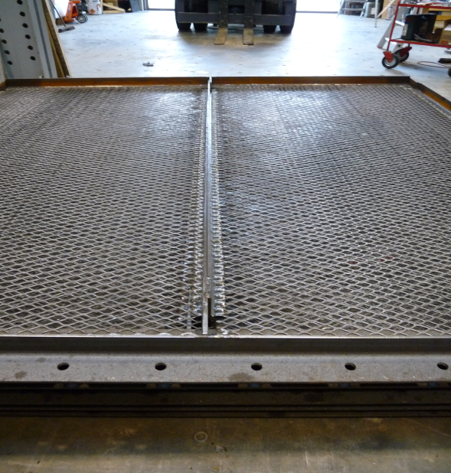
4. Parametric study on EMP – Monotonic shear loading
Resistance of combined EMP
Simplified model of combined EMP with stiff hinged intermediate gusset
Simplified model of combined EMP with ordinary hinged intermediate gusset
Notes:
The simplified shear behaviour of the EMP, presented in the previous section, is applicable for the single EMP. This means that it is applied for EMP having the widths less than the original fabricated one. However, in reality, in order to apply the EMP to the real RC-MRF we have to combine two, three or more EMP to obtain combined EMP, as like the specimens in large scale tests, here. Two EMP can be connected together the using of an intermediate gusset plate. If the gusset is very stiff, the combined EMP works as two independent bands as shown in this figure. Nevertheless, in reality only the ordinary plate is used, as in the test. The presence of this gusset plate may contribute very little to the resistance of the combined EMP. The combined EMP may work as one single equivalent band, as in this figure.

Slide 21
4. Parametric study on EMP – Monotonic shear loading
Resistance of combined EMP for the test configuration
⇒ 1 single band model represents correctly enough the behaviour
Notes:
This is clearly proved when we make the numerical simulations of the tests in large scale with and without the gusset. We can observe here the gusset does not change much the behaviour of EMP. So 1 single band model represents correctly enough the be behaviour.

Slide 22
4. Parametric study on EMP – Cyclic shear loading
Hysteretic behaviour: tension band model ⇔ complete model
(square EMP A51-27-35-30 b = 500mm)
⇒ Hysteretic behaviour of EMP is similar to that of SPSW, steel bracing…
Notes:
About 500 numerical analyses have been performed to develop the hysteretic behaviour of EMP under shear loading. The hysteretic behaviour of EMP is similar to that of concentric braces, SPSW or RC shear walls with some modification in pinching effects.
Write about SPSW …

Slide 23
4. Parametric study on EMP – Summary
One inclined tension band model provides acceptable accuracy to evaluate the response of EMP under shear loading.
The characteristics of this tension band depend on geometrical and mechanical properties, boundary dimensions and ratios related to the shape of the boundary frame.
The ductility of EMP under shear ranges from 4 to 13 depending on material characteristics.
Yield drifts range from 0.12% to 0.4%.
Ultimate drifts range from 2.5% to 3.5%
The hysteresis behaviour of EMP is comparable to that of a steel concentric brace or a unstiffened steel plate shear wall or a reinforced concrete shear wall.
Existing hysteresis models for these three systems can be used for EMP: pivot model (Dowell et al, 1998) or Takeda model (1974)…
Notes:
Some conclusions from the study on EMP under shear
One inclined tension band model provides acceptable accuracy to evaluate the response of EMP under shear loading.
The characteristics of this tension band depend on geometrical and mechanical properties, boundary dimensions and ratios related to the shape of the boundary frame.
The ductility of EMP under shear ranges from 4 to 13 depending on material characteristics.
Yield drifts range from 0.12% to 0.4%.
Ultimate drifts range from 2.5% to 3.5%
The hysteresis behaviour of EMP is comparable to that of a steel concentric brace or a unstiffened steel plate shear wall or a reinforced concrete shear wall.
Existing hysteresis models for these three systems can be used for EMP: pivot model (Dowell et al, 1998) or Takeda model (1974)…

Slide 24
DESIGN OF REFERENCE FRAMES

Slide 25
5. Design of reference RC-MRFs: 32 frames
Case study for each height
1 | 2 | 3 | 4 | 5 | 6 | 7 | 8
EC2 group |  |  | EC8 group
EC2-0.05g | EC2-0.15g | EC2-0.30g | EC8-0.05g-DCL | EC8-0.05g-DCM | EC8-0.15g-DCL | EC8-0.15g-DCM | EC8-0.3g-DCM
Notes:
Now I will introduce thirty two reference frames which are the subject of seismic retrofitting. They are divided into four configurations having 3, 6, 8 and 10 stories. There are 8 frames in each configuration, divided into two groups depending on the codes used to design them. Five frames have been designed to both EC2 and EC8 under three seismicity actions having PGAs of 0.05g, 0.15g and 0.3g. For the seismicity with PGAs of 0.05g and 0.15g, low and medium ductility classes have been adopted to design the frames. For seismicity of 0.3g, only medium ductility class was adopted to design the frame.
Then in order to compare the steel content and seismic performance of the frames designed to only EC2 and the ones designed to both EC2 and EC8, three frames in EC8 group, namely EC8-0.05-DCL, EC8-0.15-DCL, EC8-0.3-DCM, are selected to design only according to EC2.

Slide 26
5. Design of reference RC-MRFs – Some observation
The Ductility Class has not much influence on the total quantities of steel: DCM has a little advantage over DCL
The increase of DC shifts steel from beams to columns.
In many cases, especially in DCM design, the damage limitation condition and minimum reinforcement content are the criteria which define the steel content.
The reinforcement of the column in EC8 group, in most cases, is controlled by Capacity Design.
The effective width of slab plays a significant role on both cross-sectional dimensions and steel contents.
Notes:
By comparing the steel content of the studied frame, we can observe that:
The Ductility Class has not much influence on the total quantities of steel: DCM has a little advantage over DCL
The increase of DC shifts steel from beams to columns.
In many cases, especially in DCM design, the damage limitation condition and minimum reinforcement content are the criteria which define the steel content.
The reinforcement of the column in EC8 group, in most cases, is controlled by Capacity Design.
The effective width of slab plays a significant role on both cross-sectional dimensions and steel contents.

Slide 27
6. Seismic evaluation of existing RC-MRFs - Steps
Step 1: Determine the input: properties of the structures (geometry, materials...); seismic hazard; performance criteria
Material: estimated values of material strengths considered, not the design strength, in order to reflect the expected overstrength of the structure.
Concrete: uniaxial nonlinear constant confinement model (Mander et al.,1998).
Steel: elastic-perfectly plastic steel stress-strain diagram
Seismic performance criteria: FEMA356 with 3 levels of plastic deformations of beams or columns: Immediate Occupancy IO, Life Safety LS and Collapse Prevention CP.
Failure modes: (1) local failure; (2) soft-story mechanism; (3) global failure
Seismic hazard: artificial accelerograms by GOSCA PGAs equal 0.05g, 0.15g and 0.3g
Step 2: Determine the resistance of the structural components
Section analyses: CUMBIA, XTRACT and Response 2000
Step 3: Model the structures taking into account all nonlinear properties of the structures:
Beams and columns: Bernoulli beams with one plastic hinge at each end
Hysteretic behaviour: pivot model (Dowell, 1998) with degradation of strength and stiffness.
Step 4: Perform the analysis of the structures under seismic actions: Code SAP 2000; pushover is first performed or/and Nonlinear Time History is next carried out to check the results of Pushover;
Step 5: Assess the performance of the structures: bending, shear at each component, at nodes...
Notes:
To do seismic evaluation of the studied frames, general steps are summarized here:
Step 1: Determine the input: properties of the structures (geometry, materials...); seismic hazard; performance criteria
Material: estimated values of material strengths considered, not the design strength, in order to reflect the expected overstrength of the structure.
Concrete: uniaxial nonlinear constant confinement model (Mander et al.,1998).
Steel: elastic-perfectly plastic steel stress-strain diagram
Seismic performance criteria: FEMA356 with 3 levels of plastic deformations of beams or columns: Immediate Occupancy IO, Life Safety LS and Collapse Prevention CP.
Failure modes: (1) local failure; (2) soft-story mechanism; (3) global failure
Seismic hazard: artificial accelerograms by GOSCA PGAs equal 0.05g, 0.15g and 0.3g
Step 2: Determine the resistance of the structural components
Section analyses: CUMBIA, XTRACT and Response 2000
Step 3: Model the structures taking into account all nonlinear properties of the structures:
Beams and columns: Bernoulli beams with one plastic hinge at each end
Hysteretic behaviour: pivot model (Dowell, 1998) with degradation of strength and stiffness.
Step 4: Perform the analysis of the structures under seismic actions: Code SAP 2000; pushover is first performed or/and Nonlinear Time History is next carried out to check the results of Pushover;
Step 5: Assess the performance of the structures: bending, shear at each component, at nodes...

Slide 28
6. Seismic evaluation of existing RC-MRFs – Performance
Base shear (kN)
Typical pushover curves of studied frames
500
EC8-DCL frames (if node retrofitted)
400
300
Performance point at design PGA
First Yield
EC8-DCM frames
EC2 frames (if node retrofitted)
200
100
Brittle failure at node
0.00
0.50
1.00
1.50
2.00
2.50
3.00
3.50
Top displacements/total heights (%)
Notes:
There are two typical pushover curves of the studied frames. For frames designed to EC2 and frames designed to EC8 with low ductility class, the curves are linear from the beginning of loading to the brittle failure due to crushing of concrete at beam-column nodes. This failure is ussually coincident with first hinges occured in the frames. If it is assumed that all nodes are well retrofitted, the curves will continue like theses lines. This one presents the EC2 frame, and this one is for DCL frame. These frames cannot reach target dispacements due to early failures at nodes.
For frames designed to EC8 with medium ductility class, favourable behaviour is observed. The frame can reach the target displacement.

Slide 29
6. Seismic evaluation of existing RC-MRFs – Performance
Determination of the resistance of compression strut at joint
EC8-DCM frames
EC2 frames (if node retrofitted)
Notes:
The way to determine shear actions on the node is shown in this figure. Two typical failure mechanisms of studied frames are shown here: soft-story for EC2 frame if nodes are retrofitted and beam-sway for EC8 frames.

Slide 30
6. Seismic evaluation of existing RC-MRFs – Performance
Nonlinear Response
Top target displacements established by Pushover and maximum top displacements established by NLTH of studied RC-MRFs at performance point (* - frames with node retrofitted)
Notes:
The top displacements at performance points, obtained by Pushover and NLTH analyses, are shown in this figure. The results fit rather well for frames in low and moderate seismicity regions.

Slide 31
6. Seismic evaluation of existing RC-MRFs – Performance
Nonlinear Response
Design and maximum sustainable PGA of studied RC-MRFs established by Pushover analysis (* - the frames need node retrofitted)
Notes:
Maximum sustainable PGA of some studied frames, obtained by Pushover analysis, are given in this figure. As we can see that all frames in EC8 group with medium ductility class don’t need to retrofit because they can sustain the earthquake much larger than the design ones. However, frames in EC2 group and DCL frames need to retrofit because they cannot reach target displacements.
Add Maximum sustainable PGA in legend

Slide 32
6. Seismic evaluation of existing RC-MRFs – Performance
Check of the necessity of upgrading the existing frames
Configuration/Case | Design PGA (g) | PGA causing failure (g) | PGA to be sustained by retrofitted structures (g) | Failure criteria | To be upgraded or Not
Conf.1/EC2-0.05g | No | 0.06 | 0.15 | Node | YES
Conf.1/EC2-0.15g | No | 0.08 | 0.15 | Node | YES
Conf.1/EC2-0.3g | No | 0.09 | 0.30 | Node | YES
Conf.1/EC8-0.05g-L | 0.05 | 0.08 | 0.15 | Node | YES
Conf.1/EC8-0.15g-L | 0.15 | 0.13 | 0.15 | Node | YES
Conf.1/EC8-0.05g-M | 0.05 | 0.5 | 0.15 | Global | No
Conf.1/EC8-0.15g-M | 0.15 | 0.65 | 0.30 | Global | No
Conf.1/EC8-0.3g-M | 0.30 | 1.00 | 0.40 | Global | No
Notes:
We can see more clearly here, in this table, that all frames with medium ductility class do not need to retrofit. In contrast, all frames in EC2 group and EC8 with low ductility need to retrofit.

Slide 33
DESIGN OF EMP TO RETROFIT THE FRAMES

Slide 34
7. Design of EMP for seismic retrofitting – Design method
Force-Based Design or Direct Displacement-Based Design
Force-Based Design
- q factor required
→ Not known for frames with EMP
- Target displacement and seismic performance only known after the design procedure
may be not suitable for retrofitting where target displacement can be predicted
- Independency between stiffness and strength
→ Not true for EMP and RC structures
Therefore, Force-Based Design in this context may be not suitable and Direct Displacement-Based Design has been adopted to design EMP
Notes:
Up to now, we have known the shear behaviour of EMP, we have the reference frames. We have known the seismic performance of that frame. How can we design EMP for retrofitting the frames under a given earthquake? If we base on the modern seismic code, we will use force-based approach to design EMP. I will explain why force-based design is not suited in this case. First, we it is well-known that there is independency between stiffness and strength in force-based design. It is not true for RC strutures. Second, to design a new strutural type with force-based approach we have to know q factor. This is not known for structures with EMP. Finally, with force-base design, the target displacement and seismic performance only known after the design procedure by performing nonlinear analysis. This is not suitable for retrofitting where target displacment can be predicted. Therefore, Force-Based Design in this context may be not suitable and Direct Displacement-Based Design has been adopted to design EMP

Slide 35
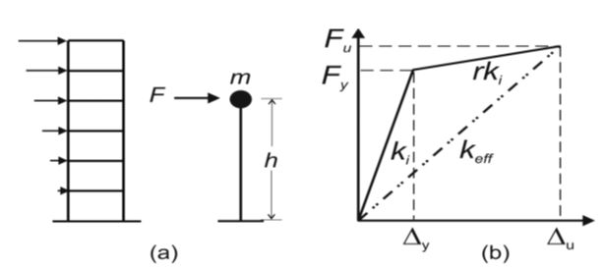
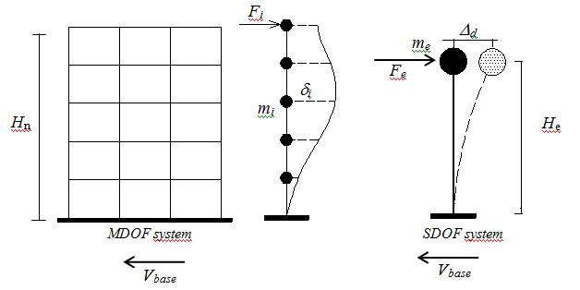
7. Design of EMP for seismic retrofitting - Background of DDBD
Inelastic Displacement Profile (Priestley, 2007)
Direct Displacement Based Design
Design Displacement of the SDOF structure
Equivalent Height of the SDOF structure
Equivalent Mass of the SDOF structure
Notes:
In the DDBD, the most important point for designing a multi-degree of freedom (MDOF) structure is to determine the characteristics of the equivalent single-degree-of-freedom (SDOF) structure at target displacement. This equivalent “SDOF-substitute” structure is characterized by the secant stiffness k_{e} at target displacement D_{d} and by a level of an equivalent viscous damping (EVD) ξ_{eq} representing the combined effect of viscous and hysteretic dissipation of the structure. These properties are determined based on target displacements and displacement profile of the structure at that target displacement.

Slide 36
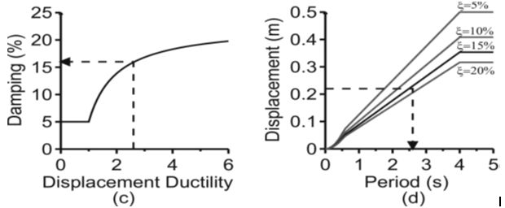
7. Design of EMP for seismic retrofitting - Background of DDBD
Steps to design or retrofit structures using DDBD
Displacement ductility of the SDOF structure
Yield displacement for RC frames
Equivalent viscous damping
Determination of the base shear and story shear forces due to seismic actions
Distribution of the design base shear vertically and horizontally to the structural elements of the lateral load resisting system
Notes:
The base shear acting on MDOF system are determined through SDOF system with the product of effective stiffness and design displacement computed previously. The effective stiffness is computed based on effective period, whcih is corresponding to the intersection of design displacement and inelastic design displacement spectrum. This spectrum is determined from elastic displacement spectrum and reduction factor computed from equivalent viscous damping of SDOF system. Then, this shear force will be distributed over the height of frames.

Slide 37
7. Design of EMP for seismic retrofitting - Methodology
Keys to select EMP to seismically retrofit RC-MRFs based on DDBD
1. Target drifts or displacements of the retrofitted frames
2. Target displacement profiles for the retrofitted frames – use the formulas by Priestley, 2007
Notes:
Based on the assessment of Pushover analysis, for the frames in EC2 group and frames designed with EC8-DCL, brittle failure due to crushing of concrete at beam-column joints dominates their seismic performance and for the frames, designed in accordance with EC8-DCM, the seismic performance is favourable with partial or beam-sway mechanisms.
The retrofit work using EMP should ensure that the unfavourable failure will not occur under a given seismic action. This means that under a given earthquake, the retrofitted structures should reach target displacements or target drifts, at which there is no brittle failure due to crushing of concrete at beam-column joints of frames in EC2 and EC8-L groups or not too large lateral drifts leading to the severe damage of non-structural components of frames in EC8-M group. Therefore, the limit drifts or displacements should be equal or less than the drifts at which the brittle failure occurs in the EC2 and EC8-L frames or at which EC8-M frames have too large displacements.
Having selected the target displacements for the retrofitted frames, in accordance with DDBD, it is necessary to predict the deflected shapes or displacement profiles of the frames at target displacements. The formulas proposed by Priestley et al. (2007) have been adopted for retrofitted frames.

Slide 38
7. Design of EMP for seismic retrofitting - Methodology
Keys to select EMP to seismically retrofit RC-MRFs based on DDBD
3. Equivalent Viscous Damping of RC-MRFs with EMP
Yield displacements of the RC-MRFs
EVD of the reinforced concrete frames (Priestley, 2007)
Notes:
In order to construct the design displacement spectra, DDBD uses an equivalent viscous damping (EVD), which is coupled with an equivalent linear SDOF system to represent the elastic and inelastic energy dissipation of a nonlinear system during seismic loading. The EVD of retrofitted frames are based on EVD of each system: RC frame and EMP system. For computing the EVD of the RC frame, the formula proposed by Priestley is adopted. The ductility of RC frame at target displacement is determined from pushover assessment.

Slide 39
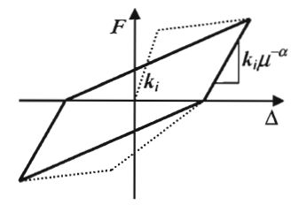
7. Design of EMP for seismic retrofitting - Methodology
Keys to select EMP to seismically retrofit RC-MRFs based on DDBD
3. Equivalent Viscous Damping (EVD) of RC-MRFs with EMP
Takeda Thin hysteresis rule (Priestley, 2007)
EVD of the EMP
A typical hysteretic behaviour of a square EMP A51-27-35-30 with the dimension of 500mm
Notes:
As we have seen that hysteretic behaviour of EMP is similar to that of Takeda Thin model(1970), as presented in this figure. Therefore, it may be possible to adopt the EVD of Takeda thin model, as reported in Priestley (2007), for the EMP. In order to compute EVD of EMP system, we have to know ductility of EMP system at target displacement.

Slide 40
7. Design of EMP for seismic retrofitting - Methodology
Keys to select EMP to seismically retrofit RC-MRFs based on DDBD
3. Equivalent Viscous Damping of RC-MRFs with EMP
Determination of the ductility of the EMP system through Strength Assignment (Paulay ,2002)
EVD of the retrofitted RC-MRFs with EMP
Notes:
The global ductility depends on the variation of local ductility and corresponding inelastic first-mode shape of the structure. We can estimate the system global ductility, μ_{dEMP}, by weighting the various ductility contributions in proportion to the work done by each system. For frame-type structure, the following equation, supposed in Priestley (2007), may be used to do this where the ductility at each level, μ_{dEMP,i}, is weighted by the corresponding story shear, V_{i}, acting on EMP at story i and story drift, θ_{i}. It is clear that in order to calculate both ductility and shear story on EMP it is necessary to know the properties of EMP at each story, which are still unknown at this stage of design process. However, there is still another approach which can help determine the system ductility of the system based on strength assignment proposed by Paulay (2002).
Similarly, we can calculate EVD of retrofitted system of frame and EMP by weighting the overturning moments and EVD of each system, as shown in this formula.

Slide 41
7. Design of EMP for seismic retrofitting - Methodology
Base shear
Principle of designing EMP – Case a
Performance point at design PGA
V_{b,Rdmax,MRF+EMP}
MRF+EMP
V_{b,Rd,MRF+EMP}
Brittle failure
MRF
V_{b,Rdmax,MRF}
V_{b,1Y,MRF+EMP}
V_{b,Rd,MRF}
Performance point at design PGA
Selected target point at design PGA
V_{b,1Y,MRF}
First yield of MRF
EMP system
V_{b,EMP}
k_{s,MRF}
k_{e,EMP}
Δ_{target}
Δ_{Limit}
Δ_{1Y,EMP}
Roof Displacement - Δ
Δ_{1Y,MRF} = Δ_{1Y,MRF+EMP}
Notes:
Using DDBD, three main cases for designing EMP in retrofitted frames are summarized here. For the case (a), only elastic resistance of EMP combined with nonlinear capacity of RC frame is activated.
Remove Vb
Green for target displacements

Slide 42
7. Design of EMP for seismic retrofitting - Methodology
Base shear
Principle of designing EMP – Case b
Performance point at design PGA
V_{b,Rdmax,MRF+EMP}
MRF+EMP
V_{b,Rd,MRF+EMP}
First yield
Brittle failure
V_{b,1Y,MRF+EMP}
MRF
V_{b,Rdmax,MRF}
V_{b,1Y,MRF}
V_{b,Rd,MRF}
Performance point at design PGA
Selected target point at design PGA
First yield EMP
EMP system
V_{b,EMP}
k_{e,MRF}
k_{e,EMP}
Δ_{target}
Δ_{Limit}
Δ_{1Y,MRF}
Roof Displacement - Δ
Δ_{1Y,EMP} = Δ_{1Y,MRF+EMP}
Notes:
In case b, both resistance and ductility of EMP combined with linear capacity of RC frame are activated.
Green for target displacements
Remove Vb

Slide 43
7. Design of EMP for seismic retrofitting - Methodology
Base shear
Performance point at design PGA
Principle of designing EMP – Case c
V_{b,Rdmax,MRF+EMP}
MRF+EMP
V_{b,1Y,MRF+EMP}
V_{b,Rd,MRF+EMP}
Brittle failure
First yield
MRF
V_{b,Rdmax,MRF}
V_{b,1Y,MRF}
V_{b,Rd,MRF}
Performance point at design PGA
Selected target point at design PGA
First yield EMP
EMP system
V_{b,EMP}
k_{e,MRF}
k_{e,EMP}
Δ_{target}
Δ_{Limit}
Δ_{1Y,EMP}
Roof Displacement - Δ
Δ_{1Y,MRF} = Δ_{1Y,MRF+EMP}
Notes:
In case c, only elastic resistance of both RC frames and EMP is activated.
Remove Vb if possible

Slide 44
7. Design of EMP for seismic retrofitting - Examples
Step 1: Selecting the target displacement of the retrofitted frame
= 93 mm
= 95 mm
Pushover curve of the existing frame and selected target drift (Case study Config2 - EC2-0.05g)
Notes:
Remove the text of node retrofitted
I take here the case b as the sample example for each step of design procedure
Step 1: Selecting the target displacement of the retrofitted frame
The pushover curve of the existing frame is shown here. There are two parts in the curve: the continuous one from origin to the brittle failure of the frame due to crushing of concrete at the beam-column joint and the other, represented by the dashed line, from the node failure point to ultimate behaviour of the frame if it is assumed that node is retrofitted. The failure of node of this frame is coincident with the first hinge occurring on the beam. This is shown by the triangular symbol. The performance point corresponding to magnitude of earthquake having PGAs of 0.15g is also presented in the figure. It is clear that under the PGA of 0.15g the frame will fail before reaching the target displacement due to premature failure at the beam-column joint. In order to ensure that after being retrofitted the frame can reach the target displacement or drift under the seismicity with PGA of 0.15g the retrofitted frame should not exceed the displacement or drift at which the collapse of beam-column joint occurs. Therefore, the target drift or displacement at the top of retrofitted frame should be less than that value. For the studied frame, the drift at failure due to node is 0.514% corresponding to a top displacement of 0.095m. The first choice of target drift or displacement of the retrofitted frame is 0.5%. The maximum resistance of the existing frame is found to be 174.7 kN corresponding to the drift of 0.514% and the shear resistance of the RC frame at 0.5% drift is found to be 170 kN.

Slide 45
7. Design of EMP for seismic retrofitting - Examples
Step 2: Target displacement profile, equivalent SDOF properties of the retrofitted frame and determination of the ductility and Equivalent Viscous Damping (EVD) of the existing frame
Story, i | H_{i}, [m] | m_{i}, [t] | Δ_{i}, [mm] | m_{i}Δ_{i}, [tm] | m_{i}Δ_{i}², [tm²] | m_{i}Δ_{i}H_{i}, [tm²]
6 | 18.5 | 55.6 | 93 | 5.14 | 0.48 | 95.07
5 | 15.5 | 60.0 | 82 | 4.90 | 0.40 | 75.93
4 | 12.5 | 60.0 | 69 | 4.15 | 0.29 | 51.91
3 | 9.5 | 60.0 | 55 | 3.31 | 0.18 | 31.45
2 | 6.5 | 60.0 | 40 | 2.37 | 0.09 | 15.41
1 | 3.5 | 60.0 | 22 | 1.33 | 0.03 | 4.67
The design displacement, Δ_{d}, the effective mass, m_{e}, the effective height, H_{e}, of the equivalent SDOF system
The EVD of RC frames is 5% because target drift is less than yield drift.
Notes:
Step 2: Target displacement profile, equivalent Single Degree of Freedom Properties of the retrofitted frame and determination of the ductility and Equivalent Viscous Damping (EVD) of the existing frame
Based on the target drift of 0.5%, the target design displacement profile is defined. This enables to calculate the properties of the new retrofitted system and of its equivalent SDOF system. They are shown in the table. From this table we can determine the design displacement, Δ_{d}, the effective mass, m_{e}, the effective height, H_{e}, of the equivalent SDOF system are defined as follows. The EVD of RC frames is 5% because target drift is less than yield drift.

Slide 46
7. Design of EMP for seismic retrofitting - Examples
Step 3: Assuming the unit base shear acting on the retrofitted frame; proportioning this base shear to the RC frame and to the EMP system; determining the shear story on EMP system
Distributing the total base shear to the RC frame and to the EMP system and calculation of the shear story on the RC frame and on the EMP (Config. 2/Case EC2-0.05g) (10% V_{b} assigned to MRF)
Story, i | F_{i,total} | V_{i,total} | F_{i,MRF} | V_{i,MRF} | F_{i,EMP} | V_{i,EMP}
6 | 0.242 | 0.242 | 0.024 | 0.024 | 0.218 | 0.218
5 | 0.231 | 0.473 | 0.023 | 0.047 | 0.208 | 0.426
4 | 0.196 | 0.669 | 0.020 | 0.067 | 0.176 | 0.602
3 | 0.156 | 0.825 | 0.016 | 0.083 | 0.141 | 0.743
2 | 0.112 | 0.937 | 0.011 | 0.094 | 0.101 | 0.843
1 | 0.063 | 1.000 | 0.006 | 0.100 | 0.057 | 0.900
SUM | 1.000 | 4.147 | 0.100 | 0.415 | 0.900 | 3.733
Notes:
Step 3: Assuming the unit base shear acting on the retrofitted frame; proportioning this base shear to the RC frame and to the EMP system; determining the shear story on EMP system
To calculate the EVD of the EMP system, it is necessary to know the shears and the ductility of EMP at each story. This can be done by using strength assignment to the RC frame and the EMP system. This is based on the approach proposed by Paulay (2002). Assuming that the total base shear acting on retrofitted system is equal to one with ten percent of the base shear assigned to the existing frame, the remaining will be assigned to the EMP system. Based on the target displacement profile calculated in step 2, the shear story on the RC frame and on the EMP system can be distributed as in this table.

Slide 47
7. Design of EMP for seismic retrofitting - Examples
Step 4: Choosing the yield drifts for the EMP; determining ductility of EMP system and EVD of the EMP system
EMP design ductility demand calculation summary (Config. 2/Case EC2-0.05g)
Story, i | Story height | θ_{y,EMP} (rad) | μ_{i,EMP} | Δ_{y,EMP} (m) | V_{i,EMP} | V_{i,EMP}θ_{i,EMP} | V_{i,EMP}θ_{i,EMP}μ_{i,EMP}
6 | 3 | 0.003 | 1.20 | 0.009 | 0.218 | 0.0008 | 0.00094
5 | 3 | 0.003 | 1.38 | 0.009 | 0.426 | 0.0018 | 0.00244
4 | 3 | 0.003 | 1.56 | 0.009 | 0.602 | 0.0028 | 0.00441
3 | 3 | 0.003 | 1.74 | 0.009 | 0.743 | 0.0039 | 0.00676
2 | 3 | 0.003 | 1.92 | 0.009 | 0.843 | 0.0049 | 0.00935
1 | 3.5 | 0.003 | 2.12 | 0.0105 | 0.900 | 0.0057 | 0.01210
 |  |  |  |  | Σ | 0.0198 | 0.03600
The overall ductility of the EMP; the EVD of the EMP system
Notes:
Step 4: Choosing the yield drifts for the EMP; determining ductility of EMP system and EVD of the EMP system
The global ductility of EMP system is dependent on the local ductility at each story, which is in turn dependent on the target and yield drifts of EMP on that story. The target drifts over the height of the retrofitted frame is already determined. The yield drifts of EMP on each story can be chosen from 0.12% to 0.4% as presented previously. In the current example, EMP yield drifts for all stories have first been chosen to be equal to 0.3%. From this drift and the shear story on EMP system, one can calculate the yield displacements as well as the ductility of EMP on each story as presented in this table. The global ductility of the EMP system is then determined by weighting the ductility and shear story on each story. From that we will calculate the EVD of EMP system.

Slide 48
7. Design of EMP for seismic retrofitting - Examples
Step 5: Determining OTM of both EMP and existing frame and calculating the Equivalent Viscous Damping of the retrofitted RC-MRF with EMP
Overturning moment calculation from equivalent force profiles (Config. 2/Case EC2-0.05g)
Story, i | Story height | H_{s} | F_{total} | M_{total} | F_{MRF} | M_{MRF} | F_{EMP} | M_{EMP}
6 | 3 | 18.5 | 0.242 | 4.484 | 0.024 | 0.448 | 0.218 | 4.035
5 | 3 | 15.5 | 0.231 | 3.581 | 0.023 | 0.358 | 0.208 | 3.223
4 | 3 | 12.5 | 0.196 | 2.448 | 0.020 | 0.245 | 0.176 | 2.203
3 | 3 | 9.5 | 0.156 | 1.483 | 0.016 | 0.148 | 0.141 | 1.335
2 | 3 | 6.5 | 0.112 | 0.727 | 0.011 | 0.073 | 0.101 | 0.654
1 | 3.5 | 3.5 | 0.063 | 0.220 | 0.006 | 0.022 | 0.067 | 0.198
 |  | Σ | 1.000 | 12.942 | 0.010 | 1.290 | 0.900 | 11.648
Notes:
Step 5: Determining OTM of both EMP and existing frame and calculating the Equivalent Viscous Damping of the retrofitted RC-MRF with EMP
The EVD of the dual system will be calculated based on the EVD of the individual systems by weighting their EVD and OTM corresponding to the shear story of each system. The proportions of overturning moment resisted by each system is determined using statics for the distribution of the equivalent lateral force acting on the dual system, presented in this table, the EVD of the dual system can be obtained by weighting the values of EVD of the individual system:

Slide 49
7. Design of EMP for seismic retrofitting - Examples
Step 6: Inelastic design spectra and DDBD design base shear
The contribution of RC frame to overall resistance of retrofitted frame is 170/459 = 37%, not 10% as already assumed. → Reassume the contribution of the RC frame to the retrofitted system from step 3
After three iterative steps: the shear resistance of the RC frame contributing to the total shear resistance of the retrofitted frame is found to be 34%. The damping of the dual system is 9.2% and the effective period of the substituted SDOF system is 1.29s. The effective stiffness and design base shear are found to be 7260189 kN/m and 503kN, respectively.
Obtaining effective period, T_{eff}, from design displacement, Δ_{d}, and reduced displacement design spectrum
Notes:
Step 6: Inelastic design spectra and DDBD design base shear
From the dual-system EVD, the spectrum reduction factor, R_{ξ}, is determined as this formula. Using this reduction factor to reduce the design spectrum, the effective period, T_{eff}, can be found from the design displacement, Δ_{d}, and the reduced spectrum as demonstrated in this figure. The effective, K_{e}, and subsequently the design base shear are then calculated.
The RC frame contributes 37% of the resistance to the dual system, not 10% as already assumed (170/459.3 = 37%). → Reassume the contribution of the RC frame to the retrofitted system. After three iterative steps: the shear resistance of the RC frame contributing to the total shear resistance of the retrofitted frame is found to be 34%. The damping of the dual system is 9.19% and the effective period of the substituted SDOF system is 1.29s. The effective stiffness and design base shear are found to be 7260189 kN/m and 503.1kN, respectively.

Slide 50
7. Design of EMP for seismic retrofitting - Examples
Step 7: Distributing the total base shear to each story and selecting and distributing the EMP throughout the structure
Story | F_{i,total} (kN) | V_{Ed,total} (kN) | V_{Ed,EMP} (kN) | Type of EMP | V_{Rd,EMP} (kN)
6 | 160.0 | 160.0 | 105.6 | 1A21-12-17-15 | 110.2
5 | 104.6 | 264.6 | 174.7 | 2A28-25-15-10 | 174.9
4 | 88.7 | 353.3 | 233.2 | 2A16-7-18-10 | 247.0
3 | 70.7 | 424.0 | 279.8 | 3A31-16-23-15 | 301.0
2 | 50.6 | 474.6 | 313.2 | 1A43-23-45-30 | 325.0
1 | 28.5 | 503.1 | 332.0 | 1A43-23-45-30 | 340.0
Step 8: Making an elastic analysis of the retrofitted frame and comparing the properties of the retrofitted frame with the design criteria
Story | Type of EMP | V_{Rd,EMP} (kN) | Yield displacement (m) | μ_{dEMP,i} | Initial stiffness (kN/m) | Secant stiffness (kN/m)
6 | 1A21-12-17-15 | 110.2 | 0.009 | 1.20 | 12249 | 10997
5 | 2A28-25-15-10 | 174.9 | 0.009 | 1.38 | 19437 | 14070
4 | 2A16-7-18-10 | 247.0 | 0.009 | 1.56 | 27440 | 17572
3 | 3A31-16-23-15 | 301.0 | 0.009 | 1.74 | 33442 | 19200
2 | 1A43-23-45-30 | 325.0 | 0.009 | 1.92 | 36110 | 18779
1 | 1A43-23-45-30 | 340.0 | 0.0105 | 2.12 | 32379 | 15294
Notes:
Step 7: Distributing the total base shear to each story and selecting and distributing the EMP throughout the structure
Having obtained the total base shear acting on structure, the shear forces acting on each story over the height of the case study frame can be determined. Based on these shear forces, the shear story acting on EMP system can be calculated based on shear proportions to EMP assumed in step 6. The kinds of EMP in each story can be selected. Due to the symmetry in geometry, EMP shall be put at the middle span of the frame. This table shows the selected EMP and their properties for each story in the current example.
Step 8: Making an elastic analysis of the retrofitted frame and comparing the properties of the retrofitted frame with the design criteria
Then, the retrofitted frame will be elastically analysed under a set of shear forces determined from the previous steps. It should be noted that the stiffness of beam and column elements is reduced by 50% taking into account the cracking of the concrete, as required by EC8. In addition, in accordance with DDBD, the stiffness of EMP will be taken as the secant stiffness, corresponding to the target displacement or target drift of the retrofitted frame. The values of initial stiffness and secant stiffness of EMP at each story are given this Table.

Slide 51
7. Design of EMP for seismic retrofitting - Examples
Step 8: Linear analysis → Δ_{top} = 116mm; V_{b,MRF} = 271 kN >> V_{b,Rd,MRF} = 170 kN.
In addition, V_{b,MRF} / V_{base} = 53% different from 34% assumed in the preliminary design process.
⇒ to reassume the target displacement at top and the yield drifts of EMP of the retrofitted frame.
In the current example, the final target drift is found to be 0.48% and the yield drifts of the EMP are taken as 0.4%. Δ_{top} = 90mm (0.49% drift); V_{b,MRF} = 165kN <V_{b,Rd,MRF} = 170.0 kN.
The RC frame contributes to 27% of the total shear resistance of the retrofitted system.
Profiles, shear resistance and secant stiffness of selected EMP throughout the retrofitted frame (Config. 2/Case EC2-0.05g)
Story | Type of EMP | V_{Rd,EMP} (kN) | Yield displacement (m) | μ_{dEMP,i} | Initial stiffness (kN/m) | Secant stiffness (kN/m)
6 | 1A86-46-43-30 | 137 | 0.012 | 1.00 | 15487 | 15487
5 | 2A16-7-18-10 | 247 | 0.012 | 1.00 | 27980 | 27980
4 | 1A43-23-45-30 | 325 | 0.012 | 1.12 | 36821 | 32749
3 | 2A51-27-35-30 | 303 | 0.012 | 1.25 | 34295 | 27347
2 | 2A62-34-45-30 | 437 | 0.012 | 1.38 | 49547 | 35806
1 | 4A21-12-17-15 | 462 | 0.014 | 1.52 | 49153 | 32245
Notes:
Step 8: Linear analysis → Δ_{top} = 0.116m; V_{b,MRF} = 270.6 kN >> V_{b,Rd,MRF} = 170.0 kN.
In addition, V_{b,MRF} / V_{base} = 53% different from 34% assumed in the preliminary design process.
⇒ to reassume the target displacement at top and the yield drifts of EMP of the retrofitted frame. In the current example, the final target drift is found to be 0.48% and the yield drifts of the EMP are taken as 0.4%. Δ_{top} = 0.091m (0.49% drift); V_{b,MRF} = 165kN <V_{b,Rd,MRF} = 170.0 kN The RC frame contributes about 27% of the total base shear acting on the retrofitted system.

Slide 52
7. Design of EMP for seismic retrofitting – Verification
Design story shears
Story shears at performance point of retrofitted frames
Story shears in EMP
Story shears in frame
Shears in frame before retrofitting
Story displacement in retrofitted frame of the example at design PGA=a_{gR}=0.15g established by Pushover and NLTH analyses
Story shears of the example under design PGA established by Pushover analysis
Notes:
The left figure presents displacement profiles of the frame before being retrofitted at selected target displacement (the curves in black). The curves in red expresses the average displacement profiles of the retrofitted frame performed by NLTH analysis under 4 accelerograms corresponding to design PGAs. The cyan dashed curves depict the target design displacements of the retrofitted frame. The curves in green show the displacement profiles of the retrofitted frame from Pushover analysis. Observing the real and target displacement profiles of the frame before and after being retrofitted, it is easily seen that all these curves fit well together. Under the design earthquake, the displacement of the retrofitted frame is nearly the same as the target displacement selected in the design process. The proposed design method in relevance with DDBD gives a useful tool to retrofit the frame using EMP. It is also observed that the results from Pushover analysis are greater than those from NLTH analysis.
Right figure shows the resulting shear forces and shear resistance of the frame before and after being retrofitted at design PGA from Pushover analysis. The dashed lines in cyan in the figures expresses the design story shears obtained by the proposed method, presented above. The continuous lines in green show that resulting story shears at target displacement (corresponding to the design PGA of 0.15g) of the retrofitted frame from Pushover analysis. Clearly, they fit rather well together. The lines in red and in yellow are corresponding to the shear forces of the RC frame and of the EMP system at the target displacement obtained by Pushover analysis. The sum of these two lines at each story is corresponding to the lines in green in those figures. The black lines in the figures are the shear resistance at each story of the existing frame at the selected target displacement. These lines are obtained by Pushover analysis of the existing frame. One can see that under the design earthquake the story shears in the RC frame (the red lines) after being retrofitted are less than or approximately equal to the story shear resistance of the existing frame

Slide 53
7. Design of EMP for seismic retrofitting – Verification
Verification of proposed method used in the examples
AFTER
BEFORE
Seismic performance of the frame Case 2/EC2-0.05g before and after being retrofitted by Pushover analysis
Notes:
Remove the text of node retrofitted
Insert texts for BEFORE and
This figure shows the Pushover curves of the original and retrofitted frames using EMP. The performance points at design PGAs of 0.15g of the frames are also given. Continuous curves are the behaviour of the frames before and after retrofitting until the failure due to crushing of concrete at beam-column joints. The dashed parts present their behaviour if it is assumed that beam-column joints are well retrofitted. It is clear that brittle failure due to the collapse of the beam-column joints governs the behaviour of the systems. In both Pushover and NLTH analyses, the brittle failure occurs at the stage at which the first plastic hinges have occurred at the ends of the intermediate beams. However, there an essential difference between two frames. For the non retrofitted one, the frame cannot reach the performance point caused by the earthquake having PGAs of 0.15g due to premature failure of the joint. On the contrary, the retrofitted frame is able to reach the performance point under the design earthquake having similar PGAs of 0.15g. The brittle failure due to the collapse of the beam-column node can occur but at a higher earthquake. As clearly observed in the figures, EMP significantly increases the stiffness and the strength for the existing frame. This leads to lower displacement and more energy dissipated in the retrofitted one than in the original one under the similar seismic action.

Slide 54
7. Design of EMP for seismic retrofitting – Application
General results of retrofit work
Properties of the “substitute SDOF” structures
Configuration/Case | % base shear assigned to EMP | Target design drift (%) | Effective height (m) | Effective mass (ton) | Design Displ. (m) | μ_{MRF} | μ_{EMP}
Conf.1/EC2-0.05g | 77 | 0.40 | 7.37 | 150.7 | 0.029 | 1.00 | 1.33
Conf.1/EC2-0.15g | 70 | 0.45 | 7.35 | 153.5 | 0.033 | 1.71 | 1.50
Conf.1/EC2-0.3g | 85 | 0.35 | 7.31 | 157.2 | 0.026 | 1.04 | 1.00
Conf.1/EC8-0.05g-L | 70 | 0.40 | 7.37 | 150.7 | 0.029 | 1.0 | 1.33
Conf.1/EC8-0.15g-L | 70 | 0.45 | 7.35 | 153.5 | 0.033 | 1.0 | 1.50
Configuration/Case | EVD of RC-frames (%) | EVD of EMP (%) | EVD of ‘dual- systems’ (%) | Effective period, T_{e} (s) | Design base shear (kN) | Base shear/Seismic weight (%)
Conf.1/EC2-0.05g | 5.0 | 8.5 | 8.00 | 0.56 | 559.6 | 33.1
Conf.1/EC2-0.15g | 12.5 | 9.7 | 10.3 | 0.65 | 474.1 | 27.5
Conf.1/EC2-0.3g | 5.7 | 5.0 | 5.1 | 0.35 | 1296.1 | 73.5
Conf.1/EC8-0.05g-L | 5.0 | 8.5 | 7.4 | 0.55 | 580.1 | 34.3
Conf.1/EC8-0.15g-L | 5.0 | 9.7 | 8.2 | 0.58 | 556.4 | 32.0
Notes:
These tables show the general properties of the “substitute” SDOF structures at target displacements of some frames (in Config 1). In most cases, the ductility of the EMP is activated. However, the ductility of the existing frames is only activated in a few cases. The EMP take rather large seismic forces for retrofitted frames. For high seismicity regions, the retrofitted frames are mostly based on elastic stiffness of EMP.

Slide 55
7. Seismic behaviour of the frames before and after retrofitting
Failure mechanism
(a) – without EMP
(b) with EMP
Typical failure mechanisms if all beam-column joints are well retrofitted
Notes:
This is the failure mechanism of frames with and without EMP if all nodes are retrofitted

Slide 56
7. Seismic behaviour of the frames before and after retrofitting
Maximum values of top displacements of all RC-MRF studied under design PGA – Configurations 1
Notes:
Displacements at performance points of frames before and after retrofitting

Slide 57
8. Conclusions and future development
Conclusions
EMP can be used to retrofit the existing RC frames thanks to its strength, stiffness and ductility.
EMP can be modelled as a tension band with pinching effects under cyclic shear loading
Deficiencies of the RC frames designed according to EC2 are mainly incomplete load path and soft-story due to brittle failure of concrete at joints or shear failure at beams and columns. On the other hand, the DCM frames exhibit very good seismic performance.
Seismic evaluation of the designed frames has indicated that EC8 Force-Based Design for new RC structures is conservative.
Pushover analysis always overestimates the seismic performance of the existing frames compared with the results from NLTHs.
Notes:
EMP can be used to retrofit the existing RC frames thanks to its strength, stiffness and ductility.
EMP can be modelled as a tension band with pinching effects under cyclic shear loading
Deficiencies of the RC frames designed according to EC2 are mainly incomplete load path and soft-story due to brittle failure of concrete at joints or shear failure at beams and columns. On the other hand, the DCM frames exhibit very good seismic performance.
Seismic evaluation of the designed frames has indicated that Force-Based Design approach is conservative.
Pushover analysis always overestimates the seismic performance of the existing frames compared with the results from NLTHs.

Slide 58
8. Conclusions and future development
Conclusions
q-factors obtained from Pushover analyses are about 1.2 to 2 times higher than that from the code.
DDBD is an efficient tool to design EMP to retrofit the existing frames under seismic actions
The comparison of the seismic performance of the frames before and after being retrofitted has shown that EMP is able to reduce the influence of the earthquake on the original frames by increasing their strength and stiffness and by absorbing the seismic energy. Depending on the capacity of the existing frame, EMP can take 60% to 90% of the seismic forces
Proposed design procedure of connection between EMP and the frame elements is applicable following Capacity Design. This was verified in the experiments when connecting EMP with the steel testing frames.
Notes:
q-factors obtained from Pushover analyses are about 1.2 to 2 times higher than that from the code.
DDBD is an efficient tool to design EMP to retrofit the existing frames under seismic actions
The comparison of the seismic performance of the frames before and after being retrofitted has shown that EMP is able to reduce the influence of the earthquake on the original frames by increasing their strength and stiffness and by absorbing the seismic energy. Depending on the capacity of the existing frame, EMP can take 60% to 90% of the seismic forces
Proposed design procedure of connection between EMP and the frame elements is applicable following Capacity Design. This was verified in the experiments when connecting EMP with the steel testing frames.

Slide 59
8. Future development
Study practical implementation: connection to RC structure.
Tests of EMP and RC frames.
Develop a new product: composite EMP-mortar panels to increase strength in compression and improve hysteretic behaviour.
Use EMP for seismic design of new RC frames.
Study cost implication of the use of EMP in retrofitting once all technical aspects are solved.
Notes:
Study practical implementation: connection to RC structure.
Tests of EMP and RC frames.
Design composite EMP (EMP + mortar) to increase panel strength in compression and improve hysteretic bebaviour.
Use EMP for seismic design of new RC frames.
Study cost implication of the use of EMP in retrofitting once all technical aspects are solved.

Slide 60
Acknowledgement
The thesis is completed thanks to:
the funding of French Community of Belgium.
the grant of Vietnamese Government.
Notes:
The thesis is completed thanks to:
the funding of French Community of Belgium.
the grant of Vietnamese Governement.

Slide 61
Thank you for your attention!
Notes:
Thank you for your attention!

