Slide 1
DYNAMIC SIMULATION OF RESIDENTIAL BUILDINGS WITH SORPTION STORAGE OF SOLAR ENERGY – PARAMETRIC ANALYSIS
ISES Solar World Congress 2011 - Kassel (Germany ) 31th August 2011
S. HENNAUT, S. THOMAS, E. DAVIN and Ph. ANDRE
Building Energy Monitoring and Simulation
University of Liège (BE)

Slide 2
Presentation overview
Introduction
Seasonal heat storage with closed adsorption system
Description of the simulated system
Performances of the system
Modification of system components
Influence of storage reactor parameters
Conclusions

Slide 3
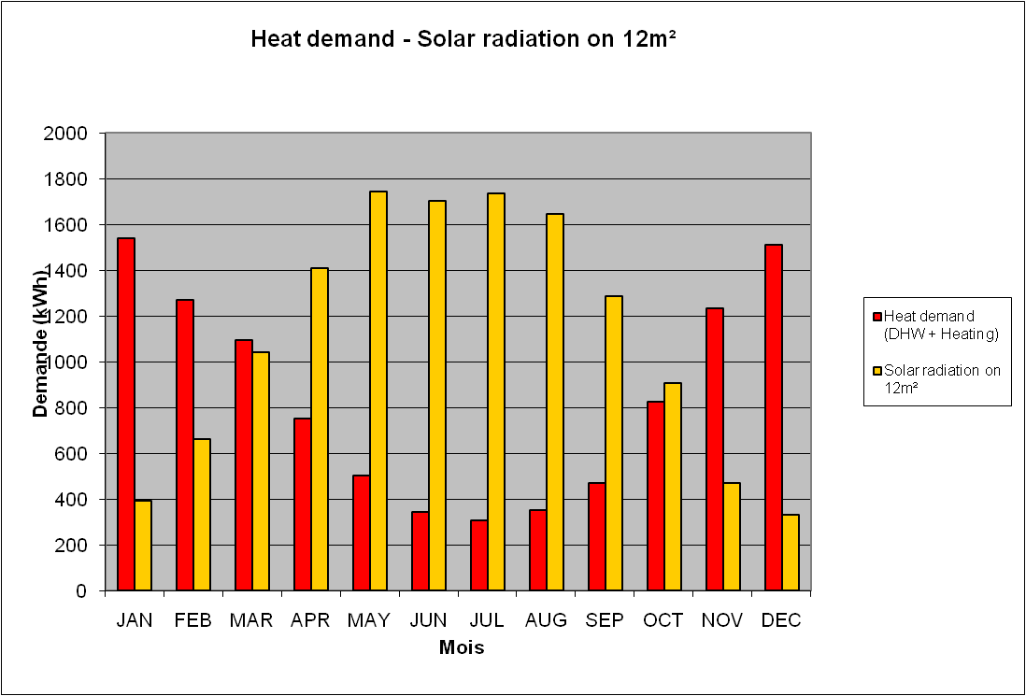
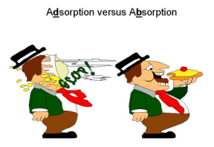
Introduction
TES = important challenge
Improve solar energy use in buildings:
→ supply = demand
Research objective
100 % solar fraction
Thermochemical storage:
→sorption phenomenon
http://www.lookfordiagnosis.com/

Slide 4
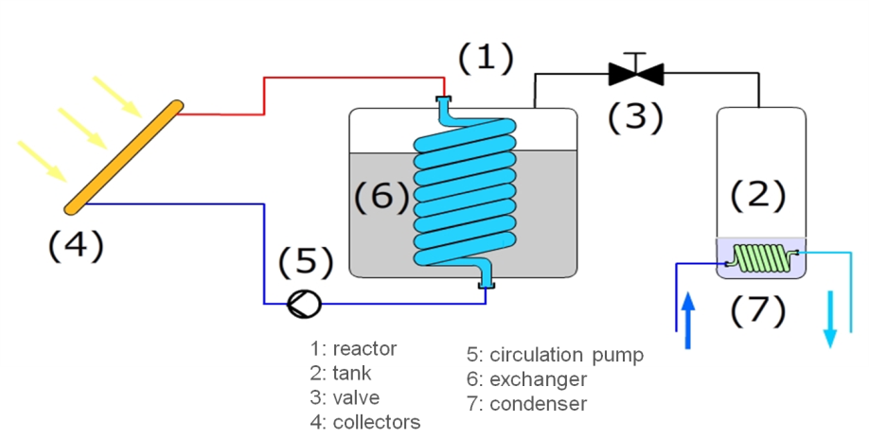
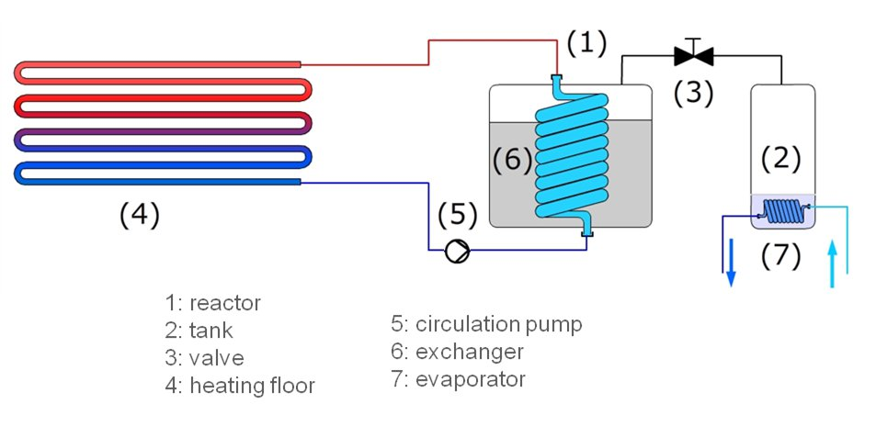

Seasonal heat storage with closed adsorption system
Adsorption reaction
$${{SrBr}_{2}.6H_{2}0}_{(s)}+ ∆H_{r} ⇌{{SrBr}_{2}.H_{2}0}_{(s)}+{5H_{2}0}_{(g)}$$
Desorption: endothermic → storage charging during summer
Adsorption: exothermic → storage discharging during winter

Slide 5
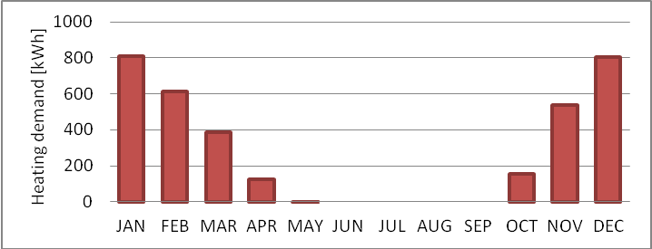
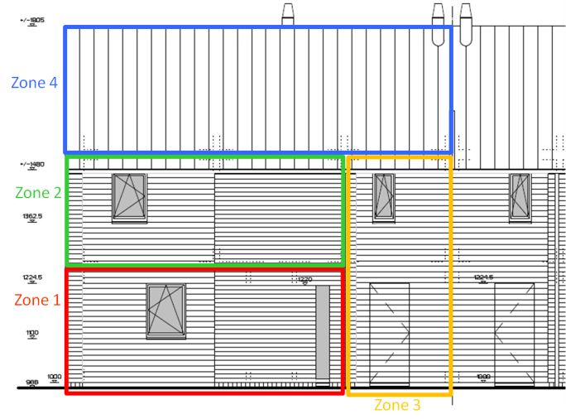
Description of the simulated system: Building energy demand
Existing wooden « low energy » building build recently
100 m² single family house
40 m² of the roof facing south: 40° slope
Space heating demand for Uccle (BE) : 3430 kWh/year

Slide 6
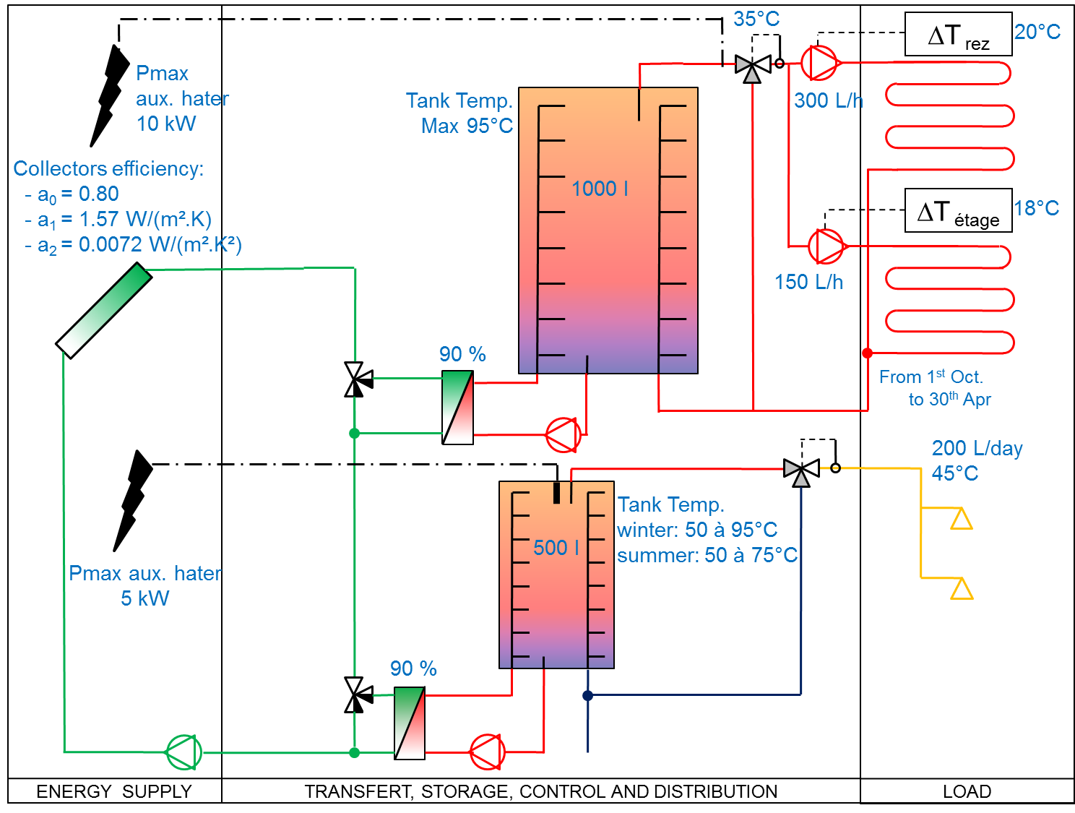
Description of the simulated system: Description of the combisystem

Slide 7
Description of the simulated system: Thermochemical storage model
Based on equilibrium curves
Adsorbent/adsorbate
Liquid/vapor of the adsorbate
Dynamic energy and mass balance of the reactor
Include some kinetics considerations
Evapo-condenser and low temperature source/sink: not simulated
Evaporation temperature: constant at 5°C
Condensation temperature: constant at 20°C
Reactor = 1 module containing all the salt
Only 1 cycle per year
TC reactor used as sensible storage if completely desorbed

Slide 8
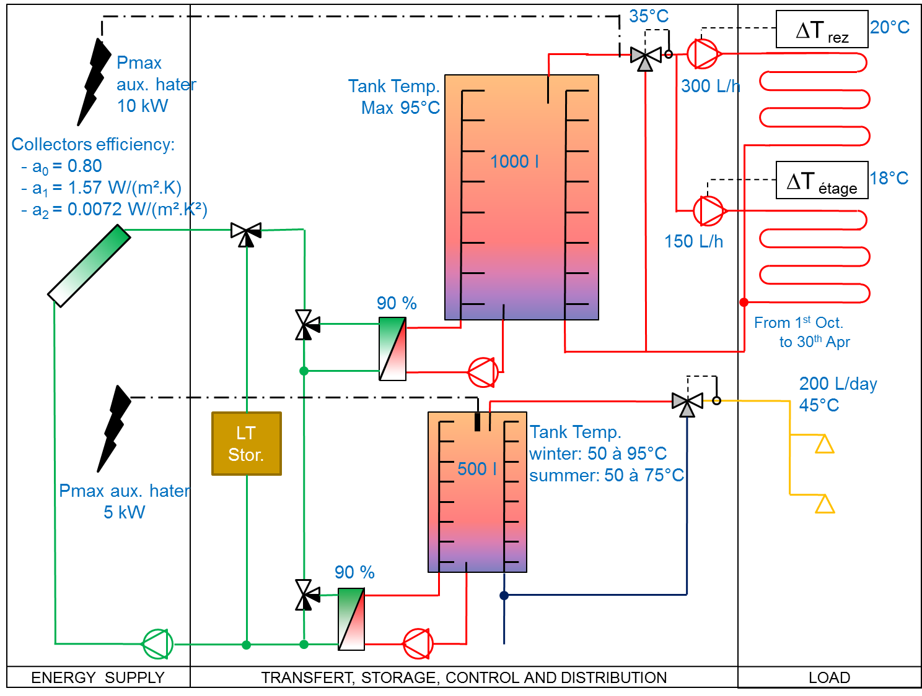
Description of the simulated system: Integration of the long-term storage

Slide 9
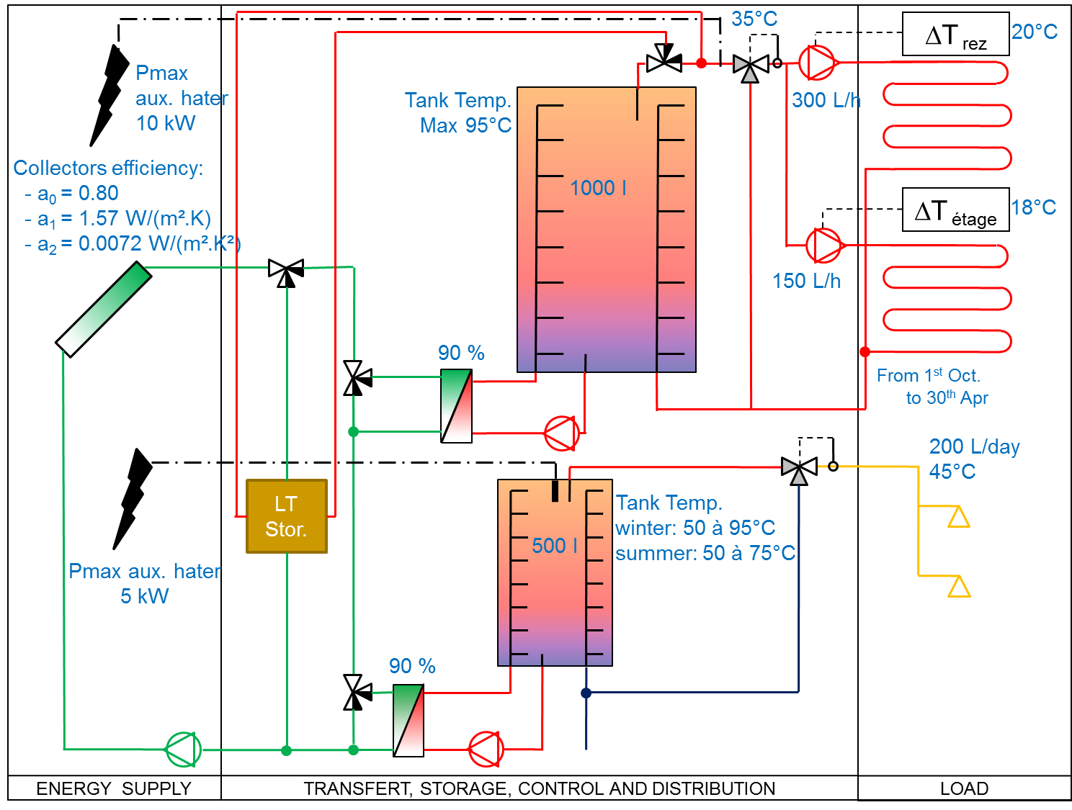
Description of the simulated system: Integration of the long-term storage

Slide 10
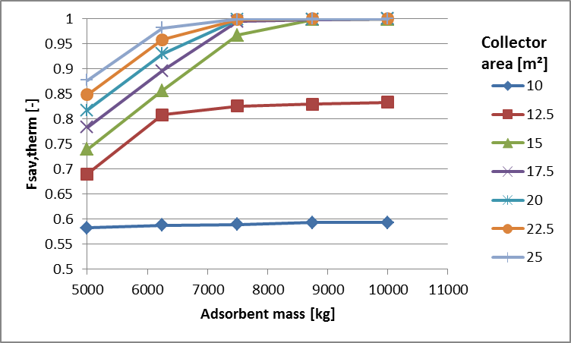
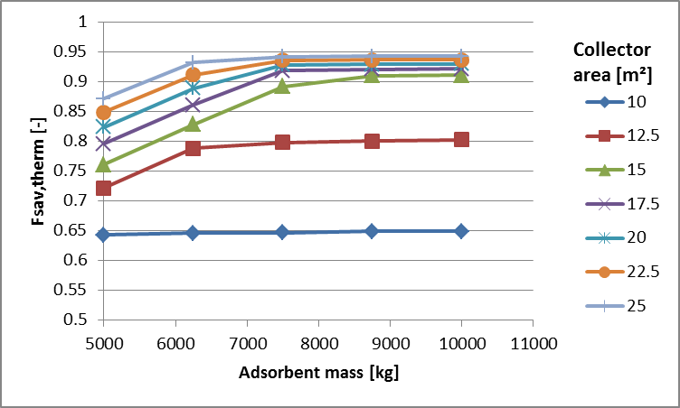
Performances of the system: reference
Excluding DHW consumption
F_{sav,therm} = 1
More than 15 m² collectors
Maximum quantity of salt necessary: 8750 kg
Including DHW consumption
F_{sav,therm} < 1
TC storage not used as auxiliary heater for DHW

Slide 11
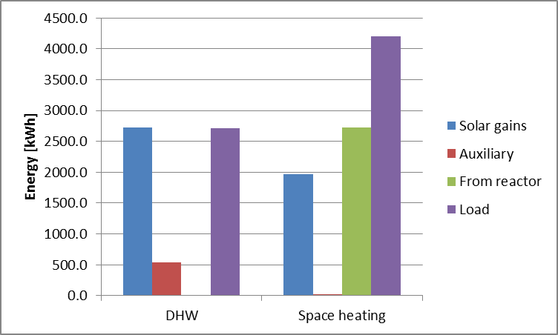
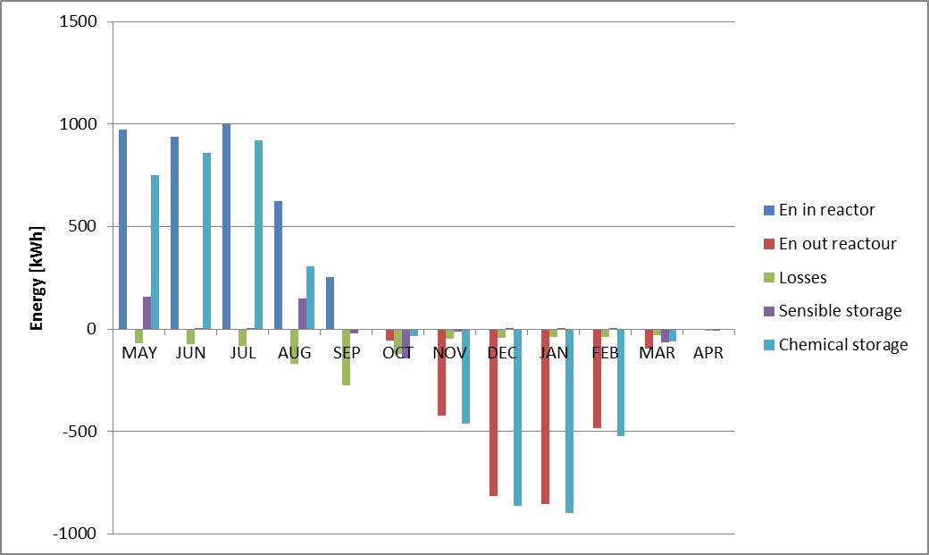
Performances of the system: 17.5 m² collector and 7500 kg SrBr₂
Useful energy sources and loads
Monthly reactor energy balance

Slide 12
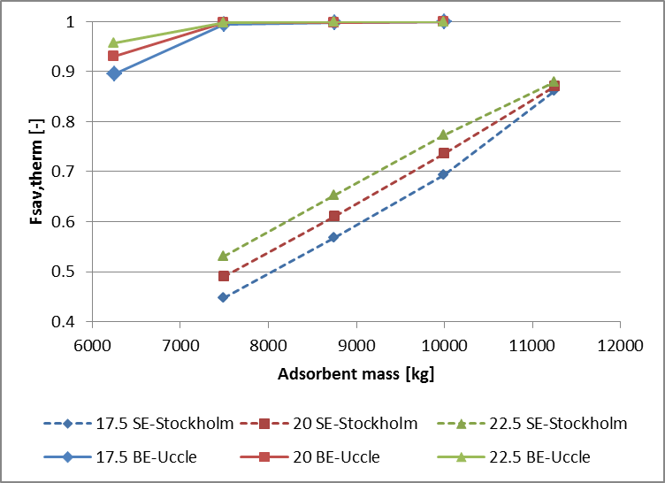
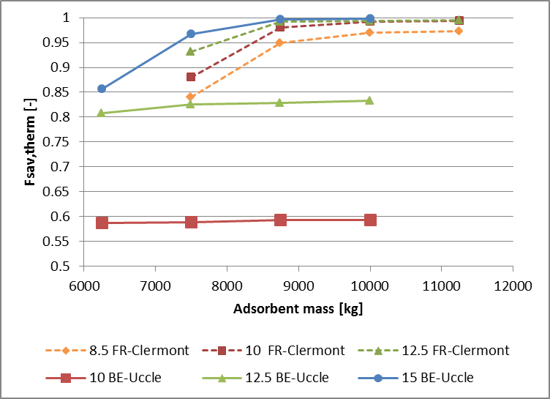
Modification of system components: Weather conditions
Location | Energy demand for space heating [kWh]
Uccle (BE) | 3430
Stockholm (SE) | 5825
Clermont-Ferrand (FR) | 2009

Slide 13
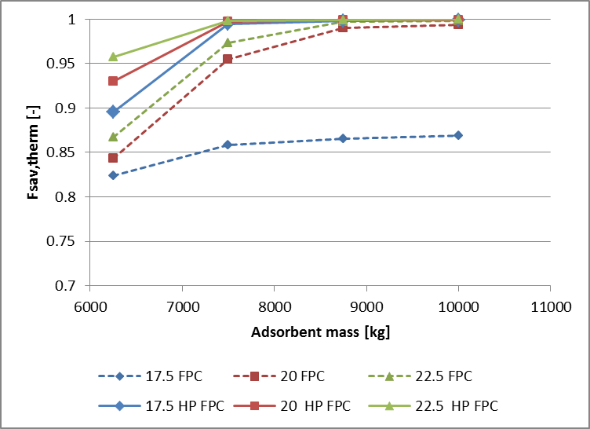
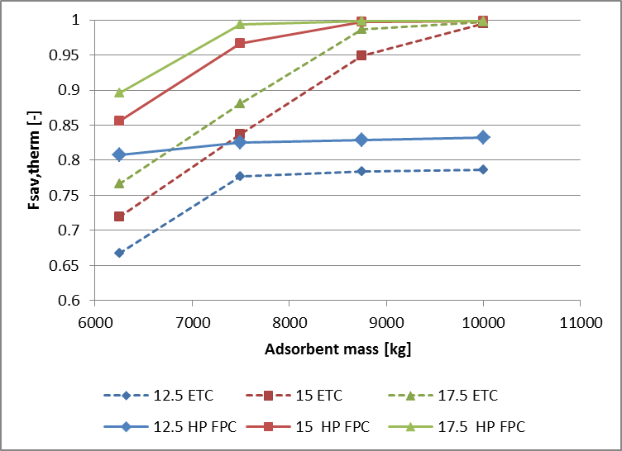
Modification of system components: Collectors
Collectors | a₀ [-] | a₁ [W/(m².K)] | a₂ [W/(m².K²)]
HP FPC | 0.8 | 1.57 | 0.0072
FPC | 0.81 | 3.6 | 0.0036
ETC | 0.601 | 0.767 | 0.004

Slide 14
Influence of storage reactor parameters
Parameters | Reference value | New value
Water evaporation temperature in the evaporator [°C] | 5 | 10
Thermal losses coefficient through the reactor walls [W/K] | 3 | 10
Specific heat transfer coefficient through the heat exchanger [W/(Km²)] | 500 | 12.5
Vapor diffusion coefficient through the salt [m²/s] | 1E-9 | 2E-10
Vapor pressure drop between the evaporator and the salt, expressed as a valve coefficient [m³/h] | 8 | 16

Slide 15
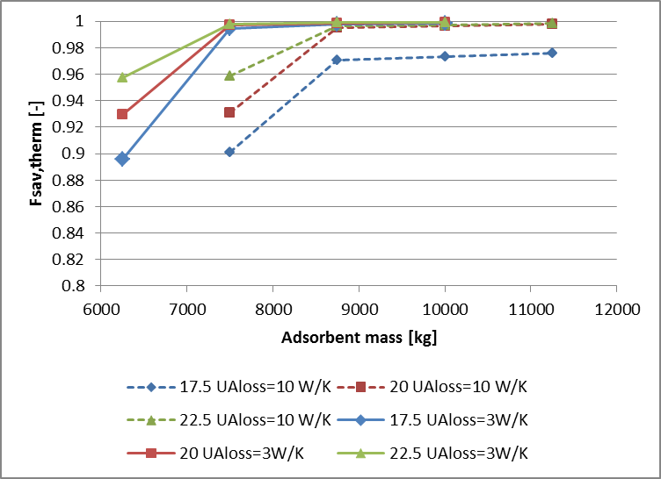
Influence of storage reactor parameters
Significant variations only for thermal losses
Necessary to insulate the reactor

Slide 16
Conclusion
100 % energy saving for space heating:
15 m² HP FPC
8750 of SrBr₂
Storage density
All components
Evaluation difficult at this stage
Current developments
Prototype construction
Economical and environmental evaluation

Slide 17

Thank you for your attention!
Research presented is conducted in the SOLAUTARK project with the following partner’s:
ESE
ArcelorMittal Liège R&D
Atelier d’architecture Ph. Jaspard
ULB
CTIB
M5
UMons
ULg
This project is funded by the Plan Marshall of the Walloon Region.

